Slide 1
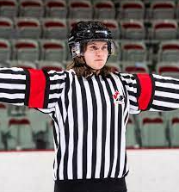
The On-Side In Chief
MCM #146
Bouzane & Tansey
8feb2023

Slide 2
A good in chief begins with…
Good prep!
What is good prep?
read the whole file not just the stuff for the witnesses that have been subpoenaed
Remember prep involves:
Prepping the file
Prepping the witnesses
Prepping the law
Ask yourself:
Why am I calling this witness?
What do I need from this witness to advance my case?
What areas is defence likely to cross on? (do I need to address these in chief)

Slide 3
Prepping the File
When reading the file, mine the disclosure for corroboration:
Injuries:
SAEK
Photos
medical records
Officer or civilian observations
Demeanour near the time of the incident:
911 calls
Officer or civilian observations
Whether other independent witnesses give corroborative/contextual accounts

Slide 4
Prepping the Witness
Flag any issues for yourself that can be addressed when you meet with the witness
Inconsistencies/clarifications
Within the same statement
Across statements from the same witness
What someone else purports the witness to have said (e.g., in SAEKs, physician’s notes in medical records, officer notes, other witness statements)
Things that need clarification/you don’t know the answer to but should ask

Slide 5
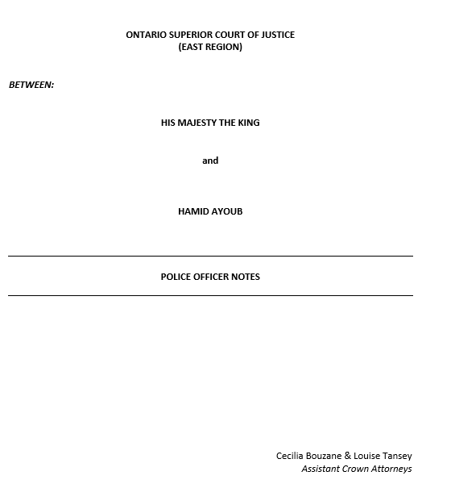
Prepping the Law
Bring a case
Write a memo
Why are you allowed to do the thing that you think you are allowed to do

Slide 6
Drafting the in chief
What is at issue/what is not admitted/what do you need to prove?
What evidence can the witness provide that addresses this? (including exhibits)
What do you need to ask the witness to elicit this?

Slide 7
Drafting the in chief – tips
Organize by themes, especially if there are multiple incidents
For example, in a historical DV case:
Intro on how the victim knows the accused
Family dynamic (kids, who lives where over what periods of time, etc.)
Incident #1: July 3, 2019 assault – family residence
Date, location, who was present
What happened + specific details of assault
Whether any injuries
Note exhibits to file
Incident #2… and so on

Slide 8
Drafting the in chief – tips
Can lead on noncontroversial topics (e.g. ID if it is an IPV)
Ensure questions won’t elicit inadmissible evidence
ODC
Hearsay
Etc.
Have submissions prepared for anticipated objections
Be prepared to refresh memory (statement chart)
Know what exhibits you will introduce and when
Have a copy for yourself, defence, judge, and witness

Slide 9
Plan for the worst
Overview of the in chief
Statement charts
Difficult or challenging areas (Seaboyer, other discreditable conduct, evidence that has been ruled inadmissible)

Slide 10
Statement Charts
Ensure you are considering all statements from the witness
Oral statements recorded in an IA/DB notes
R7s
TRN of interviews with police
TRN of 911 calls
TRN of prelim
Other
Doing so will also help you spot inconsistencies to address in prep and navigating the in-chief

Slide 11
Statement chart example
Question in chief | Response you are eliciting | Source to refresh memory
Where on your body did he hit you? | Right shoulder | R7 p. 2 Prelim TRN p. 36 Police stmt TRN pp. 23, 27
How did he hit you? | Hit with closed fist | Prelim TRN p. 14 Police stmt TRN pp. 21
How many times? | At least 3 times | Prelim TRN p. 15 Police stmt TRN pp. 24
Were you injured? Please describe. | Bruising to right shoulder | R7 p. 1 Prelim TRN pp. 15, 16 Police stmt TRN pp. 10, 11
Where in the house were you? | Kitchen | Prelim TRN pp. 12 Police stmt TRN pp. 17
INCIDENT #1: JULY 3, 2019 ASSAULT – FAMILY RESIDENCE

Slide 12
In Chief Overview – Sample Police Witness

Slide 13
In Chief Overview- Police Witness

Slide 14
In Chief Overview- Sample Civilian

Slide 15
Witness prep - reviewing the in chief
The following tips specifically address reviewing the in chief/witness’ evidence and therefore only form part of what should be covered in a witness prep meeting.

Slide 16
Witness prep - reviewing the in chief
IO must be there for note taking (in exceptional circumstances secure a substitute)
You will have prepped the prep; your in chief and/or statement chart will be drafted
Review areas of questioning with the witness, you may even want to run through the in chief with them
Show them any exhibits you plan to file through them to ensure they will actually be able to authenticate it
No witness should see an exhibit for the first time in court

Slide 17
Excellent Officer’s Notes from Prep

Slide 18
Witness prep - reviewing the in chief
Go over things you flagged for yourself when you reviewed the file:
If you don’t know the answer to a question you need to ask, ask it in prep
Get ahead of inconsistencies and get clarifications you need
If refreshing memory will ensure a more accurate clarification by witness, do that first
MAKE SURE OFFICER IS TAKING NOTES!!! – this part of the prep is very likely to produce new disclosure and you MUST avoid making yourself a witness
DO NOT assume that the officer knows what to do. It is our job to tell them what our expectations are around note-taking at prep

Slide 19
Caution
The first time you watch a witness’ statement (ie 715.1) should NOT be in court.
Do not rely on the transcript as the basis for deciding whether to pursue a s715.1 route to admissibility
There is so much non-verbal information and tone that is not captured in a statement.
In some cases you may also observe things like flat affect, giggling and other indicia of the neurobiology of trauma- you must prepare for these things
This Photo by Unknown Author is licensed under CC BY

Slide 20
Witness Prep Means Talking About the Evidence
If there is a video and you want them to watch it- watch it with them
Talk about it
At this point you looked upset, what was upsetting you?
Here you made a gesture with your hand and you were shaking your head, what was that about?
The good and the bad
Here you called the Mr Accused a vicious monster who steals from his grandma- I can totally understand why you might feel that way but in this trial we are going to focus only on the charge of impaired driving which means ...
Ask about inconsistencies
At p. 6 you said first he pushed you. Later though at p. 9 you said it started when he hit you. lets read through that together I want to make sure I have this right. Also this is the kind of thing defence might ask you questions about.
If its not clear to you it’s not clear to anyone
He was behind me and on top of me and then he put his hands on my neck and I could see in his eyes and how mad he was.

Slide 21
Witness prep - reviewing the in chief
Review more complex areas
e.g. evidence that is circumscribed by a ruling of inadmissibility (276/Seaboyer)
If applicable, flag areas that crown will NOT be leading
ODC
Hearsay
Etc.
Explain process of refreshing memory

Slide 22
Police Witnesses Require Prep Too
Do not assume that a police officer has experience testifying or even if they have experience, is a good witness

Slide 23
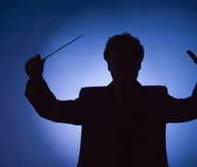
Conducting the in chief at trial
Trauma informed approach (IPV, SA, CA)
Testimonial aids
Support dog
Plan for entering and exiting the courtroom (IO and VWAP are your teammates work with them)
Leading
Lead!
Don’t pretend like admissions made don’t exist
Qualifying police notes
Refreshing memory
Past recollection recorded
This Photo by Unknown Author is licensed under CC BY-SA-NC

Slide 24
Police vs. Civilian
Generally speaking, procedure for refreshing memory can be different between the two:
Police IAs, duty book notes, and reports can be qualified at the outset of the in chief so they can refer to it throughout their testimony in order to refresh memory
Civilian’s various statements can be used to refresh their memory, but you must take procedural steps each time to do so
NOTE: Technically you can refresh any witness’ memory with anything, even inadmissible evidence:
This can have a tremendous impact on how you prep.

Slide 25
Refreshing Memory
Where it is a case of refreshing memory as opposed to past recollection recorded, the witness usually does not realize she has omitted to mention the matter of interest and therefore would have no reason to ask (for the statement to refresh)
COUNSEL is the ONLY one who realizes this and wants to jog the memory of the witness
R. v. SS, [1997] OJ No 361 (Gen Div) @6-7
The fact that a witness does not say they need their memory refreshed is “neither here nor there”. If the witness did not want their memory refreshed the matter would have moved to cross under 9(2) CEA
R. v. Slatter, 2018 ONCA 962 @53-54
R. v. Baier, 2016 BCCA 426

Slide 26
Conducting the in chief at trial - Trauma informed approach
Depending on type of case, witness may not provide perfectly chronological account
Crown must be able to adapt based on order in which witness recalls events
Important to organize in chief accordingly by theme
Can then jump back and forth more easily from event to event based on how witness recollects on the stand

Slide 27
Conducting the in chief at trial - Refreshing Memory
Statement Chart = invaluable tool to have at your disposal
Arises when:
You ask a question and the witness expresses they can’t recall
You know the answer to the question is in one of their statements
Locate answer in your chart and what the source is

Slide 28
Conducting the in chief at trial - Refreshing Memory
Steps:
Do you recall giving a statement to police on X date?
Would reviewing a transcript of your statement assist in refreshing your memory?
Ask the court permission to approach witness
Have witness confirm whether document you are showing them is their statement
Once they confirm, point them to specific area in statement that they will review, have them read it to themselves
Once done, ask if that helped to refresh their memory
If so, re-ask your question

Slide 29
Conducting the in chief at trial - Qualifying police notes
In your notebook, changes, alterations, deletions?
When were those notes made? (Hopefully contemporaneously when events fresh in memory)
Would using your notes assist in refreshing your memory?
Do you have independent recollection of the events?
Are those notes with you?
Does defence have any questions?

Slide 30
Notebook Law
Despite what some defence lawyers say there is no law that requires an officer to write down everything they saw in their notebook to comply with our disclosure obligation: Machado, 2010 OJ No 387 (SCJ) @121
The police have a duty to prepare accurate, detailed and comprehensive notes as soon as possible after an event has been investigated: Wood v Schaeffer, 2013 SCC 71 at para 67
Officer’s notes aren’t evidence- they’re a testimonial aid: Machado, 2010 OJ No 387 (SCJ) @122; Antoniak, 2007 OJ No 4816 (SCJ)
A judge is not required to disregard evidence because there was no note!: Lynch, 2010 OJ No 5394 (SCJ) @34-35

Slide 31
Independent Recollection
Professionals such as doctors, nurses, lawyers, judges, police officers, deal with hundreds of cases over the course of weeks, months or years. They cannot possibly recall all and so they make notes to trigger their memory of events. They may readily recall some cases -- the delivery by a doctor or a nurse of the first child; counsel's first murder case or initial appearance in the Supreme Court of Canada; the swearing in of a judge; the first investigation by a police officer into the affairs of a major criminal organisation. But in many, if not most cases, their memory will be refreshed only after consulting their notes. That does not mean to say that the person does not have an independent recollection of the event.
A forgetful witness may rely on any means to jar or spark a memory. What triggers recollection is not significant. In this way the witness' memory is presently revived in the witness box and he or she can then give oral testimony of the remembered event present memory revived. Although not the only way, the usual means to revive memory is by reference to a written document made at an earlier time by the witness: see The Law of Evidence in Canada, (2nd ed.) by Sopinka, Lederman and Bryant, p. 924, para. 16.77. The evidence is the refreshed memory of the witness and not the document.
Where a witness has no memory whatsoever of the event even after consulting a statement made by him, the witness can rely on the document. That is the situation with past recollection recorded. The Ontario Court of Appeal has distinguished between past recollection recorded and present memory revived in respect of prior statements. For the former, the document is the evidence and provided that the proper foundation is laid, it may be marked as an exhibit: Colangelo, 2007 ONCJ 489 @28-30
This Photo by Unknown Author is licensed under CC BY-SA

Slide 32
Conducting the in chief at trial - Past Recollection Recorded
You attempt to refresh a civilian’s memory or qualify an officer’s notes
Civilian says they still don’t remember; OR
Officer says they don’t have an independent recollection
What now?
See if you can have record of statement admitted under past recollection recorded. There are 4 pre-requisites:

Slide 33
Conducting the in chief at trial - Past Recollection Recorded
Reliable record:
The past recollection must have been recorded in a reliable way. This requirement can be broken down into two separate considerations:
First, it requires the witness to have prepared the record personally, or to have reviewed it for accuracy if someone else prepared it.
Second, the original record must be used if it is available.
R v Louangrath, 2016 ONCA 550 at para 43
R v Richardson, 2003 OJ No 3215 at para 24

Slide 34
Conducting the in chief at trial - Past Recollection Recorded
2) Timeliness:
The record must have been made or reviewed within a reasonable time, while the event was sufficiently fresh in the witness's mind to be vivid and likely accurate.
R v Louangrath, 2016 ONCA 550 at para 43
R v Richardson, 2003 OJ No 3215 at para 24

Slide 35
Conducting the in chief at trial - Past Recollection Recorded
3) Absence of memory:
At the time the witness testifies, he or she must have no memory of the recorded events.
R v Louangrath, 2016 ONCA 550 at para 43
R v Richardson, 2003 OJ No 3215 at para 24

Slide 36
Conducting the in chief at trial - Past Recollection Recorded
4) Present voucher as to accuracy:
The witness, although having no memory of the recorded events, must vouch for the accuracy of the assertions in the record; in other words, the witness must be able to say that he or she was being truthful at the time the assertions were recorded.
R v Louangrath, 2016 ONCA 550 at para 43
R v Richardson, 2003 OJ No 3215 at para 24

Slide 37
Prepping the Law

Slide 38
Helpful resources
Go watch other Crowns in court
Talk to more experienced Crowns about structuring your in chief/prep
E-library has draft in chiefs for impaired files:
Arresting officer
Breath tech
DREs
Crown Witness Interviews Primer elibrary
This Photo by Unknown Author is licensed under CC BY

Slide 39
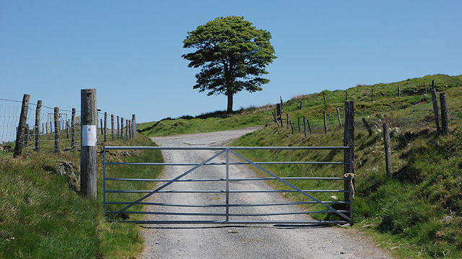
The End
This Photo by Unknown Author is licensed under CC BY-SA

