Slide 1
The PROSECUTION OF NORMAND SIGOUIN
MY
STORY

Slide 2
The PROSECUTION OF NORMAND SIGOUIN
The Background

Slide 3
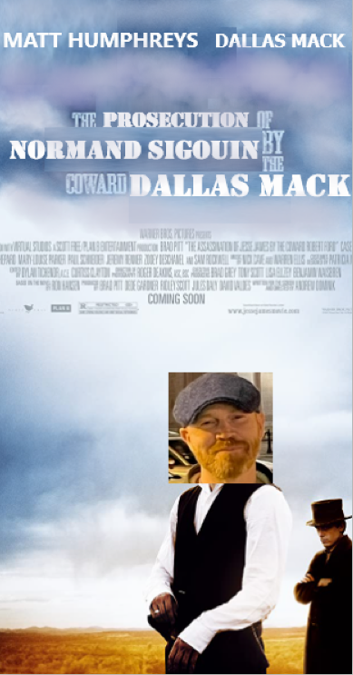
The
Trial

Slide 4
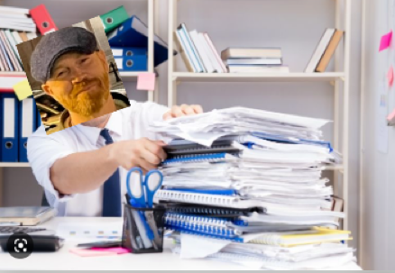
The SITUATION

Slide 5
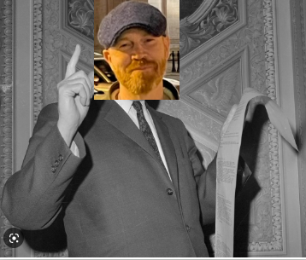
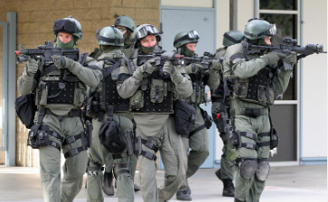
The SOLUTION

Slide 6
Don’t roll over Get CREATIVE USE THE TIME YOU HAVE
The LESSONS

