Slide 1
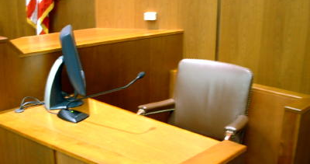
WITNESS PREPARATION IN SEXUAL VIOLENCE CASES
RupERT & TANSEY
MINOR CASE MANAGEMENT – NOVEMBER 2, 2023

Slide 2
The criminal trial process can be invasive, humiliating, and degrading for victims of sexual offences, in part because myths and stereotypes continue to haunt the criminal justice system. Historically, trials provided few if any protections for complainants. More often than not, they could expect to have the minutiae of their lives and character unjustifiably scrutinized in an attempt to intimidate and embarrass them, and call their credibility into question — all of which jeopardized the truth-seeking function of the trial. It also undermined the dignity, equality, and privacy of those who had the courage to lay a complaint and undergo the rigours of a public trial.
Notes:
@ R. v. J.J. 2022 SCC 28
First paragraph of a monumental decision from the SCC – describing the criminal trial process for victims of sexual offences.
Not only because of the presence of myths and stereotypes – it’s coming to court to speak about the most intimate and personal aspects of their lives. In a courtroom full of strangers.
We have to do our part in preparing our victims and witnesses properly for court. Remember your first day as a trial crown in court and how nervous you felt. And that is someone who has years of education behind you. Now imagine the most vulnerable of victims coming to this building, being asked about the most traumatic events of their lives. In a packed courtroom.
We don’t secure convictions in every sexual assault that we prosecute. But the process matters – how we treat victims matters almost as much to them as the court outcome itself. Some of the most heartfelt messages of thanks that I have received from victims are cases that I lost in court – that’s because they were treated well and that is something they can remember.
Presented recently with Dr. Lori Haskell on trauma informed prosecutions – her research has found most victims of sexual violence feel under-prepared for court.
I walked into court recently and heard a defence lawyer say that a crown prepation session should not go beyond explaining the set up of the courtroom and explaining what an oath is – that’s wrong.

Slide 3
TOP TIPS*
*TO ENHANCE YOUR victim / witness PREPARATION MEETINGS

Slide 4
1. BE FLEXIBLE
Substance of meeting(s)
Length / Timing of meeting(s)
Number of meetings
Format / Venue of meeting(s) (virtual, at the courthouse)
IO will be present at trial prep meeting
Notes:
Consider the needs of your victim
New process coming soon where trial prep will be scheduled further in advance.
Lots of pressure on the police and vwap regarding these meetings, rest assured – we have the support of the police and they understand the necessity of holding trial prep meetings.
Whether you do virtual or in person – up to you. I like in person where possible because I think it allows us to establish a better rapport with our victims.

Slide 5
2. BE PREPARED
Know your file
Gather intelligence (OIC, VWAP)
Confer with VWAP in advance of the meeting – ‘game plan’
Notes:
You have to prepare yourself fully for the witness prep meeting.
Know the entire file – inside and out. You will want to have a clear sense not just what the victim has told police but also about what others have said.
Check in with VWAP and the IO to see how the victim is doing before you meet her/him – but don’t make any assumptions. For example, if you have heard that she is not wanting to proceed – keep an entirely open mind. Things get lost in the grapevine of communication and people change their perspectives about things over time.

Slide 6
3. MANAGE EXPECTATIONS
Encouragement & support vs. false hope
Explaining W.D.
Notes:
One thing that I have always done consistently in the context of a trial prep meeting is to explain the standard of proof in a criminal trial. We don’t have to bog them down with the legal test in W.D., but we need to paint a picture of what we are required to prove.
Don’t leave a negative impression with them but be honest and candid.
What is entirely appropriate is to tell them that the police believed them when they laid the charge, and you believe them too.

Slide 7
4. MAXIMIZE CHOICE* *where possible
EXAMPLES OF THINGS WE CAN CONTROL:
Number / location / format of meetings
Statement review (when / where / how)
Warm-up questions
540(7) applications*
This Photo by Unknown Author is licensed under CC BY-SA-NC
Notes:
Many times, victims feel a loss of agency – they have been victimized. They are now exposed to a brand-new process and they feel overwhelmed by it. It’s confusing and it’s uncertain to say the least.
I try and encourage as much possible for the victims to have a degree of control in the format of the meeting (virtual or in person), and also on whether more than one trial prep is necessary. On that point, keep in mind that we are hearing from the police that they are strained in terms of resources but sometimes it’s necessary – even with an adult victim – particularly an adult victim who is very vulnerable.
Statement Review – the victims have to review their statements either as part of the trial prep meeting or in advance.
I learned from VWAP that most people are simply sending the transcripts of victims' interviews to the victim, ahead of the prep meeting and that the prep meetings are brief.
Gold standard – what I have found works best is having the victim view their statement while I am present (officer also). If you send the materials to the victim in advance, it is ofte the case that they don’t read them. It’s traumatic to revisit alone and they think they recall events.
Your choice how you get the statement review done – but make that choice carefully.
Also: if you are sending transcripts, make sure they reach the correct recipient, make sure they don’t share them, and make sure you have properly redacted them.

Slide 8
OVERARCHING GOALS

Slide 9
Build trust
Build rapport
Canvass concerns
Break down barriers
Be mindful of your language
How would the person like to be addressed?
How to refer to the accused?
Check your biases
This Photo by Unknown Author is licensed under CC BY
Notes:
#1 goal of the trial prep meeting is to establish a rapport with the victim or witness you are meeting with
Know something about them as a person and not just as a victim
Example from human trafficking case a few years ago – bonded in the cells downstairs
They will feel nervous and intimated by us, ease into the first meeting
Tell them you understand that this must be a brand new process for them and you are here to explain it to them and to answers all questions that they have for you
Language matters when discussing the allegations – not you had sex, forced intercourse
Explain how you will refer to the accused
Leave your assumptions as the door – employ trauma informed lense, no judgement – watch your body language. Crossed arms – people will form an impression about someone within the first few seconds of meeting them.

Slide 10
Demystify the process
Give the person a sense of what to expect
Make them feel [as] comfortable [as possible]
Seek out and answer their questions
Confirm that they have been offered (had) a courtroom tour, CCTV room tour
Notes:
Try and use plain language to give an explanation of the court process from start to finish
Be realistic about how much time they will be on the stand for ; in-chief and cross
Be realistic about when we might expect a decision in the case
Try and put them ease as much as possible
*Don’t ever meet a victim alone
*Don’t trade in information – this is a hard one. I have found over the years that it can almost be irrestible to want to share some information about our own lives when you have a victim telling you the most personal aspects of their own. I don’t think that’s a good idea at all to be overly personal. As much as we want to build a rapport, it still has to be professional. They might like football and you might also – that’s fine, it make sense to find points in common if they exist. One victim recently had bedsheets with the Eiffel tower – and we talked about how much we love Paris. Totally fine… But don’t be too personal and don’t meet victims alone. Over the course of your career you will meet victims in cases that will keep in contact with you – sometimes for decades. That’s a very positive aspect of our job. It means we had a positive impact on someone’s life. But remember to clearly keep a professional line drawn.

Slide 11
Take the pressure off
Job is to tell the truth about everything
No wrong answers (besides lies or guesses)
No need to memorize
Explain the process of refreshing memory
Let me worry about what’s important
Be yourself!

Slide 12
Consider the witness’s background & preferences
Indigenous witnesses
‘We can – and must – do better’ (R. v. Barton 2019 SCC 33)
Consider culturally appropriate aids & oaths
E.g. eagle feathers
Seek input about appropriate supports
LGBQT2S+ witnesses
Preferred pronouns – if you don’t know, ASK

Slide 13
POINTS TO COVER: INITIAL MEETING(S)

Slide 14
THE ROLE OF THE CROWN
I am not your lawyer….
…but I AM HERE FOR YOU!
Disclosure obligations
Communications with a witness about attendance at court, scheduling interviews, and explaining court procedure are not disclosable
R v. Jalili, [2018] ONSC 6408 at para. 53
R. v. Flis, 2006 CanLII 3263 (ONCA)at paras. 110-113
Notes:
Do you meet your victim well in advance of trial in a sexual violence case – maybe?
In a very serious case with a very vulnerable victim – likely a good idea to hold an introductory meeting (need a police witness to be present), introduce yourself and explain some preliminary matters to them about the court process.
Case by case basis assessment with a regard to the fact that our fellow justice stakeholders are strained in terms of resources.

Slide 15
PUBLICATION BANS
Explain the s.486.4 publication ban
Explain what the ban means for them in terms of their identity

Slide 16
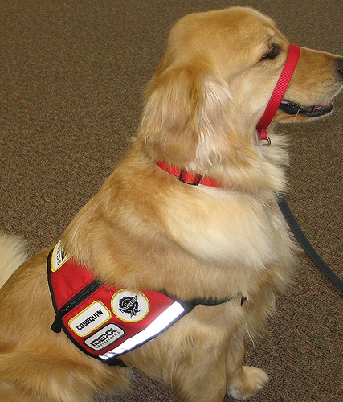
TESTIMONIAL AIDS
Support persons
Support animals
CCTV / screen
Notes:
Do not over promise and under deliver
Give yourself enough time to bring these applications
Do not forego bringing these applications because you think it will be better for the judge to see a more emotional response from the victim

Slide 17
276 APPLICATIONS
Explain that she will be getting her own lawyer if / when the time comes
Explain that absent a successful 276 application (and assuming you are not leading any 276 evidence), she should not discuss her sexual history or any other sexual activity (including evidence e.g. that she is a virgin)
Notes:
You have to explain the purpose of this provision to every victim – even if you are not bringing a Seaboyer and even if there is no 276 pending before the court.
Explain what it means
Explain that they should absolutely not discuss other sexual activity
If there is a ruling – you will explain the outcome of the ruling to them

Slide 18
278 APPLICATIONS
Explain she will be getting her own lawyer if / when the time comes
Consider explaining that absent a successful 278.3 application, she will not be answering any questions – and should not discuss – the contents of any private record (e.g. a diary, therapy records).

Slide 19
ELECTRONIC COMMUNICATIONS / 278.92 APPLICATIONS
Explain that the accused may have access to her text messages and social media postings
Explain the possibility that she will be cross-examined on the above
Pending a ruling on a 278.92, it is best NOT to show or discuss with her the specific content of any potential ‘record’ in the hands of the defence
When you know what records will be adduced, it’s a different consideration.
Notes:
Once you know what messages are going in – can put them to her. Entire point of provisions is to reduce psychological ambush.

Slide 20
POINTS TO COVER: CLOSER TO TRIAL

Slide 21
WHAT TO EXPECT
How to dress
Oath / affirmation
Seeing the accused (if in the courtroom)
Differences between examination-in-chief and cross-examination
Possibility of re-examination
Objections
Notes:
Refer to Cheat Sheet
VWAP does a very limited review

Slide 22
TIPS RE: TESTIFYING
Take your time
Ask for breaks (if necessary)
You control the pace
LISTEN
If you don’t understand, ask
If you don’t know, don’t guess
If you are sure, stand your ground
No wrong answers (besides guesses and lies)
Do not OVERTHINK!
Stick to the questions
Let the Crown worry about the narrative
Hearsay

Slide 23
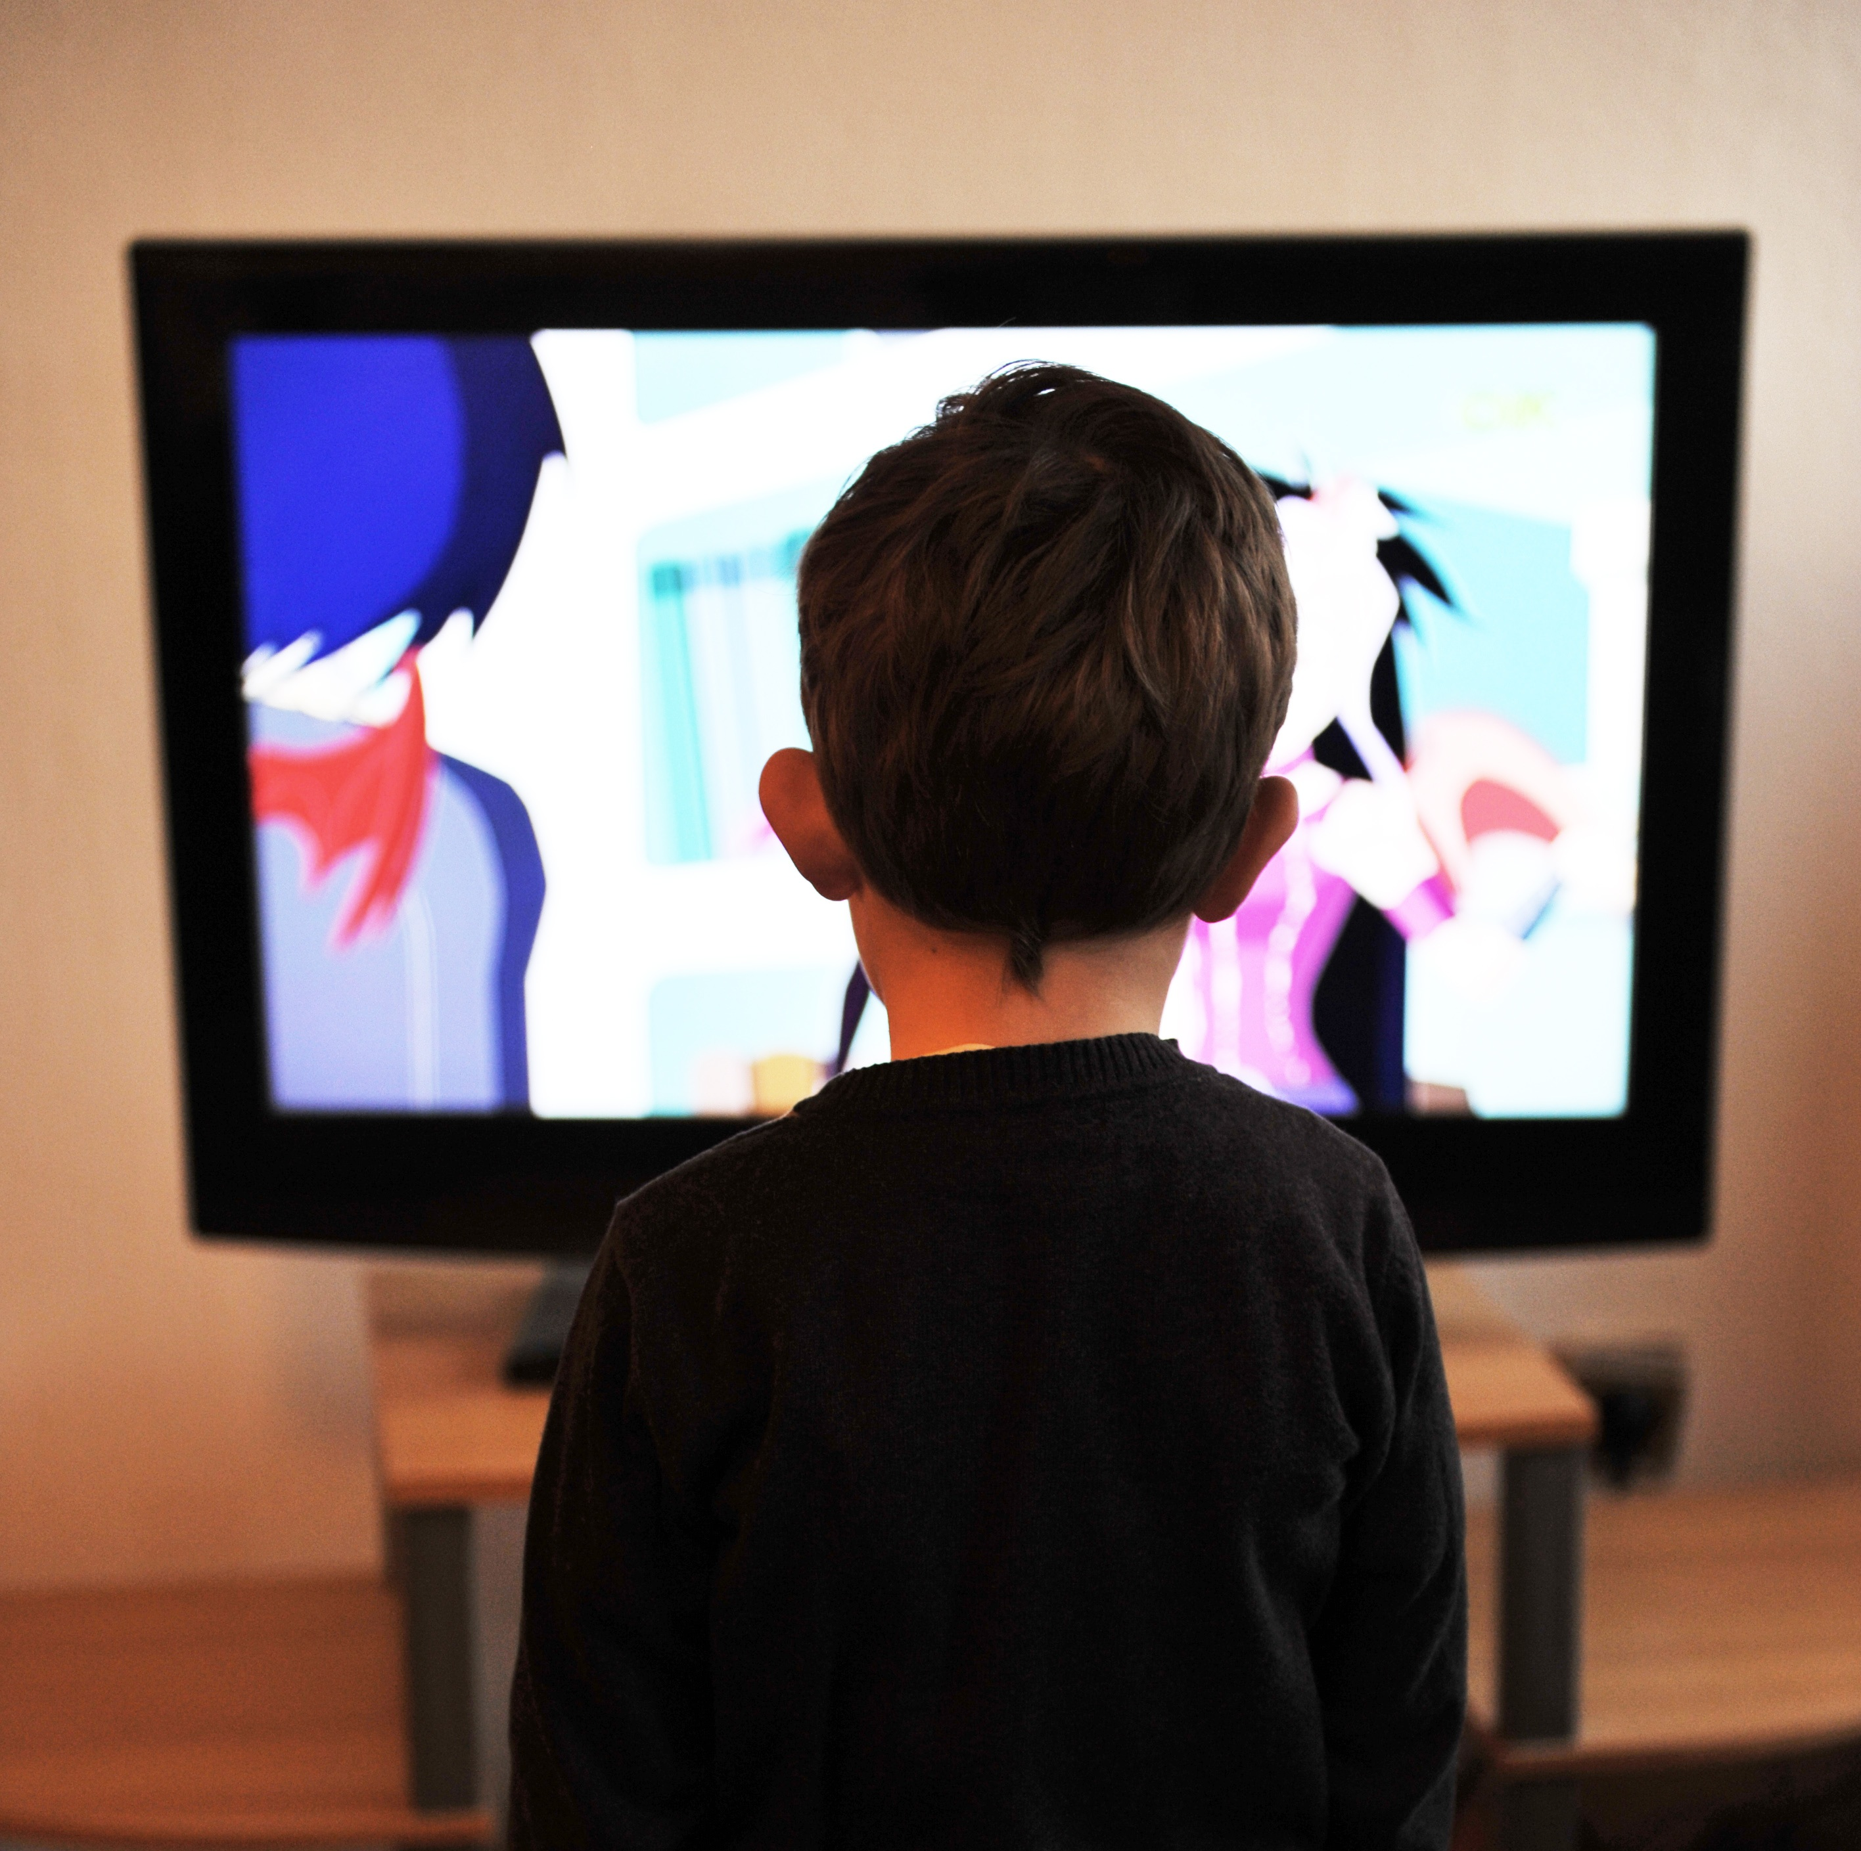
STATEMENT / EVIDENCE REVIEW
The evidence should be reviewed before trial
Does the witness want someone watching the statement with her?
Highlight important areas
Clarify any points of uncertainty – OIC must be present and taking notes
Ensure notes are disclosed in a timely way
Do not have the witness re-tell her account:
Re-traumatization
Inconsistencies / new disclosure
Risk of evidence appearing ‘scripted’ / ‘flat’ at trial
Notes:
You should review evidence
That’s the reason that we have a police officer there
If there is something that does not make sense to you or that you need to clarify – ask in the prep session. I don’t ask questions in court that I don’t know the answers to in advance.
I don’t have the victim rehearse my in-chief; I do cover the areas that I am going to ask about
It’s wrong not to include a discussion of the evidence – at least going over areas you are going to cover with them. Don’t need their answers.
Have the officer take notes – not verbatim notes of the court procedure process. Notes need to capture what is new in terms of what the witness says. I like to review the notes before the officer finalizes them to ensure they have recorded what is new and relevant.
If trial is next day – you should send the notes to defence yourself and scan a copy into scope for the file. It’s a short turn around, do not assume they will make it.

Slide 24
PREPARING YOUR WITNESS FOR CROSS-EXAMINATION

Slide 25
PREPARING FOR CROSS-EXAMINATION
It is entirely appropriate for the Crown to alert its witnesses to subjects likely to be raised in cross-examination
See e.g. R. v. Mahmood 2011 ONCA 693 at para. 67
Notes:
Don’t tell them that they are wrong if they give you an answer that contradicts the evidence
Intoxication live issue – tell them they will be asked about it.
Tell them to recount what they had.
Tell them to answer defence in the same way they answered you.
Ask for breaks.

Slide 26
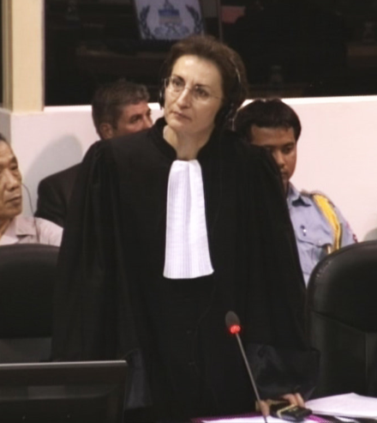
TIPS FOR YOUR WITNESS
Don’t take it personally
Expect leading questions
Not restricted to yes or no
Every statement is a question (‘I am going to suggest’….)
Browne v Dunn
There are no wrong answers (besides guesses and lies)
TAKE YOUR TIME!
You control the pace
Notes:
Prepare them for the “I am going to suggest to you question…” don’t leave it hanging it out there.
Not restricted to yes or no.

Slide 27
FINAL TIPS
Don’t meet a victim alone
Don’t email victims and witnesses directly – except a professional witness
Don’t forget to tell victims/witnesses not to discuss their evidence with anyone else involved in the case
Don’t give up in the face of a reluctant witness
Notes:
Reluctant witness
Nobody wants to be here except for us
Victim tells you she is reluctant to proceed
Find out why
Address concerns
Do not fold as soon as you hear this
Often based on misperceptions – address court and safety concerns
Things change

Slide 28
ADDITIONAL SVAG RESOURCES

Slide 29
ADDITIONAL RESOURCES
Sexual Offences Against Adults CAP (e-Library)
Victims with Disabilities paper (e-Library)

