Slide 1
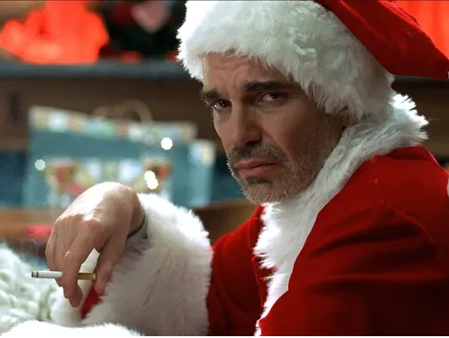
MCM XTRAVAGANZA 2022
PERSEVERANCE, NOT CAPITULATION

Slide 2
Keep moving forward
“Move forward and find out what happens next.”
Frank Shorter
1972 Olympic Marathon Gold Medalist
Things will happen
You cannot control all the things that happen
There is (almost) always a solution for the things that happen
Get comfortable with being uncomfortable

Slide 3
R. V. m.c & J.C.M
HT Prosecution
Trial Started – October 15, 2019 – set for 6 days
M.C. – O. Abergel
J.C.M. – R. Guertin
October 17, 2019 – J.C.M. severed off. He testifies (before complainant) against M.C. at trial (IO swore a new info against J.C.M. on the first day of trial)
Mid-trial – I/O advises that phone dump of accused’s cell phone is complete (obvs not disclosed at this point)
Early November 2019 – J.C.M. suffers a brain aneurysm. Charges w/d vs. J.C.M.. No RPC (based on complainant’s evidence at trial) and no public interest.

Slide 4
R. V. M.C. & J.C.M
COMPLAINANT – SEX TRADE WORKER, SCHIZOPHRENIC, ADDICTED TO CRACK COCAINE AND A SIGNIFICANT SPEECH IMPEDIMENT (she also had a conviction for public mischief). She was a challenging witness.
Trial Transcript, Evidence of complainant (2 pages in/ about 6 mins in chief)
Q. Okay. I also understand that you are a drug
addict?
A. Yes, that’s true, I am a crack head.
Q. Okay. And that’s, kind of, a – that’s a
street term that’s used but....
I am addicted to crack cocaine.

Slide 5
R. V. M.C. & J.C.M.
The complainant got a little bit “fighty” with Mr. Abergel during cross examination:
THE WITNESS: Fucking hurry up. You’re a joke.
You still didn’t get the haircut and the beard
shaved, eh? And you come to Court like that?
You’re disgusting, I’m disgusted by you, I’m
about to throw up.
This was one of the more “polite” exchanges.

Slide 6
R. V. M.C. & J.C.M.
December 20, 2019 – Submissions on the trial concluded. Dumel J. reserves
January 20, 2019 – Dumel J. advises trial decision not complete, March 24, 2020 set for HH to deliver decision
March 20, 2020 -

Slide 7
R. V. M.C. & J.C.M.
March 24, 2020 – Dumel J. renders decision in writing. M.C. found guilty on 8 of 11 counts. Adjourned to June 2, 2020 #7 for the purpose of setting a sentencing hearing
Crown makes efforts to schedule a virtual sentencing hearing. Offender insists he wants to be present in court for his sentencing hearing.
April 2020 – Investigating officer charged and arrested in tow-truck kick back scheme
September 20th, 2020 set for full day sentencing hearing. Ultimately this date had to be adjourned because, among other reasons;
1. The video VIS couldn’t be opened and wasn’t disclosed prior to the sentencing hearing.
2. The offender wanted to ask for enhanced “Covid19” credit and this would increase the time required for the hearing

Slide 8
R. V. M.C. & J.C.M.
Late September 2020 – Complainant dies of a drug overdose
December 10, 2020 – Matter set for sentencing submissions on this date. In the week leading up to the sentencing hearing, Mr. Abergel filed an application to re-open the case based on the contents of the video victim impact statement. (the complainant disclosed that she had been using crack cocaine during the period of her trial testimony)
March 8, 9 & 12, 2021 – Defence application to re-open argued
March 30, 2021 – Defence application dismissed(Thank you Louise, Anya & Meaghan!)
May 7, 2021 – Sentencing submissions scheduled for 2pm. Mr. Abergel advises at 1:30pm that he intends on calling M.C. as a witness on the hearing. Submissions & evidence (shockingly)not completed on this date

Slide 9
R. V. M.C. & J.C.M.
May 18, 2021 – Sentencing submissions (including cross of accused) complete
June 9, 2021 – Accused sentenced to 8 years jail less PSC, DNA, s.109 (life), SOIRA (life)
From the Reasons for Judgment:
[77] T.H .'s evidence raises credibility and reliability issues. They include her
conviction for a public mischief charge and the way she testified particularly in
cross-examination with her sarcasm and saying that she lied. There are also
peripheral external inconsistencies such as her denial of hurling racial slurs at Cst.
Graham and her description of her relationship with her mother. She also
repeatedly acknowledges memory issues. The concerns regarding the credibility
and reliability of her evidence do not require me to reject her evidence. They do
require me to exercise caution when considering T.H.'s evidence. I can accept
some, none, or all of it.

