Slide 1
MCM #127
Presented by: Rupert, Bramwell, Humphreys & Moors
10 FEB 2022

Slide 2
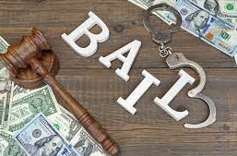
Bail:
A Case Study of What Can Happen When We Don’t Run It
Presented by: Fara Rupert

Slide 3
Events of July 2020
Mr. P and the victim had been dating off and on for 10 years.
There was one report of Mr. P assaulting the victim from Alberta.
Mr. P had no criminal record.
The v has four children from previous relationships.
On this date, Mr. P attended the v’s hotel room. He was upset because the v had been texting another man.
Mr. P forced his way inside the hotel room, grabbed her by the hair, punched her and said “I’m going to kill you tonight.”
He dragged the v to the bathroom, choked her, said she was going to die. He filled the tub and tried to drown her.
He got some knives and poked her with them.
He later sexually assaulted her and confined her to the room.
The kids were present for much of this.

Slide 4
Show Cause Position Endorsed in Scope
A senior crown with extensive experience prosecuting IPV cases reviewed the entire file and noted:
“The accused is a high risk to reoffend. The victim advises VWAP that the relationship is over, but the accused won’t let go. I cannot consent to release. This is a prolonged attack on the victim which appears to be fueled by jealousy. The proposed surety is the mother of the accused with whom he already seems to reside.”
Crown Onus/ RUN
Notes:
Bail Vettor also – connected with IO and considered risk assessment (was high).

Slide 5
Proceedings In Bail Court
The ACA commenced the hearing.
After hearing the evidence (not clear what evidence), a decision was made to abandon the hearing and consent to the release of the accused to his mother.
Are there any issues with this decision?
Notes:
Issues:
There are lots:
The Crown speaks with one voice – there was already a position on file which was to run the hearing. That means running the entire hearing, not half.
Options – do not depart from the original endorsement in the file. Bail is no exception. Run the entire hearing.
The decision was also contrary to crown policy “The prosecutor must be conscious of the potential increased risk of harm in these cases and must seek a detention order where they consider it necessary for the safety and security of the victim or the public.”

Slide 6
Events of September 2020
The v had been moved to a safe house, after the accused was released.
He learned where she was living.
Mr. P waited outside of her room, he pushed his way in and said she was going to die.
He stabbed her. She ran out of the room, and he followed her.
She made it outside, the accused slit her throat in the parking lot.
He hit her carotid artery.
Police arrived quickly, arrested him, and he had a bloody pair of scissors on him.

Slide 7
Bottom Line
Be Careful
Run It
The Crown speaks with “one voice”.
If you are conducting bail hearings, you must read “Judicial Interim Release (Bail) – Confidential Advice to Prosecutors” and “Intimate Partner Violence Directive and Confidential Advice to Prosecutors.”

Slide 8
You don't gotta go to work (*since March 2020) Work, work, work, work, work, work But you gotta put in work Work, work, work, work, work, work -Fifth Harmony
Presented by: Lia Bramwell

Slide 9
Application to Terminate SOIRA Order
Offender convicted of sexual assault by Shephard J in 2006
Sentenced to 6 month conditional sentence
Granted a pardon in 2014
No other criminal record
In 2021 offender files application to terminate SOIRA
Notes:
Briefly discuss what a SOIRA order is – and where people can get more information
This was a 20 year order. So set to expire in 2026.
I knew the basics about SOIRA orders. I knew nothing about termination of them. I knew nothing about the effect of a pardon but frankly, I thought there was a good chance it would lead to an early termination.

Slide 10
Application to Terminate SOIRA Order
In support of application files affidavit asserting:
The sex assault was minor (unwanted kissing of adult babysitter of his children)
He was actually trying to remove a crumb of food off her lip.
Huge impact on marriage, employment, international travel.
All as a result of ongoing SOIRA obligations

Slide 11
Does anything about this set off your Crown spidey sense?

Slide 12
Going to Work
Order transcript of 2006 proceedings
Assess accused affidavit in light of transcript
What is the test to terminate SOIRA?
Preparing to cross the accused in light of that test
What’s the legal impact of a pardon on SOIRA?
What evidence might the Crown call?
Notes:
Defence was also suggesting that the order was potentially invalid since if Crown had proceeded summarily, and because the Information literally provided no guidance. Both boxes checked, multiple dates, other heiroglyphics etc. So that was another reason to order the transcript.
Transcript comes – two things become clear immediately – 1. Crown proceeded by indictment so the invalid order argument is dispensed with. 2. Offender told the same story as he’d set out in his affidavit, 15 years before at the Gardiner hearing (briefly explain what that is) and it was rejected outright by the judge.
Judge referred to bruising on her mouth. Couldn’t get photos due to pardon (this is an example of being practical in not opening that can of worms)
So offender has now, at a minimum, mislead the Court in his affidavit about what happened and what is involved in complying with SOIRA orders.
Test: s. 490.016(1)
Grossly disproportionate – that is a high standard for the offender to meet – onus is on applicant
Know your law: the test, the onus, what other cases have found – not inconvenience, not stigma associated with conviction
Affidavit from officer at SOIRA Unit – Darren Vinet is in charge of the unit and he set me up with an officer on his team withing 24 hours – I sent emailed questions and turned the answers into an affidavit
A pardon means nothing other than you get to seek a termination
Considering the public interest, considering the relatively simple process to report – especially during COVID – I was starting to feel better about this and that it mattered
Then….

Slide 13
Does the audience matter?
Notes:
Some thoughts on how to manage our own feelings of dismay when it feels like a waste of time:
We don’t have to go along with it and we don’t have to make it easy
They may be asking us to sort out the thorny issues for them so they can ultimately find for us – surprise!
We have a job to do
Who is your audience – only that judge? No. Court of Appeal, management, 720 Bay committee, victims, accused
And it isn’t over until it’s over….your immediate audience may change

Slide 14
Perseverance
I find that the Applicant has failed to persuade this Court that the test, which is a high one, it contains a very high threshold of proof, has been met. In other words, he has failed to persuade me that the test has been met. First of all, none of the points or complaints that were raised come close to making the continuation of the order grossly disproportionate to the public interest described at section 490.016.
The Applicant has been able to travel, both within Canada and overseas, on many occasions since his conviction and during the period of reporting obviously. He described the fact of having to give detailed travel information to the police as an inconvenience. An inconvenience, of course, doesn’t come anywhere close to something grossly disproportionate to the public interest in this context.
He has been able to become a Canadian citizen whilst on the registry. He has worked for three different federal government departments or agencies, although he is unemployed currently because of the COVID pandemic. He’s also working on a Master’s degree, all of this during the timeframe of the continuing SOIRA order. His other complaints or concerns regarding the effect of the order on him I find cannot be distinguished from the effects of the offence itself.
Notes:
What I thought was a dead loser became a success.
Did I know what I was doing at the beginning? No.
Did I feel fired up about diving into the nitty gritty on SOIRA Orders and their termination? No.
Did I ask myself “oh who really cares? The guy’s got a pardon. Can’t we just let him have his termination?” Yes
Did I have other things to do? Yes.
Am I glad I dug in and figured it out? Yes.
Once I knew that he was still trying to manipulate the system by controlling the narrative, 15 years later, I realized this guy just doesn’t get it and so who knows if he’s been rehabilitated. Who knows if he’d do it again? Who knows if it’s a one off. It really came through in cross that he just didn’t think the same rules should apply to him that apply to everyone else.
It was a good day. Things went the Crown’s way because, in this case, they should have. But the judge wouldn’t have known what to do without the cases and without the evidence from OPS and the cross.
It feels good to do something well and to get good results because you’ve dug in and figured it out.

Slide 15
battle Lines
Presented by Matt Humphreys

Slide 16
“There is no great sport in having bullets flying about one in every direction but I find they have less horror when among them than when in anticipation.”
Ulysses S. Grant

Slide 17
Scenario
You are a week out from trial and defence counsel emails you about trying to resolve an aggravated assault and breaching his probation file
The accused is alleged to have punched the complainant, his wife, in the side of the head and detached her retina while bound by a condition not to be within 250 meters of her
The matter has previously been CPT’d and JPT’d to no avail
Defence counsel explains to you how the complainant doesn’t want to proceed and that the children want their father to come home
You are told that their client is interested in pleading – you are intrigued

Slide 18
And Now, The Back & forth BEGINS

Slide 19
SCENARIO
Counsel tells you that the accused is prepared to admit that he tripped over their dog and his hand glanced off the side of her head but he didn’t hit her intentionally and not only that, he thought his probation order has been varied to allow him contact
After some reflection, you observe that if this is true, the accused is likely not guilty of anything
15-20 emails and multiple phone calls later you are only slightly further ahead, counsel proposes that the accused pleads guilty to a mischief involving the dog and a breach of KPGB condition
It is at this point you realize that you have spent more time trying to resolve this file than it would have taken to prep it
Notes:
History has a habit of repeating itself – if you couldn’t get it resolved at the CPT or the JPT, and the Crown was making their best offers then, probably not going to meet in the middle now unless the accused can no longer afford to pay the lawyer for trial
They have to admit the essential elements of the offence
Resolution is supposed to save resources not drain them further
At times a defence strategy in more major cases
“This position is primarily based on an early guilty plea. Our Court of Appeal in R v Mann, [2010] OJ No 1924 at ¶21 stated, “A guilty plea, especially an early one, is entitled to a substantial credit in the sentencing process.” In R v Faulds, [1994] OJ No 2145 the Ontario Court of Appeal at ¶14 held that a guilty plea is important for several reasons, one of which is saving “valuable judicial resources.” All of this to say, the more time that passes, the more judicial resources that are expended, the more likely our position is to increase in recognition of the decreasing mitigation afforded to the guilty plea. I want to make this clear for Mr. RADFORD from the outset and the basis for the Crown’s reasoning moving forward.”

Slide 20
The Good News
You wisely did NOT cancel any witnesses when counsel told you that their client was interested in resolving and therefore maintain the upper hand
You reached out to IO to speak to the complainant, turns out that although reluctant, she will attend and testify despite the pressure the extraordinary pressure the accused is putting on her
Turns out the kids hate their father
You have insisted that any resolution would have to be based on a written agreed statement of facts

Slide 21
What if counsel pitches an 810?
Notes:
- There is a reason why they need to be approved

Slide 22
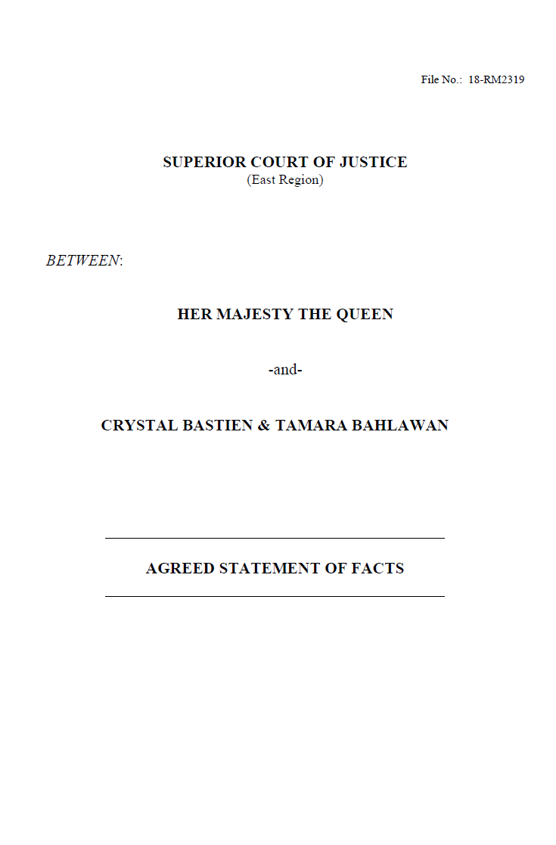
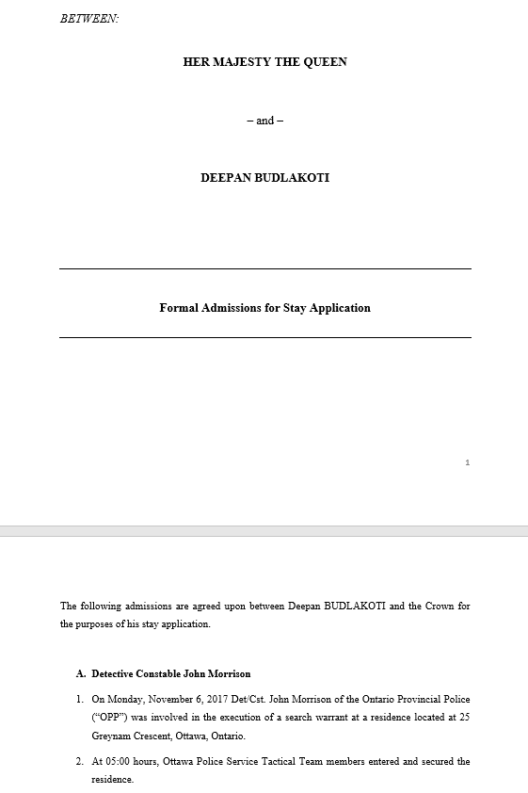
Get It In writing
Insist on a written agreed statement of facts when appropriate – work up front will save you headaches later
Section 655 of the Criminal Code for admissions – work up front will save you headaches later
Notes:
- Also in relation to trying to craft admissions, you can just call the witness

Slide 23
You Don’t Have to DO the deal!
You have the trial time booked
Your witnesses have been subpoenaed
You are prepared
You tried to previously resolve it at a CPT & JPT
This is what you do as a trial Crown
This is what the trial judge gets paid to do
The accused is the one who chose to set the trial date
What will be your reward for resolving this case?

Slide 24
How Low is Too Low?
Presented by: Mark Moors

Slide 25
Tomorrow Morning in your Trial Court…
At the last minute you are handed a 09:30 Sentencing
You know nothing about the file
Our position is extremely ”light” & well outside your comfort level
Defence counsel makes their submissions
They inform the Judge about the joint position
The judge is very unhappy & clearly believes it is inappropriate
She lets you know this before you begin your submissions
What do you do?

Slide 26
Scenario #1 – Where is the Bus?
You inform the judge that you are just the messenger and had nothing to do with the position
You let the judge know the identity of the Crown who took the position
You make minimal cursory submissions that in effect reinforce the judge’s opinion that the position is inappropriate:
“Your Honour, all I can tell you is that it is a joint position”

Slide 27
Scenario #2 – Crown Hunting
Stand the matter down
Go find the Crown & say WTF?
Demand they come and do the sentencing

Slide 28
Scenario #3 – Run It!
Crown Speaks with One Voice
Dynamic of working as an Asst Crown Attorney:
Working alone, but working together
Sometimes there are multiple hands on each file
Having each other’s back
How we are seen by others:
Defence
Judges
The Public

Slide 29
Good Practices
Resolving files
Joint Positions
Crown Endorsement
When you should request it be stood down:
Procedural issue – i.e. Missing VIS
The once every couple years file…

Slide 30
Good Practices
Taking “outlier” positions
Don’t send the Sentencing Crown into Court unarmed
Good notes make for good submissions
Sentencing Crown: Articulate and Advocate

