Slide 1
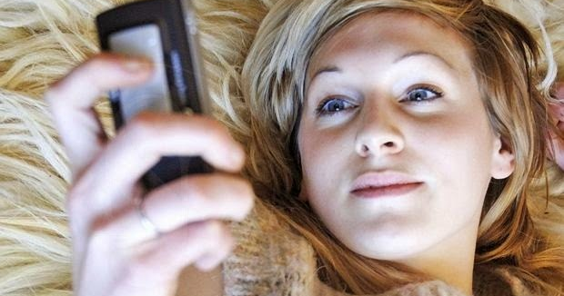
Section 276 & 278.92 issues: Adducing evidence of other sexual activity and private records
This Photo by Unknown Author is licensed under CC BY-SA-NC
MCM
NOVEMBER 9, 2022
Notes:
HELLO EVERYONE
THANK YOU FOR JOINING ME TODAY FOR ANOTHER MCM SESSION. IN MY LAST PRESENTATION, I FOCUSED ON S.276 (OTHER SEXUAL HISTORY). I REALIZED THAT THERE WERE A FEW MORE TIPS THAT I DID NOT GET TO LAST TIME ON THAT ISSUE, SO I HAVE INCLUDED SOME FURTHER DETAILS IN THIS PRESENTATION. ALTHOUGH THE BULK OF MY PRESENTATION WILL FOCUS ON 278.92 and THE RELATED REGIME, DEALING WITH RECORDS.
THE PURPOSE OF THIS SESSION IS TO GIVE YOU SOME PRACTICAL TIPS FOR MANAGING THESE APPLICATIONS WHEN THEY ARISE IN YOUR PROSEUCTIONS AND SOME PRO-ACTIVE TIPS ON HOW TO AVOID DELAY

Slide 2
Overview
30-minute presentation
30 minutes of discussion on 3 scenarios
Notes:
HOPEFULLY THIS WILL BE MORE INFORMAL
I WILL TALK TO YOU FOR ABOUT 30 MINUTES AND THEN THERE WILL BE 30 MINUTES OF DISCUSSION ON 3 SCENARIOS
IF YOU HAVE QUESTIONS, PLEASE FEEL FREE TO ASK THEM AS I AM PRESENTING OR AT THE END – WHICHEVER YOU PREFER

Slide 3
Section 276 - OSA
‘Other’ sexual activity
**NEWER** includes sexualized communications (s.276(4))
**NEWER** complainant has standing at hearing [stage 2] (s.278.94(2))
This Photo by Unknown Author is licensed under CC BY-NC
Notes:
SECTION 276 OF THE CODE ITSELF IS NOT NEW – IT IS ALREADY FAMILIAR TO ALL OF YOU. IT DEALS WITH “OTHER” SEXUAL ACTIVITY.
KEEP IN MIND WHEN WE SPEAK OF OTHER SEXUAL ACTIVITY IN SECTION 276, THE REACH OF THIS SECTION IS BROAD. IT APPLIES TO CONSENSUAL AND NON-CONSENSUAL ACTIVITY BY A COMPLAINANT, INCLUDING CONDUCT OCCURING BEFORE, PROXIMATE TO, AND AFTER THE SEXUAL ASSAULT (SEE: R. v. L.S., 2017 ONCA 685).
AS A RESULT OF BILL C-51 in 2018, THERE WERE AMENDMENTS TO SOME OF THE SEXUAL VIOLENCE PROVISIONS IN THE CODE INCULDING THE ONE’s HIGHLIGHTED ON THIS SLIDE:
276(4) – REALLY A CODIFICATION OF EXISTING PRINCIPLES AND A RECOGNITION OF HOW PEOPLE COMMUNICATE NOW: SEXUAL ACTIVITY NOW INCLUDES ANY COMMUNICATION MADE FOR A SEXUAL PURPOSE OR WHOSE CONTENT IS OF A SEXUAL NATURE.
AN EXAMPLE WOULD BE “SEXTING”
AND ALSO: THE COMPLAINANT NOW HAS STANDING AT STAGE 2 - THE HEARING, WHEREAS BEFORE IT WAS JUST THE CROWN AND DEFENCE COUNSEL WHO WOULD MAKE SUBMISSIONS.

Slide 4
Section 278.92 – Accused in Possession of Records relating to the Complainant
This all starts with: Is it a ‘record’?
278.1 lists enumerated records (non exhaustive list);
Personal Info and Reasonable expectation of privacy is the test.
Big question: text messages between the parties…
Case law chart
Video, audio, photos of the “sexual activity in question” is a “record”: R v. F.I., 2019 ONSC 6120 @4-5
Notes:
ALSO NEW AS A RESULT OF BILL C-51: SECTION 278.92 DEALS WITH APPLICATIONS FOR WHEN AN ACCUSED IS IN POSSESSION OF A PRIVATE RECORD RELATING TO THE COMPLAINANT.
IT’S A SCREENING MECHANISM THAT IS MEANT TO ADDRESS A GAP IN THE LEGISLATION (WE HAD A REGIME FOR PRODUCTION OF RECORDS BUT NOT ONE DEALING WITH ADMISSIBILITY) AND THE PURPOSE BEHIND IT WAS TO PREVENT COMPLAINANTS FROM BEING AMBUSHED IN COURT BY DEFENCE WHEN TESTIFING.
EXAMPLE OF HOW THINGS USED TO BE – YOU WOULD CALL THE COMPLAINANT’S EVIDENCE IN CHIEF, SHE WOULD GO INTO CROSS AND DEFENCE WOULD PRODUCE A SERIES OF MESSAGES TO CONFRONT HER IN OPEN COURT, WITHOUT ANY PRIOR VETTING. SO THAT’S THE TYPE OF SITUATION THE PROVISION IS DESIGNED TO ADDRESS
WHEN THIS ISSUE BECAME MOST PREVALENT IN TERMS OF IDENTIFYING A GAP IN THE LEGISLATION: THE GHOMESHI TRIAL IN TORONTO. GHOMESHI WAS A FAMOUS CBC RADIO PERSONALITY AND HE WAS CHARGED WITH SEXUAL ASSAULTING MULTIPLE COMPLAINANTS. BEFORE HE WAS ARRESTED, HE POSTED ON HIS FACEBOOK WALL, THAT HE ENJOYED S & M AND ROUGH SEX. THE TRIAL WAS WIDELY PUBLICIZED. MARIE HENEIN WAS DEFENCE COUNSEL FOR GHOMESHI. THE COMPLAINANT’s WERE AMBUSHED IN CROSS EXAMINATION WITH LETTERS, TEXT MESSAGES, THAT THEY HAD SENT TO MR. GHOESHI. SOME OF THEM SUGGESTED THAT THEY CONTINUED TO ASSOCIATE WITH HIM AFTER THE INCIDENTS – SO VERY RELIANT ON MYTHS AND STEREOTYPES. GHOMESHI WAS AQUITTED, THE VICTIMS WERE HUMILIATED, AND PARLIAEMENT RESPONDED BY ENACTING THIS SCREENING MECHANSIM.
DEFENCE LAWYERS DO NOT LIKE IT – THEY FEEL IT DIMINISHES THEIR ABILITY TO SURPRISE THE COMPLAINANT. THE SCC FEELS OTHERWISE.
FOR THE PURPOSE OF THIS SECTION, IT DOES NOT MATTER HOW THE RECORDS GOT INTO THE ACCUSED’S HANDS OF THE ACCUSED, IT COULD BE AS A RESULT OF THE COURT ORDERING PRODUCTION (AFTER A 3RD PARTY RECORD APPLICATION) OR IT COULD BE THAT THEY GAVE THEIR LAWYER THE RECORDS IN QUESTION.
FIRST ISSUE – IS WHAT THEY HAVE A RECORD?
SECTION 278.1 PROVIDES AN ENUMERATED LIST OF RECORDS WHICH INCLUDES MEDICAL, PSCYCHIATRIC, COUNSELLING, EDUCATION, EMPLOYMENT, CHILD WELFARE, PERSONAL JOURNALS AND DIARIES. THESE ONES ARE EASY TO RECOGNIZE.
THE LIST IN 278.1 IS NOT EXHAUSTIVE AND SO DOCUMENTS NOT OF THE TYPE LISTED IN 278.1 CAN STILL BE RECORDS IF THEY CONTAIN PERSONAL INFORMATION THAT GIVES RISE TO A REASONABLE EXPECTATION OF PRIVACY
WHAT ABOUT TEXT MESSAGES?
NO DOUBT YOU HAVE DEALT WITH THIS ISSUE
SOME CASES HAVE SAID THEY ARE RECORDS, OTHERS HAVE SAID THEY ARE NOT.
WHAT WE GLEAN FROM THESE CASES IS THAT:
THE ANALYSIS IS CONTENT DRIVEN (WHAT WAS BEING DISCUSSED IN THE CONTENT OF THE MESSAGES?), DOES THE COMPLAINANT HAVE A REASONABLE EXPECTATION OF PRIVACY IN THE COMMUNICATIONS? IT IS NOT EVERY COMMUNICATION THAT GIVES RISE TO A REASONABLE EXPECTATION OF PRIVACY.
REFER TO OUR CASE LAW CHART ON ELIBRARY FOR A SUMMARY OF WHAT HAS BEEN FOUND TO BE A RECORD VS. NOT
E.M. – PROFERRED RECORDS WERE AUDIO, VIDEO AND PICTURES OF THE SEXUAL ACTIVITY IN QUESTION ALL QUALIFIED AS RECORDS. 278.92 APPLIED.

Slide 5
Section 278.92
Disclosure/Production vs Admissibility/Adduce
Record ‘in possession or control of the accused’
Exclusive control is not required
E.g. records disclosed by Crown
R v. Balando, [2021] O.J. 3597 @79
E.g. third party records produced to accused
R. v. S.L. 2020 ONSC 497
Notes:
AGAIN, KEEP IN MIND, THIS SECTION IS DIFFERENT FROM THE PRODUCTION REGIME. THIS SECTION APPLIES WHEN DEFENCE COUNSEL WANTS TO ADDUCE A PRIVATE RECORD.
AGAIN, IT DOES NOT MATTER HOW THEY GOT THE RECORD.
THERE IS A DIFFERENCE BETWEEN DISCLOSURE/PRODUCTION VS. ADMISSIBLITY.
THIS SECTION IS A SCREENIG MECHANISM THAT DEALS WITH THE ADMISSIBILITY.
HERE IS AN EXAMPLE:
YOU ARE REVIEWING THE CROWN BRIEF. THE FILE CONTAINS A SEXUAL ASSAULT EVIDENCE KIT AND A HOSPITAL RECORD THAT IS NOT PART OF THE SAEK, BUT THAT HAS DESCRIPTIONS OF THE VICTIM'S DEMEANOUR AND HER INJURIES. LET’S SAY IN THIS EXAMPLE THAT IT IS A CHARGE OF AGGRAVATED SEXUAL ASSAULT. THE VICTIM WAS EXAMINED BY A SEXUAL ASSAULT NURSE EXAMINER AND THEN ADMITTED INTO THE HOSPITAL FOR 4 DAYS FOR A SURGICAL REPAIR TO HER VAGINAL WALL.
THE SAEK IS GOING AS FIRST PARTY DISCLOSURE; R. V.T.S. , JUSTICE DOODY’S DECISION (THE SAEK FALLS INTO THE EXEMPTED CATEGORY IN SECTION 278.1 “…BUT DOES NOT INCLUDE RECORDS MADE BY PERSONS RESPONSIBLE FOR THE INVESTIGATION OR PROSECUTION OF THE OFFENCE.”
THE HOSPITAL RECORDS ARE THIRD PARTY RECORDS. YOU REVIEW THE HOSPITAL RECORDS AS THE POLICE HAVE OBTIANED THEM AS A RESULT OF HAVING THE VICTIM SIGN A CONSENT FORM.
FIRST STEP – DEFENCE COUNSEL HAS BEEN PUT ON NOTICE THAT WE ARE IN POSN OF THIRD-PARTY RECORDS.
YOU HAVE VIEWED THE HOSPITAL RECORDS; YOU DETERMINE THAT THEY ARE RELEVANT AND THAT AN ORDER FOR PRODUCTION WOULD BE A GIVEN. YOU MEET WITH THE COMPLAINANT TO DISCUSS AN EXPRESS WAIVER AND THE HOSPITAL RECORDS ARE PRODUCED TO DEFENCE COUNSEL. (SEE SECTION 278.2(2)).
PROCESS FOR OBTAINING AN EXPRESS WAIVER
COMMUNICATE WITH ASSIGNED VWAP WORKER – SET UP A MEETING.
EXPLAIN TO THE VICTIM WHY YOU WANT TO USE THIS EVIDENCE.
THEY CAN (BUT THEY DO NOT HAVE TO) HAVE ACCESS TO ILA FOR SIGNING THE WAIVER.
THIS DOES NOT REQUIRE AN APPOINTMENT OF COUNSEL, IT IS ACCESS TO A 1 800 # AVAILABLE ON ELIBRARY FOR UP TO FOUR HOURS OF FREE LEGAL ADVICE
IF DEFENCE WANTS TO ADDUCE THOSE HOSPITAL RECORDS THAT YOU HAVE PRODUCED, THEY STILL NEED TO BRING AN APPLICATION UNDER THIS SECTION – IF YOU AS THE CROWN WERE NOT RELYING ON THE HOSPITAL RECORDS AS PART OF YOUR CASE. PRACTICAL IMPLICATION: YOU MUST DECIDE IF YOU ARE RELYING ON, LEADING THESE RECORDS AS PART OF THE CROWN CASE OR NOT AT YOUR EARLIEST OF OPPORTUNITIES.
**NOTE: THE CONSENT FORM THAT THE POLICE OBTAIN TO ACQUIRE THE V’S MEDICAL REOCORDS IS NOT A WAIVER. YOU WILL OFTEN SEE THIS CONSENT FORM AS PART OF WHAT THE POLICE SEND OVER TO US. THAT IS SIMPLY THE FORM FOR GETTING THE RECORDS. WE SHOULD NOT BE RELYING ON THAT AS A WAIVER. THEY ARE DIFFERENT. WAIVER IS A MUCH HIGHER STANDARD – SEE R. v. B.G. 2021 ONSC 83.
R. v. S.L.. - SAME PRINCIPLES APPLY WHERE DEFENCE COUNSEL HAS RECEIVED PRODUCTION OF PRIVATE THIRD-PARTY RECORDS PURSUANT TO SECTIONS 278.2 to 278.8 (MILLS REGIME). CAS RECORDS THAT WENT – COURT SAYS ADMISSIBILITY FRAMEWORK IN 278.92 STILL APPLIES
NEED TO CONSIDER THESE IMPLICATIONS FOR WHEN YOU ARE CONDUCTING CPT’S, JPT’s, AND SETTING PRE-TRIAL MOTIONS SO THAT YOU HAVE ENOUGH TIME

Slide 6
Section 276 and 278.92 Defence Applications
Statutory Framework applies to Defence-led other sexual activity and Defence-led records relating to the complainant; (See Bill C-51 Power Point: Comprehensive Overview)
This evidence is presumptively inadmissible when accused intends to adduce it (278.92(1) and 276(2))
The statutory regime does not apply to Crown-led records.
Crown-led other sexual activity is governed by the common law principles of R v. Seaboyer: R v. Barton, 2019 SCC 33 @80
The Seaboyer test permits the Crown to introduce relevant and material evidence that is not captured by an exclusionary rule where the evidence is possessed of some probative value not substantially outweighed by its prejudicial effect: R v. A.L. 2020 BCCA 18, @226
Notes:
IMPORTANT TO KEEP IN MIND: THESE ARE DEFENCE LED APPLICATIONS WHERE THE EVIDENCE IS PRESUMPTIVELY INADMISSIBLE
BACK TO THE HOSPITAL RECORD EXAMPLE: YOU HAVE REVIEWED THE RECORD, IT’S RELEVANT, YOU HAVE OBTAINED AN EXPRESS WAIVER FROM THE COMPLAINANT AND YOU WANT TO RELY ON IT AS PART OF THE CROWN’s CASE – YOU CAN DO SO – SUBJECT TO THE REGULAR RULES OF EVIDENCE.
THE ISSUE THAT WE ALWAYS HAVE TO BE ALIVE TO IF WE ARE INTENT ON LEADING RECORDS, TEXT MESSAGES: YOU MUST IDENTIFY THE PRECISE PURPOSE FOR WHICH YOU ARE LEADING THIS EVIDENCE. GREATEST CONCERN IN THIS AREA: IS THE CROWN LEADING IT FOR THE IMPROPER PURPOSE OF LEADING PRIOR CONSISTENT STATEMENTS, OATH HELPING.
IDENTIFY THE INTENDED USE AND PURPOSE OF THE EVIDENCE AT THE OUTSET:
HOCKEY PLAYER EXAMPLE FROM LAST SESSION.
TINDER DATE GONE HORRIBLY WRONG
VICTIM SEXUALLY ASSAULTED WHEN SHE RETURNED TO THE ACCUSED’s APARTMENT
TEXT MESSAGES BEFORE, BETWEEN, AND AFTER THE SEXUAL ASSAULT
DELINEATED PURPOSE FOR EACH SET OF EXCHANGES ON THE RECORD AT THE OUTSET OF THE TRIAL WITH A CORRESPONDING INSTRUCTION TO THE JURY THAT THE MESSAGES WOULD NOT BE USED FOR THE PROHIBITED PURPOSE
CRTICALLY IMPORTANT POINT: 278.92 DOES NOT APPLY TO THE CROWN.
WHAT ABOUT WHEN THE CROWN WANTS TO LEAD OTHER SEXUAL ACTIVITY AS PART OF OUR OWN CASE?
WE ARE GOVERNED BY THE COMMON LAW, BARTON REFERENCES THE PRINCIPLES IN SEABOYER. WE ARE ALSO SUBJECT TO SECTION 276(1) – THE PROHIBIITON ON TWIN MYTH REASONING

Slide 7
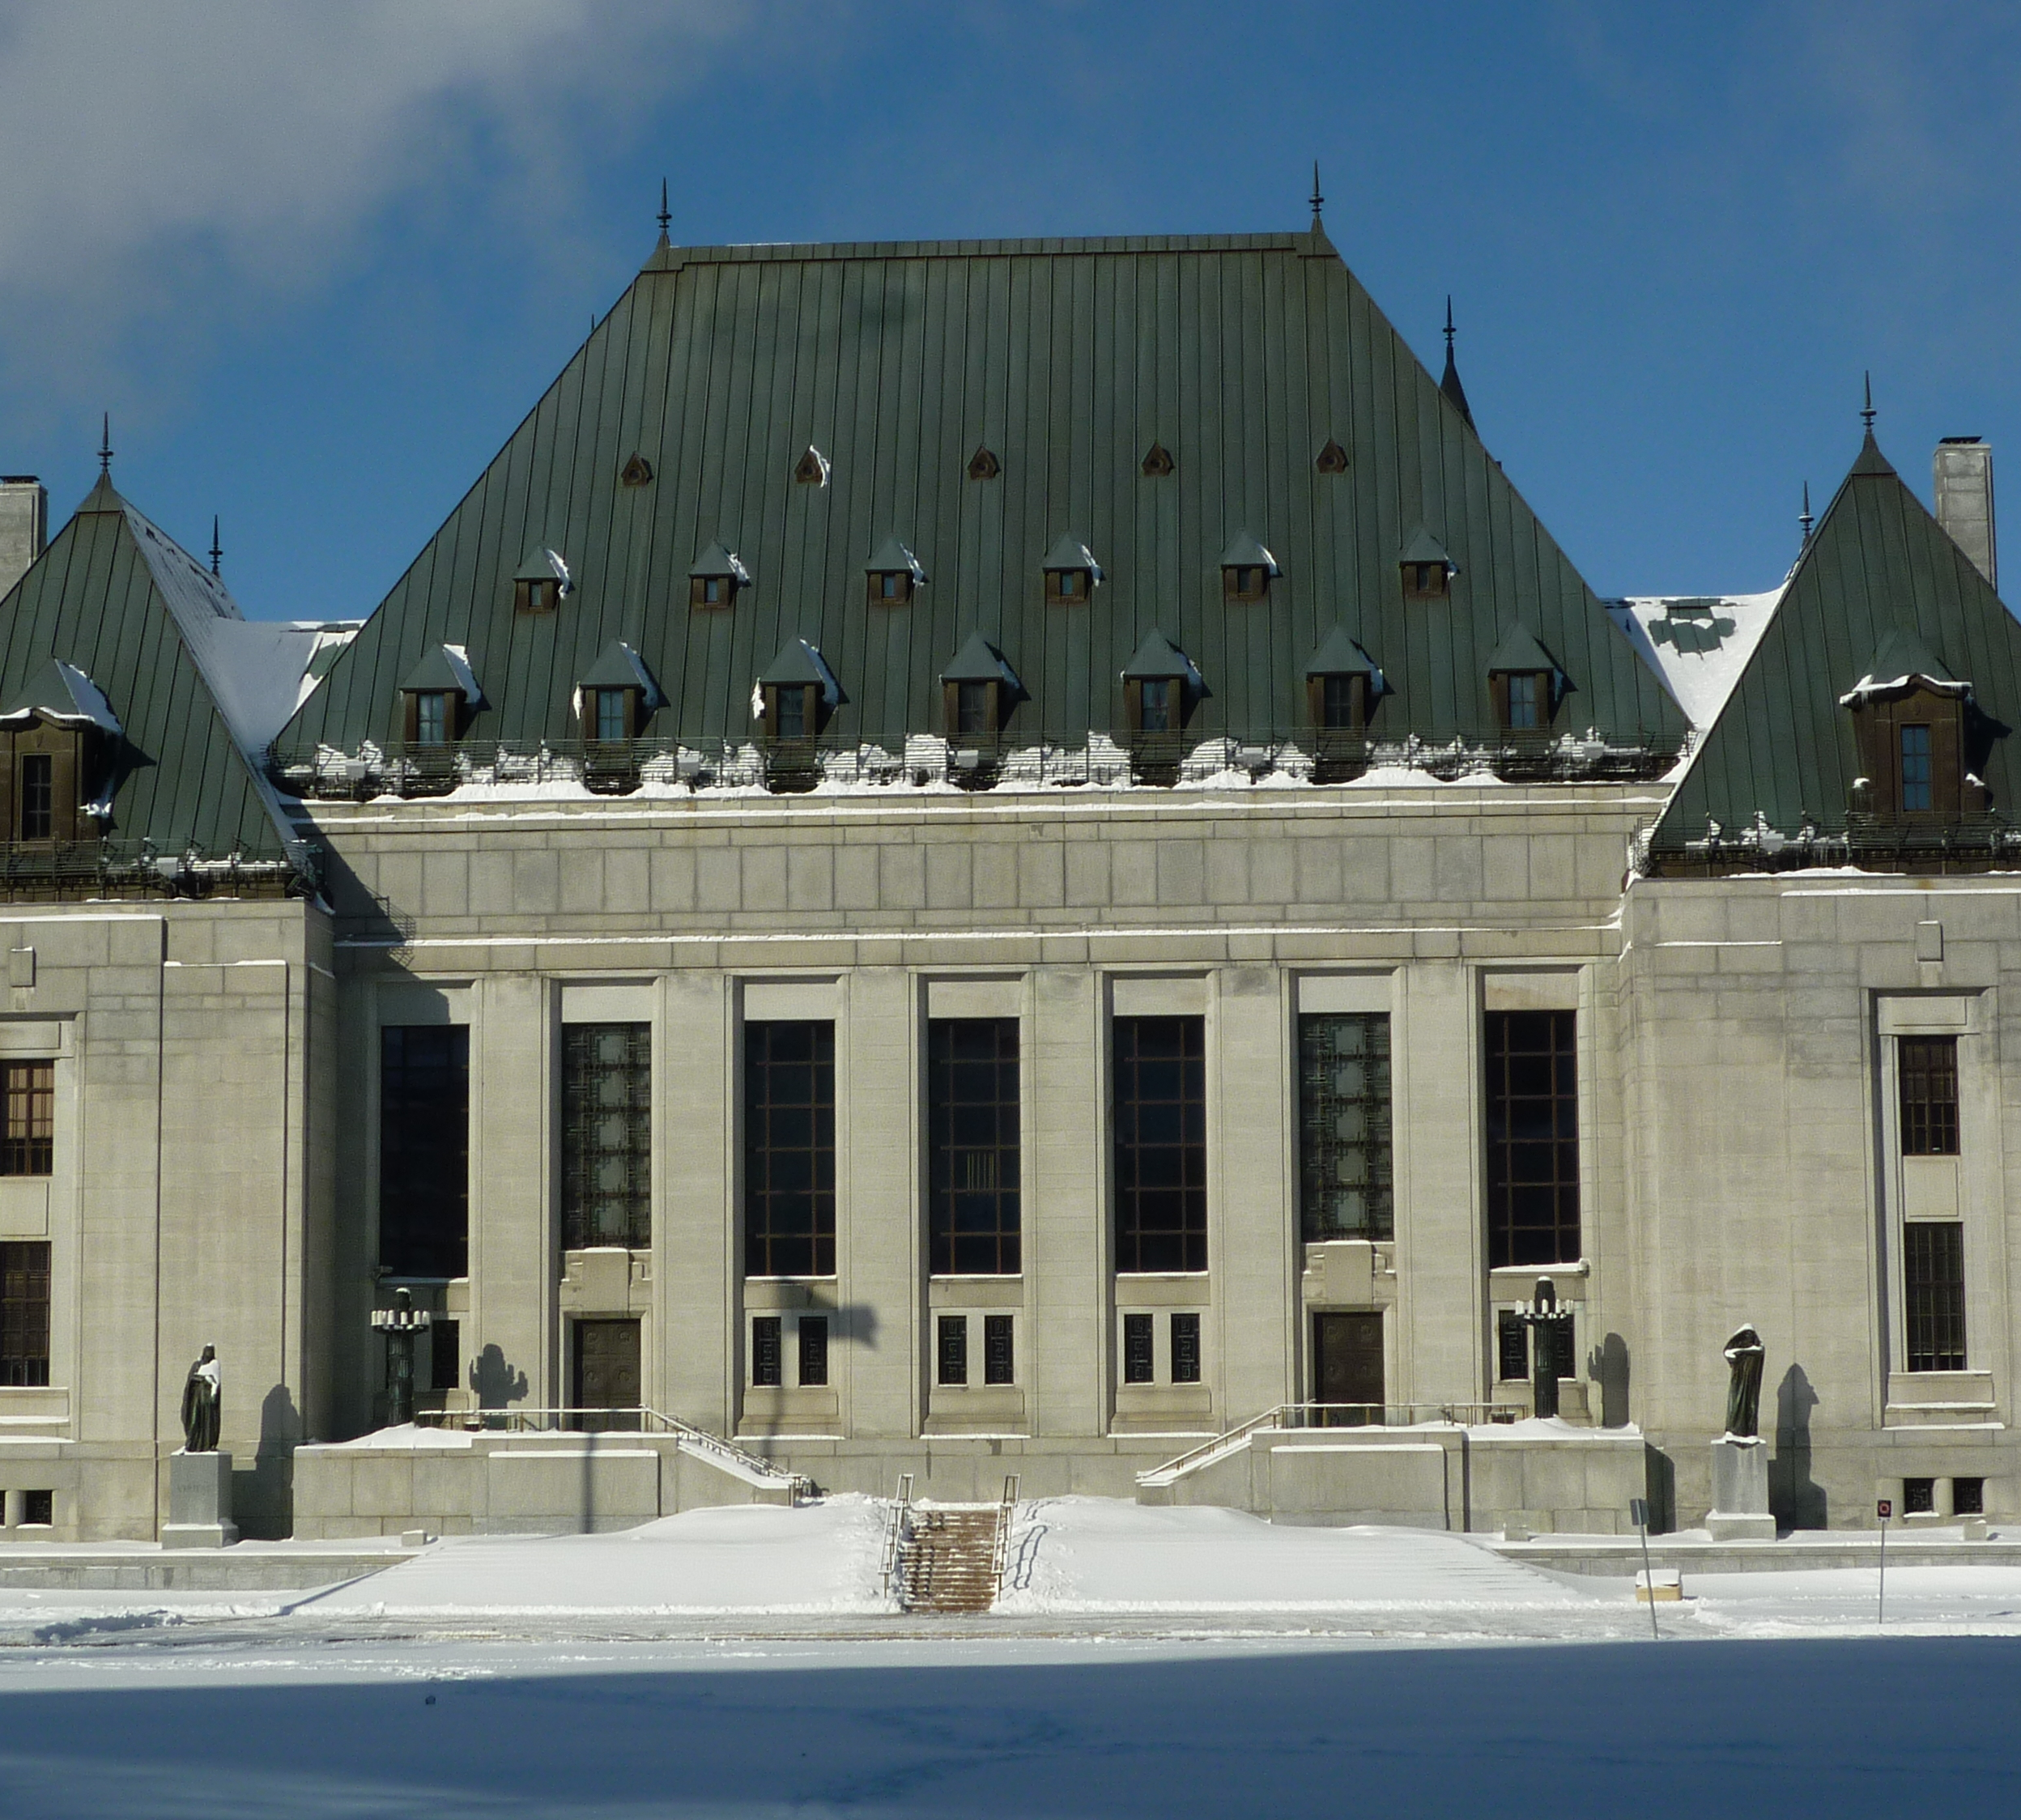
Constitutional – YES!
SCC decision RELEASED: R. v. J.J. 2022 SCC 28
R. v. J.J. & A.S. / Reddick
Entirety of s. 278.92 scheme
Participatory rights of complainant (ss.278.94(2) + (3))
7-day notice provision (s.278.93(4))
This Photo by Unknown Author is licensed under CC BY-ND
Notes:
IS ALL OF THIS CONSTIUTIONAL? YES, IT IS
JJ, AS, REDDICK WENT UP AS COMPANION CASES. REDDICK WAS DECIDED BY JUSTICE SUHAIL AKHTAR, WHO SOME OF YOU MAY REMEMBER AS A FORMER CROWN.
WITHOUT OVER SIMPLIFYING, DEFENCE COUNSEL DON’T LIKE THE AMENDMENTS: DON’T LIKE TIPPING THEIR HANDS.
JILL WITKIN THE CHAIR OF THE SVAG ARGUED THIS LAST FALL. DECISION RELEASED ON JUNE 30, 2022

Slide 8
This is the first paragraph of JJ: Use it
The criminal trial process can be invasive, humiliating, and degrading for victims o sexual offences, in part because myths and stereotypes continue to haunt the criminal justice system. Historically, trials provided few if any protections for complainants. More often than not, they could expect to have the minutiae of their lives and character unjustifiably scrutinized to intimate and embarrass them and call their credibility into question – all of which jeopardized the truth-seeking function of the trial. It also undermined the dignity, equality, and privacy of those who had the courage to lay a complaint and undergo the rigours of a public trial.
Notes:
THE SECOND PARAGRAPH IS EVEN MORE POWERFUL – MOST VICTIMS OF SEXUAL VIOLENCE DO NOT REPORT THESE CRIMES. ONLY A FRACTION OF REPORTED OFFENCES RESULT IN A COMPLETED PROSECUTION. MORE NEEDS TO BE DONE.
SCC SAYS – PROVISIONS ARE CONSTITUTIONAL BECAUSE THEY BALANCE THE ACCUSED’S RIGHTS TO A FAIR TRIAL WITH THE COMPLAINANT’S RIGHTS to DIGNITY, AND PRIVACY AND THE PUBLIC’s INTEREST IN A LEGITIMATE SEARCH FOR THE TRUTH.
WHAT ARE THE IMPLICATIONS FOR OUR WORK IN LIGHT OF THIS DECISION?
The scheme is constitutional.
On a 276 application, counsel for the complainant has standing at stage 2 – the hearing process, but no longer has the right to conduct cross-examination of the accused on his affidavit. That role falls to the crown.
The 7-day notice period is constitutional – in reality, these applications should be scheduled well in advance of 7 days.
The court provides guidance on s.2781 – enumerated records and non-enumerated records.
Enumerated category of records as in defined in s.278.1 include “medical, psychiatric, therapeutic, counselling, education, employment, child welfare, adoption and social services records, personal journals and diaries, and records containing personal information the production or disclosure of which is protected by any other Act of Parliament or a provincial legislature.”
Paragraph 42 – A non-enumerated record will only be captured by s.278.1, in the context of the record screening regime, if the record contains information of an intimate or highly personal nature that is integral to the complainant’s overall physical, psychological, or emotional well-being. Such information will have implications for the complainant’s dignity.
Paragraph 45 – They adopt the Sherman Estate v. Donovan 2021 SCC 25 definition of privacy – is the information sensitive, would it have an impact on their dignity? To reach the level of an impact on dignity, an intrusion on informational privacy must transcend personal inconvenience by reasons of the highly sensitive nature of the information that might be revealed.”
Further, it’s not the medium that the determines whether there is a REOP – but rather the sensitivity of the information contained in the records.

Slide 9
1. Identify the evidence
Do you have any of these things in the Crown brief?
Is it disclosable?
276: To Edit or Not: Other Sexual Activity in the Crown Brief
Cover letter to defence
SVAG Guide: Electronic communications between victim and accused
Third Party ‘records’: consider an express waiver (s.278.2(2))
Free ILA for all adult victims in Ontario
Cover letter to defence to notify them we have the records (s.278.2(3))
Primer Third Party Records
This Photo by Unknown Author is licensed under CC BY-NC
Notes:
REVIEW THE CROWN BRIEF EARLY TO SEE WHAT YOU HAVE AND WHAT DECISIONS NEED TO BE MADE IS THE KEY TO AVOIDING DELAY IN THESE CASES:
DO YOU HAVE EVIDENCE OF OTHER SEXUAL ACTIVTY AND IF SO, ARE YOU VETTING IT OUT?
HERE ARE SOME EXAMPLES:
VICTIMS STATEMENT: MET ON TINDER. GOT TOGETHER, SHE CONSENTED TO ORAL AND VAGINAL SEX. SHE LEFT. RETURNED 20 MINUTES LATER. THE ACCUSED FORCED ANAL SEX HER. HE WAS CHARGED. THE CONSENSUAL ORAL AND VAGINAL SEX WHILE PROXIMATE IS STILL= OTHER SEXUAL ACTIVITY.
JUST BECAUSE IT’s 276 DOES NOT MEAN YOU ARE AUTOMATICALLY EDITTING IT OUT. SEE THE SVAG RESOURCE – TO EDIT OR NOT.
WE ARE STILL GOVERNED BY STINCHCOMBE. WE ARE ONLY VETTING OUT THAT WHICH IS CLEARLY IRRELEVANT. CAN’T SAY THE CONSENSUAL PORTION IS CLEARLY IRRELEVANT. STATEMENT IS DISCLOSED UNREDACTED.
VICTIM’S STATEMENT – WHEN HE WAS SEXUALLY ASSAUTLING ME, I FROZE BECAUSE IT REMINDED ME OF WHEN MY UNCLE USED TO MOLEST ME. IS THIS CLEARLY IRRELEVANT.
COMMON ERROR – SOME DEFENCE LAWYERS MAY BELIEVE THAT BECAUSE IT’S BEEN DISCLOSED, THEY CAN USE IT. THAT’S NOT THE CASE.
WHAT YOU NEED TO IS COMMUNICATE WITH DEFENCE AT EARLIEST OPPORTUNITY IS YOUR POSITION ON THIS EVIDENCE. ARE YOU LEADING IT? SET OUT IN WRITING WHAT YOUR POSN IS ON THE OSA – IE., THE CROWN IS LEADING IT AND YOU CAN’T GO BEYOND WHAT I AM LEADING WITHOUT A 276 OR CROWN IS NOT LEADING IT, YOU ARE AWARE OF IT – OVER TO YOU DEFENCE TO DECIDE IF YOU ARE PURSUING A 276.
IF WE LEAVE THIS DECISION MAKING TO THE TRIAL DOOR – WE WILL ENCOUNTER DELAY. DEFENCE WILL SAY THEY DIDN”T KNOW WHAT THE CROWN WAS DOING AND WE COULD WEAR SOME OF THAT DELAY
TEXT MESSAGES OFTEN FORM PART OF OUR CROWN BRIEF:
CURRENT ADVICE – REFER TO THE SVAG GUIDE, ELECOTRONIC COMMUNCATIONS
PRODUCTION AND USE ARE DIFFERENT
TEXTS BETWEEN THE ACCUSED AND THE COMPLAINANT; NO REOP, CAN BE DISCLOSED/PRODUCED WITHOUT A WAIVER MOST TIMES. HE’s SEEN THEM. IF HE WANTS TO USE THEM, STILL NEEDS AN APPLICATION.
TEXTS BETWEEN THE COMPLAINANT AND HER FRIEND – DIFFERENT. REOP LIKELY. IF YOU WANT TO USE THEM, SEEK AN EXPRESS WAIVER. ARRANGE A MEETING, HAVE A WITNESS PRESENT, EXPLAIN THE PROCESS, SHE CAN ACCESS ILA IF SHE WANTS. ONCE YOU HAVE A SIGNED WAIVER, CAN DISCLOSE. WE CAN RELY ON THEM – SUBJECT TO REGULAR RULES OF EVIDENCE.
TELL DEFENCE COUNSEL YOUR POSN ON THESE MESSAGES: I AM LEADING AS PART OF THE CROWN’S CASE OR OVER TO YOU DEFENCE COUNSEL TO BRING YOUR APPLICATION. AGAIN COMMUNICATE THIS TO THEM AT THE EARLIEST POSSIBLE OPPORTUNITY AND IN WRITING SO THEY ARE INFORMED ABOUT OUR POSITION AND WHAT APPLICATIONS THEY NEED TO BRING

Slide 10
2. Consider your position
Will the Crown lead it?
Crown-led 276 [‘other sexual activity’] evidence
“Seaboyer” guidance – SVAG Paper
R v. Langan, 2019 BCCA 467, dissent adopted by SCC: 2020 SCC 33
Crown need not apply to adduce 278.92 ‘records’
Might the Crown concede admissibility?
Crown cannot unilaterally concede admissibility or waive complainant’s right to privacy, dignity, equality (R. v. Barton 2019 SCC 33 at paras. 9, 68)
This Photo by Unknown Author is licensed under CC BY-NC
Notes:
STICK WITH MY EARLIER EXAMPLE OF THE TINDER EXAMPLE: THE PRIOR CONSENSUAL ORAL AND VAGINAL SEX.
LET'S SAY YOU MAKE THE DECISION TO LEAD THIS.
SEABOYER GOVERNS.
NEED TO DETERMINE THIS AT THE EARLIEST POSSIBLE OPPORTUNITY: CPT, JPT. OUR DECISION ON USE OF THIS EVIDENCE HAS IMPLICATIONS FOR DEFENCE AND THEY NEED TO BE AWARE OF OUR POSN.
BARTON SCC – WE HAVE TO BE CAUTIONS ABOUT LEADING OTHER SEXUAL ACTIVITY EVIDENCE.
-BARTON SPEAKS OF A SEABOYER VOIR DIRE, -KEEP IN MIND: IF YOU LEAD IT, IT’S NOT OPEN SEASON FOR DEFENCE. IF THEY WANT TO GO BEYOND WHAT YOU ARE LEADING, THEY NEED A 276.
-AS PER THE SCC IN R.V., THESE ISSUES SHOULD BE CONSIDERED AT THE SAME TIME
HOW ARE YOU GOING TO FRAME THIS? THE OTHER SA EVIDENCE IS RELEVANT TO SHOW HOW THE COMPLAINANT FRAMED THE PARAMETERS OF HER CONSENT.
THE COURT WILL WANT TO KNOW: IS THE COMPLAINANT AWARE OF THIS AND WHAT ARE HER VIEWS? COMPLAINANT DOES NOT HAVE COUNSEL ON THIS. [I MEET WITH THE COMPLAINANT IN ADVANCE WITH A WITNESS TO DISCUSS THIS, SHE CAN ACCESS ILA AGAIN IF SHE WANTS].
-CONSIDER HOW BEST TO LEAD THIS TYPE OF EVIDENCE WITH A REGARD TO SAFEGUARDING THE V’s INTEGRITY AND PROMOTING EFFICIENCY : AGREED STATEMENT OF FACT? PERMISSION TO LEAD IN THIS AREA? GOAL IS TO PREERVE V’S DIGNITY
-IN ONE CASE, I HAD DEFENCE VET HIS QUESTIONS WITH THE JUDGE IN ADVANCE OF THE V’S EVIDENCE. HE WAS ALLOWED TWO QUESTIONS AND IT KEPT THE PROCESS STREAMLINED AND CONTROLLED.
***LANGAN (PRE-AND POST VISIT TEXT MESSAGE COMMUNICATIONS) THIS CASE IS A MUST READ FOR ANYONE DOING THESE PROSEUCTIONS – THE SCC ADOPTS THE DISSENT. SPEAKS TO THE IMPORTANCE OF ALWAYS INDICATING ON THE RECORD THE PURPOSE FOR WHICH YOU ARE LEADING EVIDENCE.
-WE CAN’T UNILATERALLY CONCEDE ADMISSIBILTY OR WAIVE V’S RIGHT TO PRIVACY – JUDGE IS THE GATEKEEPER

Slide 11
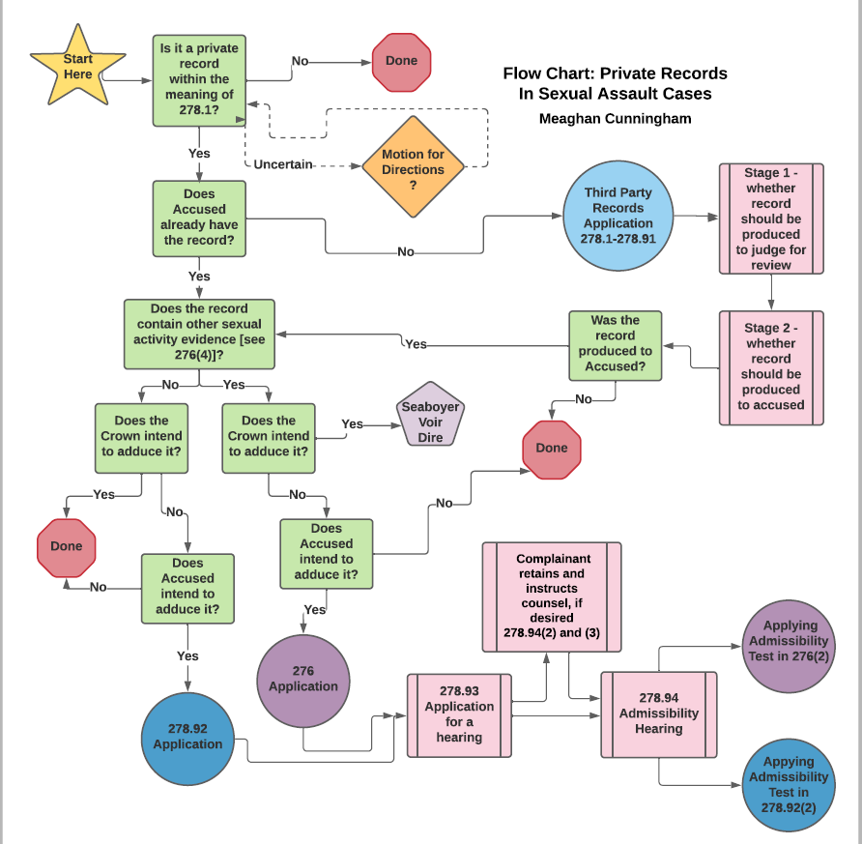
Private Records Flow Chart

Slide 12
3. NAIL DOWN defence position
FLAG it
At CPT / JPT (Pre-Trial worksheet)
Preliminary issues? (applicability, timing)
Draft Order Appointing Complainant’s Counsel
PUSH it
Confirm defence position
Propose filing deadlines
DOCUMENT it
Notes:
HOW CAN WE MITIGATE 11B ISSUES IN THESE CASES.
FLAG THE ISSUES FOR DEFENCE AT THE EARLIEST POSSIBLE OPPORTUNITY:
CPT/JPT: ASK THEM – ARE YOU PURSUING A THIRD-PARTY RECORDS APPLICATION?
ARE YOU SEEKING TO ADDUCE RECORDS IN YOUR POSSESSION?
PUSH IT: JPT – MAKE IT AS PRODUCTIVE AS POSSIBLE. PUSH THE ISSUE WITH DEFENCE. I TOLD YOU THAT I AM NOT LEADING EVIDENCE OF OSA. ARE YOU BRINGING THIS APPLICATION?
COME WITH A DRAFT ORDER FOR THE APPT OF COUNSEL, IF THEY GET PAST STAGE 1, YOU ALREADY HAVE THE ORDER SIGNED.
IF DEFENCE UNCERTAIN ABOUT WHETHER THEY ARE BRINGING THE APPLICATION, SET A TRIAL DATE AND COME BACK FOR ANOTHER JPT TO SEE IF DEFENCE IS BRINGING THEIR APPLICATION AND MORE TIME IS NEEDED.
DOCUMENT ALL OF YOUR INTERACTIONS WITH DEFENCE VIA LETTER, THE RECORD IN COURT, MEMOS TO FILE – will make it very hard for them to argue down the road that they did not anticipate having to bring the application when you have been raising it since the CPT stage.
USE THE JPT TO ESTABLISH FILING DEADLINES
SECTION 278.93(4) CONTEMPLATES A FILING DEADLINE OF ONLY 7 DAYS OR LESS BEFORE THE STAGE 1 APPLICATION, WE RECOMMEND ADVOCATING FOR FILING TIMELINES OF 30 DAYS OR MORE, WHICH ACCORDS WITH THE SCJ CRIMINAL PROCEEDING RULES (6.04(2)) and the OCJ RULES (3.1).
IF ADDITIONAL MATERIALS WILL BE FILED BETWEEN STAGES 1 and 2, SIMILAR DEADLINES SHOULD APPLY.
THIS IS IMPORTANT BECAUSE V’s COUNSEL WILL OFTEN ONLY BE SEEING THE APPLICATION REOCRD FOR THE FIRST TIME AFTER STAGE 1. V’S COUNSEL WILL NEED TIME TO DIGEST THE MATERIALS and PREPARE A RESPONSE. THE JUDGE WILL NEED TIME BETWEEN APPEARANCES TO RENDER A DECISION.
DON’T FORGET – IF THEY ARE PURSUNG A THIRD-PARTY RECORDS APPLICATION – STILL NEED TIME FOR THE 278.92 APPLICATION AFTER PRODUCTION.

Slide 13
4. Schedule the Application(s)
Motion for directions??
Consider litigating these issues at stage 1 instead
Two stages for 276 & 278.92 applications – how much time is actually needed for each? Between them?
Request filing deadlines.
Notes:
WHEN THE LEGISLATION WAS INTRODUCED, WE SAW MOTIONS FOR DIRECTIONS. THIS IS NOT DERIVED FROM THE STATUTE. THE STATUTE CONTEMPLATES TWO STAGES.
THERE IS ENOUGH LAW IN THIS AREA NOW THAT WE SHOULD NOT BE SEEING THESE AS OFTEN.
IF THEY DO ARISE – IF DEFENCE IS QUESTIONING WHETHER SOMETHING IS A RECORD OR NOT, TELL THEM TO PUT IN WRITING AND ADDRESS THIS AS PART OF STAGE ONE.
RECENT EXAMPLE: TWO ACAs IN OUR OFFICE. NCDII NOT AN ENUMERATED OFFENCE IN S.276. MOTION FOR DIRECTION TO ARGUE THE APPLICABILITY OF THE STATUTORY REGIME. APPROPRIATE USE OF COURT TIME, WANT TO ENSURE V’S DIGNITY IS PROTECTED.

Slide 14
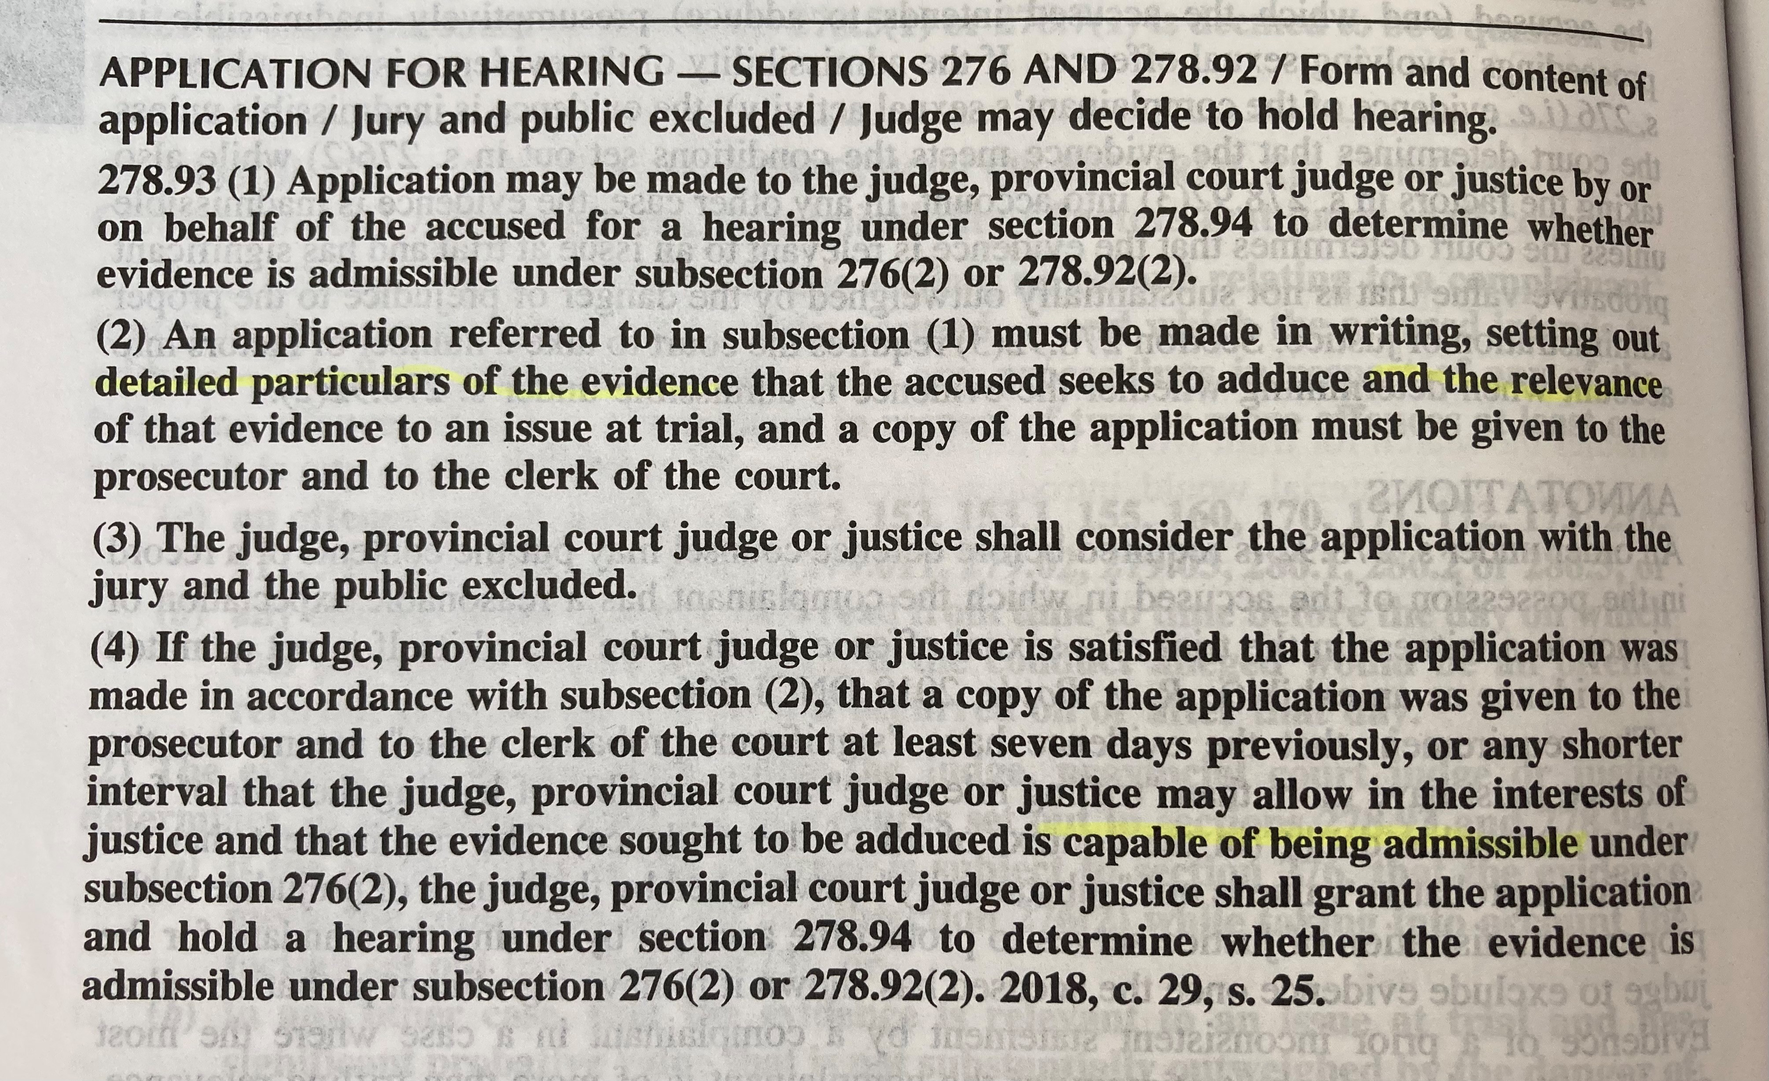
Stage 1: s.278.93 application
Complainant’s counsel has no standing
Complainant’s counsel does not get materials*
Threshold question: will a 278.94 hearing be ordered?
In writing
Served 7 days (or less) in advance*
Detailed particulars (may not be a copy of record)
Relevance
(276 only): Capable of admission
Information & belief affidavit sufficient
R. v. Darrach 2000 SCC 46 at para. 53
Notes:
STAGE ONE OF THE APPLICATION – MUST BE A WRITTEN APPLICATION.
THE COMPLAINANT DOES NOT HAVE STANDING. AND COMPLAINANT”S COUNSEL DOES NOT GET THE MATERIALS.
SOME JURISDICTIONS ARE PROCEEDING ONLY IN WRITING, OTTAWA IS NOT. BUT A BRIEF COURT APPEARANCE IS SUFFICIENT – YOU DON’T NEED MORE THAN AN HOUR OF COURT TIME.
IT”S A THRESHOLD QUESTION – WILL THEY GET A HEARING?
THE CROWN CAN CONCEDE STAGE ONE: BUT I WOULD NEVER EVER DO THIS WITOUT FIRST SEEING THE APPLICATION IN WRITING. THINGS CAN EVOLVE FOR DEFENCE COUNSEL. HOW THEY EXPLAIN THE APPLICATION AT THE JPT MIGHT BE DIFFERENT THAN WHAT THEY ULTIMATLY PUT IN WRITING. THINGS CHANGE SO WAIT UNTIL YOU GET THE WRITTEN APPLICTION BEFORE CONCEEDING.
NOTE: THE APPLICATION MATERIALS CAN BE PROVIDED TO V’s COUNSEL BEFORE STAGE 1, BUT ONLY WITH THE CONSENT OF DEFENCE COUNSEL (IN WRITING) OR WITH LEAVE OF THE COURT.
RELEVANCE IS THE KEY, ADDED CONSIDERATION IF DEALING WITH 276 – THE EVIDENCE HAS TO BE CAPABLE OF BEING ADMISSIBLE UNDER SECTION 276(2)
STAGE 1 FOR 276 – INFORMATION AND BELIEF AFFIDAVIT IS SUFFICIENT
STAGE 2 FOR 276 – NEED A PERSONAL AFFIDAVIT
The application materials can only be served less than 7 days in advance if it is ‘in the interests of justice’ (s.278.93(4)). Defence counsel should generally be encouraged to serve their materials at least 30 days in advance of each stage, in accordance with the SCJ Criminal Proceedings Rules (6.04(2)) and the OCJ Criminal Rules (3.1).
NOTE: IF YOU CATCH WIND OF DEFENCE COUNSEL SAYING, “HEY I’M GOING TO BRING THIS APPLICATION AT THE CLOSE OF HER IN-CHIEF”, WE NEED TO SHUT THIS DOWN ON THE RECORD. THAT IS ANOTHER WAY OF DEFENCE COUNSEL TRYING TO CIRCUMVENT THE REGIME.
ALEX RIOPEL EXAMPLE

Slide 15
Dismissing it at Stage 1
Deficient Stage 1 Materials = no Stage 2 hearing: R. v. Goldfinch, 2019 SCC 38 @ 94
Judge’s screening function - Dismiss summarily: R v. Cody, 2017 SCC 31 @38
Fails to meet Threshold for Stage 2 Hearing
“…none of the proposed evidence is capable of being admitted and I decline to hold a hearing under s. 278.94 of the Criminal Code.”: R v. John, [2019] O.J. No. 3201 @53
Notes:
WE”VE HAD SUCCESS GETTING THESE BOOTED OUT AT STAGE 1 WHERE THE MATERIALS ARE DEFICIENT.

Slide 16
Stage 2: s.278.94 hearing
Complainant’s counsel HAS standing
Complainant’s counsel GETS the materials
Test:
Relevance to an issue at trial (s.278.92(2)(b))
Significant probative value that is not substantially outweighed by the danger of prejudice to the administration of justice (s.278.92(2)(b))
(276 only): no twin myth reasoning + specific instances of sexual activity (s.276(2))
Personal affidavit required at this stage
R. v. Darrach 2000 SCC 46 at paras. 53 and following
Factors for consideration: s.278.92(3) (and s.276(3) for 276 evidence)
Even if not successful, the Crown is entitled to cross examine the accused on his Affidavit/evidence for impeachment purposes at trial.
This Photo by Unknown Author is licensed under CC BY
Notes:
COMPLAINANT HAS STANDING AT THE STAGE 2 HEARING BY VIRTUE OF SECTION 278.94(2).
COMPLAINANT ALSO GETS THE MATERIALS. HER RIGHT TO THE MATERIALS IS NOT CODIFIED, BUT THERE IS GOOD LAW SUPPORTING THAT THIS IS THE ONLY WAY FOR HER TO MEANINGFULLY PARTICIPATE. (see e.g. R. v. A.C., 2019 ONSC 4270 at paras. 32-44; R. v. A.M., 2020 ONSC 1846 at para. 29; R. v. Boyle, 2019 ONCJ 11 at paras. 10-43).
COMPLAINANT’s PARTICIPATION AT THE HEARING – NOW LIMITED TO MAKING SUBMISSIONS
THE FACTORS ARE ENUMERATED IN THE CODE
GENERALLY – RELEVANCE TO AN ISSUE AT TRIAL
FOR 276 – CAN”T BE FOR TWIN MYTH REASONING, NO GENERALIZED REPUTATIONAL EVIDENCE
NOTE RE: 276: EVEN IF APPLICATION NOT SUCCESSFUL, YOU CAN STILL USE THE AFFIDAVIT OF THE ACCUSED AND ANY EVIDENCE HE GAVE FOR IMPEACHMENT PURPOSES AT TRIAL.

Slide 17
Responding to Last Minute / Mid-trial Applications
… the principles of fundamental justice do not entitle the accused to “the most favourable procedures that could possibly be imagined”: R v. Mills, [1999] 3 SCR 668 @ p.718
…“Justice delayed is justice denied.” An unreasonable delay denies justice to the accused, victims and their families, and the public as a whole: R. v. Jordan, 2016 SCC 27 @19
Trial fairness must be assessed from “the point of view of fairness in the eyes of the community and the complainant and not just the accused”: R v. Mills @ p.718
Judges are entitled to control the procedure of trial to ensure, as best they can, that the proceedings are effective, efficient and fair to all parties, including those required to give evidence: R v. John, 2017 ONCA 622 @47
A court may deny an adjournment request on the basis that it would result in unacceptably long delay, even where it would be deductible as defence delay: R v. Cody, 2017 SCC 31 @37
Trial judges should generally dismiss such applications and requests the moment it becomes apparent they are frivolous: R v. Jordan, 2016 SCC 27 @63; see also R v. Cody, 2017 SCC 31 @38
Notes:
THESE LAST-MINUTE APPLICATIONS MID-TRIAL APPLICATIONS ARE A PROBLEM FOR SURE:
FOR THE COMPLAINANT – A BIFURCATED PROCEEDING IS DEVESTATING. JILL WITKIN ADDRESSED THIS ISSUE IN HER FACTUM FOR JJ.
FOR THE TRIAL PROCESS ITSELF – CAN CREATE SIGNFICANT DELAYS
WHAT CAN WE DO?
IF WE HAVE BEEN SAYING TO DEFENCE FROM THE OUTSET WHAT OUR POSITION IS: IE., I TOLD YOU I WAS NOT LEADING THE OSA AS PART OF MY CASE AND THAT A 276 REQUIRED, THEY CAN’T CLAIM THIS WAS UNPREDICTABLE. EARLY FLAGGING AND DOCUMENTATION GUARDS AGAINST AN 11B.
HERE ARE SOME GREAT SOUND BITES FOR TRYING TO GET THESE APPLICATIONS DISSMISSED. IF YOU CAN SHOW DEFENCE WAS ON NOTICE ABOUT WHAT WAS REQUIRED AND WHEN YOU FIRST ALERTED THEM, IT IS NOT GOING TO ASSIST THEM AND HOPEFULLY THE TRIAL JUDGE WON’T ALLOW IT.
OTHER OPTION:
CAN WE FASHION A CREATIVE SOLUTION?
CAN THE QUESTION BE ASKED IN A WAY THAT REMOVES THE SEXUALIZED COMPONENT? THERE WOULD THEN BE NO NEED FOR A MID-TRIAL S.276

Slide 18
Streamlining the Process
Pin the positions down early and set the deadlines. Be vocal about the issues and scheduling.
Stage 1 in writing? R v. Cody, 2017 SCC 31 @39 “proceed on documentary record alone”
Conceding stage 1?
CAUTION re: blending the two stages
Appointment of Case Management Judge (s.551.1)?
See SVAG doc re avoiding delay
This Photo by Unknown Author is licensed under CC BY-SA
Notes:
IN TERMS OF HOW WE CAN STREAMLINE THE PROCESS:
BEST ADVICE – PIN YOUR POSITION DOWN EARLY, AND PIN DOWN DEFENCE POSITION EARLY. KNOW WHAT YOU ARE DOING WITH THE EVIDENCE IN YOUR FILE AND KNOW WHAT IF ANY APPLICATIONS DEFENCE HAS TO BRING AS A RESULT.
STAY ON TOP OF THIS AND BE FIRM ABOUT SCHEDULING AND FILING DEADLINES.
CAUTION:
WE DON’T RECOMMEND BLENDING STAGES 1 and 2: DIFFERENT CONSIDERATIONS APPPLY AT EACH STAGE.
EXCELLENT RESOURCE ON OUR ELIBRARY PAGE: AVOIDING DELAY

Slide 19
Some Scenarios

Slide 20
Scenario 1
You are reviewing a sexual violence file at the screening stage. As part of your review of the file, you watch the complainant’s video statement. In the statement, the victim states the following:
Q: What happened immediately after the attack?
A: Right after it happened, I decided to start keeping a journal to help me further explore my feelings about being attacked. I found that the journal was a useful tool to helping in the healing process.
Do you request that this information be vetted out of the statement?
Notes:
If you leave it, what do you tell defence about it?

Slide 21
Scenario 2
You have scheduled a witness prep meeting for the evening before your trial starts. The meeting is held with the investigator up at the Victim Witness Assistance Program offices on the fourth floor. In this meeting, the victim watches her video interview so that it is fresh in her mind. Just as the video is ending, the victim states “last night when I re-read my journal, I remembered some more details about what happened that night?” “I brought my journal with me today.”
Do you disclose this information to defence counsel? If so, when do you do that?
What do you with the journal?

Slide 22
Scenario 3
Notes:
Now shuttered Kavali nightclub
Complainant Sexually Assaulted inside the upstairs bathroom by her employer
She consumed 9 shots before he followed her inside the bathroom
She delayed disclosing until she attempted suicide and was in the hospital, she disclosed to a police officer who was called to the hospital
In her video statement, said the reason she tried to end her life was because she was sexually assaulted
First trial – conviction, ONT CA sends it back because of one line in the trial judge’s reasons
In the meantime, the victim sues the accused and as part of her statement of claim, serves him with her entire psychiatric history. Civil counsel provides that to defence counsel in the criminal proceeding. Defence counsel stands up in cross and wants to use those records – notwithstanding his non-compliance with the scheme, says she has no REOP because the accused has seen them.
What do you do?

Slide 23
Scenario 3 cont’d….
How do you respond to counsel’s assertion that the complainant has no reasonable expectation of privacy in her psychiatric records now that she has served them upon the accused?
If you take the position that she has a REOP, your trial will be adjourned or paused.
Took the position that she maintained a REOP
Took the position that notwithstanding the fact that they had been produced to the accused, he had to comply with s.278.92.
Novel issue: ONT SCJ Ryan-Bell J. She retained a REOP in the records and defence counsel would have to comply with the statutory screening regime. Privacy is not an all or nothing concept.

Slide 24
ADDITIONAL RESOURCES

Slide 26
E-Library Resources
Links embedded in blue above
Bill C-51 powerpoint - A Comprehensive Overview of Legislative Changes and Emerging Caselaw
Primer: Section 276
Primer: Private Records in the Hands of the Accused
Avoiding Delay in Sexual Violence Cases

Slide 27
CONTACT SVAG IF YOU NEED THEM
Jill Witkin (Chair) – jill.witkin@ontario.ca
Kelli Frew (Central West) – kelli.frew@ontario.ca
Mareike Newhouse (Central East) – mareike.newhouse@ontario.ca
Julia Forward (West) – julia.forward@ontario.ca
Neville Golwalla (Toronto) – neville.golwalla@ontario.ca
Elaine Evans (East) – elaine.evans@ontario.ca
Kara Vakiparta (North) – kara.vakiparta@ontario.ca

Slide 28
QUESTIONS?

