Slide 1
CRIMINAL HARASSMENT (s. 264) Siobhain Wetscher & Lindsay Little
Notes:
It’s a bad vibe

Slide 2
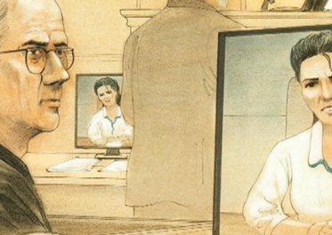
WHY IS IT IMPORTANT?
Becoming more prevalent (perhaps)
Tricky to case manage
Giovanni Palumbo – Shania Twain
Can be harbinger of things to come
Joshua Graves – the Ready family
In this office: two first degree murders with criminal harassment routes, both IPV (s. 231(6))
Notes:
More prevalent – not MAG numbers, personal experience
Tricky to case manage – many moving parts. Regularly breaches. Not insignificant amount of self-reps. Scope issues.
High stakes – at various points in the process
Dr. Palumbo – prosecuted by our very own Mark Moors. Himself a celebrity as a previous CFL player. He was assigned to this file – Mark Moors is the master of facts on this one. I’m providing a summary. Dr. Palumbo was a former Ottawa physician who had mental health issues. He became convinced that Shania Twain and himself were destined to be together. He began sending her letters in Geneva, where she lives (if you haven’t watched the recent Netflix documentary). From 2010-2012, various stalking actions undertaken. She has a “cottage” (I use that term loosely) in the Muskokas. He goes there, in a boat. He goes to her grandmother’s funeral. He goes and sees her brother. A lot of lawyers get involved – her European lawyers hire a lawyer from Oakville. She refuses to participate in the trial scheduled in front of Justice Nadel. Mark Moors makes the difficult decision that he can’t proceed, and the charges are dismissed. He then attends at the Juno Awards, where Shania Twain is appearing. He’s arrested in Toronto for criminal harassment. Media circus. She testifies about how she was initially uncomfortable, but that this evolved into outright fear. Ultimately, he pleads guilty. Emblematic of various kinds of stalking.
The Ready family – a beautiful family from Alta Vista. Graves was released with a residential surety after being charged with sexual assault and criminal harassment against a 16YO. Shortly thereafter, he attends at his former neighbours’ home, where there is another 16YO he’s obsessed with (Jasmine), her elder sister (Catherine), and their mother, Dr. Anne-Marie Ready. The father is in Barbados. He kills Jasmine and Dr. Ready. He attempts to kill Catherine. He’s shot dead by police.
Cecilia & Louise, Cavvy & Purcell – IPV crim harassment

Slide 3
S. 264 CRIMINAL CODE
264 (1) No person shall, without lawful authority and knowing that another person is harassed or recklessly as to whether the other person is harassed, engage in conduct referred to in subsection (2) that causes that other person reasonably, in all the circumstances, to fear for their safety or the safety of anyone known to them.
Prohibited conduct
(2) The conduct mentioned in subsection (1) consists of
(a) repeatedly following from place to place the other person or anyone known to them;
(b) repeatedly communicating with, either directly or indirectly, the other person or anyone known to them;
(c) besetting or watching the dwelling-house, or place where the other person, or anyone known to them, resides, works, carries on business or happens to be; or
(d) engaging in threatening conduct directed at the other person or any member of their family.

Slide 4
ELEMENTS OF THE OFFENCE
There are five elements:
The accused engaged in the conduct set out in ss. 264(2)(a)-(d);
The victim was harassed;
The accused knew that the victim was harassed or was reckless or willfully blind as to whether the victim was harassed;
The conduct caused the victim to fear for his/her safety or the safety of anyone known to him/her; and,
The victim’s fear was, in all of the circumstances, reasonable.
Notes:
R. v. Sillip (1997), 120 C.C.C. (3d) 384 (Alta. C.A.) at para. 18, leave to appeal to S.C.C. refused [1998] S.C.C.A. No. 3.
Pursuant to s. 264(1), if an individual had lawful authority for their actions, such as police conducting surveillance, their acts do not constitute criminal harassment.
Note also – knowledge = honest mistake is a defence

Slide 5
BREAKING DOWN THE ELEMENTS (1/2)
s. 264(2)(a)-(d)
Repeatedly following from place to place: not the same place. Family members, friends, co-workers, all may count.
Repeated communication: direct or indirect. Not the same words or same means. More than once, but twice is sufficient. No temporal link required (cf. R v Ohenhen 2005 CarswellOnt 4631).
Besetting or watching: besetting = present at or near it in a troubling way. Continuous observation for particular purpose.
Threatening conduct: can be single communication. Assessment is according to reasonable person in the shoes of the target (whether would find this threat or intimidation, must be viewed objectively (cf. R v Sim 2017 ONCA 856 at para 20)
Notes:
This slide and the next – cheat sheet
- No temporal link required (e.g. two letters 18 months apart - . R. v. Ohenhen, [2005] O.J. No. 4072 (C.A), para 31, leave to appeal to S.C.C. refused [2006] S.C.C.A. No. 119.
- R v O’Donnell 2009 ONCA 587 at para 5: We disagree. This offence was far from an isolated incident. The appellant has five prior convictions for criminal harassment of the same victim as well as several convictions for breach of recognizance. Although the letter in issue was written in a therapeutic context, the appellant had been instructed not to send it to the victim. Moreover, he sent the letter while incarcerated and took some pains to hide its true destination from prison authorities. The sentence imposed was designed to impress on the appellant that his conduct must stop. We so no basis to interfere with it.

Slide 6
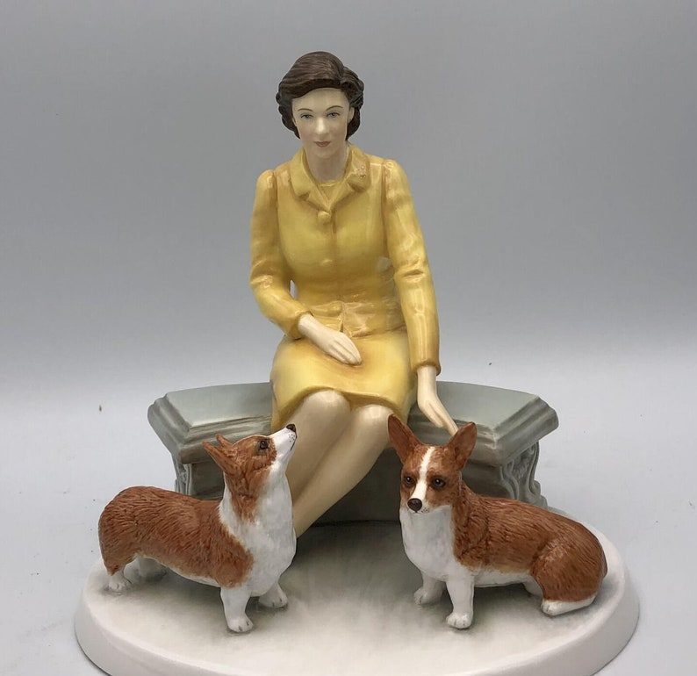
BREAKING DOWN THE ELEMENTS (2/2)
Other elements
(ii) V was harassed: best language “the victim was in a state of being harassed or felt harassed in the sense of feeling tormented, troubled, chronically or continually worried, plagued, bedeviled and badgered. It is not enough for the victim to be vexed, disquieted or annoyed.” (R v Province 2019 ONCA 638, citing Kosikar)
(iii) A knew V harassed: mens rea is actual knowledge, recklessness, or wilful blindness
(iv) V was fearful
(v) Fear was in all of the circumstances, reasonable: not thin skull – reasonable person is normal temperament, fortitude and level of self control. Not exceptionally excitable or easily intimidated or scared. Aware of previous history.
Notes:
Source of best lanuge is R v Province 2019 ONCA 638 – typical Watt JA judgment, very readable – first degree murder, domestic. Continuous fears about safety including smashing Royal Daulton figurines (this one is worth $1,200 on eBay)
Defence: honest mistake
R. v. Kosikar (1999), 138 C.C.C. (3d) 217 (Ont. C.A.) at paras. 24-25, leave to appeal to S.C.C. refused [1999] S.C.C.A. No. 549)

Slide 7
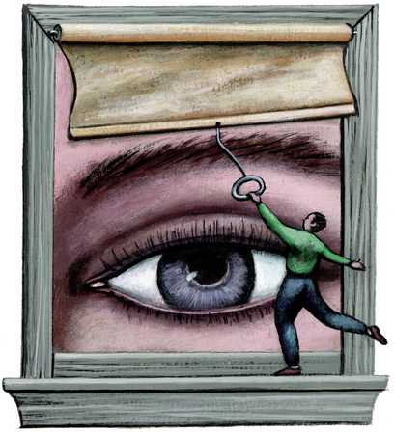
BAIL: BEST PRACTICES
Reverse onus: s. 515(6)(b.1) & (c)
Sureties
Ability to supervise is crucial
Consider condition to provide all electronic devices to the surety to review upon demand
No contact
No contact conditions in custody – s. 516(2) and s. 515(12)
Consider adding “or any member of their family” regardless of form of release
Wider radius conditions (500m at minimum)
Always notify VWAP/IO of release
Miscellaneous
No weapons (s. 109 will eventually apply)
Extreme cases: limit access to electronic devices
Notes:
Generally now dealt with by a specialty team but we can all stay on top of our game.

Slide 8
FILE SCREENING

Slide 9
CM ISSUES: DISCLOSURE
1. Linking various occurrence numbers to the principal occurrence
Oftentimes, linking in RMS does not mean that it will be pushed through to Scope
Ensure that previous occurrence reports are included and disclosed
Reach out to IO (via screening notice) to have the occurrence(s) attached. Easiest workaround is a PDF uploaded to the principal occurrence.
2. Threats and communications in other languages: get interpretation from LOL. Have complainant testify to this at trial and to what the specific meaning was to them.
3. Proving provenance of messages (R v Aslami 2021 ONCA 249): make follow-up requests for production orders, etc. early.
Notes:
ENSURE YOU HAVE ALL FIRST PARTY DISCLOSURE
R v Aslami – argued by MGM in this office. Ultimately sent back by ONCA on appeal. Paras 23-30 deal with the issue of SMS and TextNow messages. Basically, it is NOT enough to rely on the substantive content to prove the provenance. Consider what evidence you need to muster to prove this, gather it as first party disclosure at an early stage.

Slide 10
CM ISSUES: CHARGE THE RIGHT THING
Case Study 1:
Domestic relationship for four years, break up in early 2000s
Intermittently messages V for years
High emotional needs V
Charged with criminal harassment from 04/26/2017 to 10/27/2018
Does ND (poorly), receives 810 in February 2020
In Sept & Oct 2020, V begins receiving texts & FB messages acknowledging 810 still in effect
Notes:
E.g. 2 -messages are about their relationship, the Acc's feelings, how he apparently doesn't have feelings for V anymore, talks about V's father and V's sister and V's new boyfriend - all quite manipulative in nature
-Acc also states "Peace bond is still in effect so you can rat me out now if you feel like it." - turns out she took his advice
Q: What should be charged?
A: Criminal harassment – repeated communication. Breach of 810.
Q: What was charged?
A: Breach of 810 only.
- High emotional needs V is a red herring. It’s a REASONABLE PERSON standard – not particularly excitable. Recall earlier slide - reasonable person is normal temperament, fortitude and level of self control. Not exceptionally excitable or easily intimidated or scared. Aware of previous history.

Slide 11
CM ISSUES: MANAGING INFORMATIONS
Multiple counts for types of (a)-(d) behaviour & specificity
Date ranges rather than specific dates
Bifurcating Informations (e.g. separating physical violence from criminal harassment Informations – do not do!)
Amalgamating/relaying Informations – practical considerations
Do this early and on your terms
Scope – rejects RMS submissions where relay. You will receive email from Scope Toronto about this, generally not actionable.
Reviewing new information (ensuring proper date range, all offences listed)
Notes:
Applied in the next slide

Slide 12
CM ISSUES: BREACHES IN PRACTICE
Case Study 2:
Mentally ill man in Byward Market
Attends at vendor’s kiosk, who he doesn’t know, and threatens to kill him (Info. No. 1 = utter threats)
Released on undertaking in immediate aftermath not to attend within 250m of kiosk
Within two hours, walks past kiosk. Doesn’t acknowledge vendor. (Info. No. 2 = breach)
Notes:
Should you consider asking police to lay criminal harassment
E.g. 1 – no. Fast resolution. Consider entry into MHC for basic assessment and to get connected to services.

Slide 13
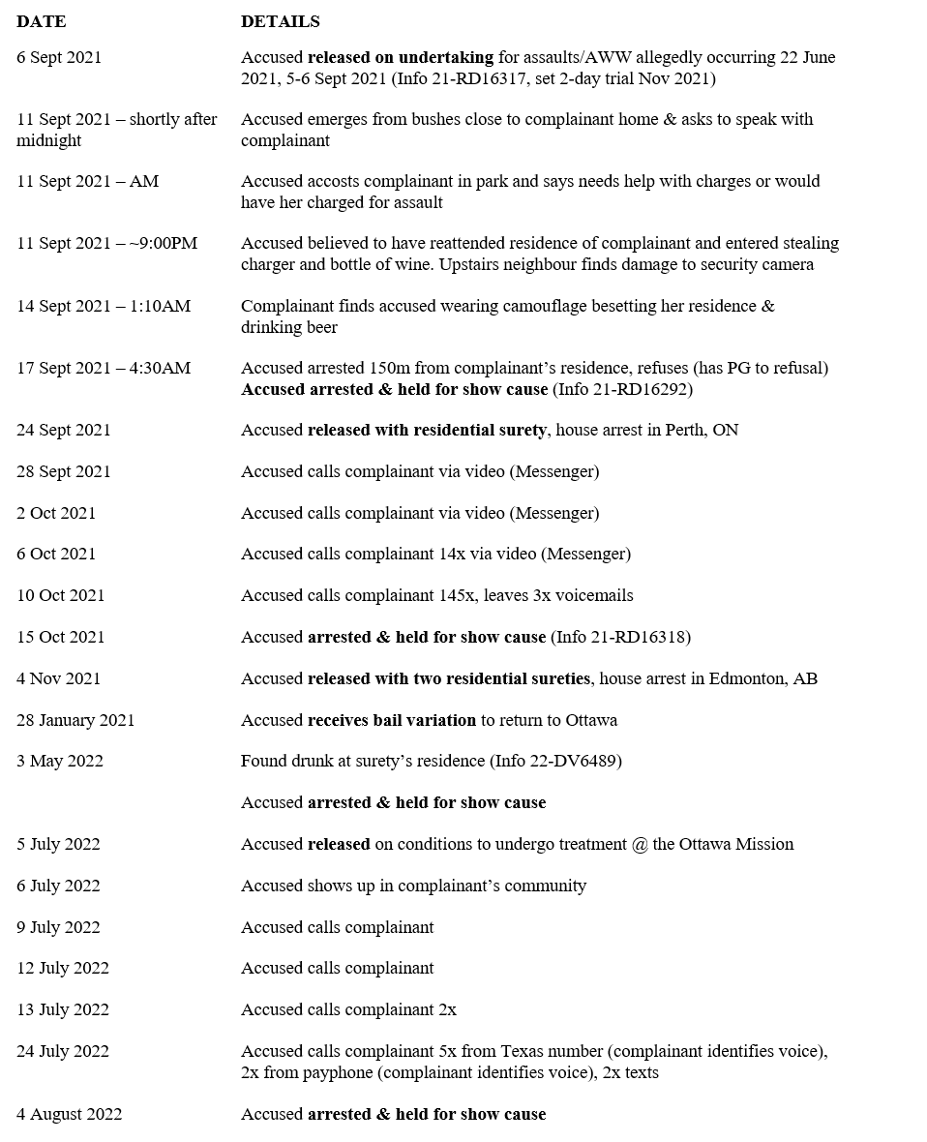
CM ISSUES: IN PRACTICE Case Study 3:
Notes:
Simplified procedural history

Slide 14
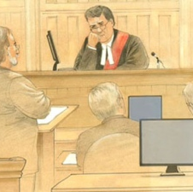
GETTING YOUR FILE READY FOR TRIAL

Slide 15
TELL THE FULL STORY
Is a PTM necessary for the history between the parties (“prior discreditable conduct”)?
NO. Prior conduct is presumptively admissible as it sets the background of the charge (R v DSF (1999 ONCA), R v DD (2005 ONCA), R v Deary (2014 ONSC))
Notes:
This is presumptively admissible evidence.
R v DD, a decision from the Ontario Court of Appeal, sets out the applicability and analysis of pre-charge conduct, as it relates to criminal harassment charges.
In that case, the Ontario Court of Appeal outlined the legal framework for the analysis of whether pre-charge conduct would be admissible in cases of criminal harassment. It succinctly summarizes the Krushel, Kosikar, and Ryback caselaw.
The Court concludes that the trial court had incorrectly emphasized the prejudicial effect of the evidence, where the evidence was introduced for the purpose of:
whether the conduct of the respondent on October 15, 2002 caused the complainant to fear for her safety;
whether the respondent was aware or reckless as to the fear his conduct may have caused;
whether the complainant’s fear was objectively justified.

Slide 16
PROTECTING YOUR WITNESS
Self rep: appointment of counsel to cross-examine
AS OF RIGHT (s. 486.3(2)), but not absolute. Residual discretion to forego if proper administration of justice requires accused to personally conduct the cross examination
Consider the evidentiary basis for your application if contested. Affidavit, viva voce testimony of the IO/scribe officer
Materials relied upon should be reflective of the seriousness and scope of the harassment
Consider testimonial aids in all cases
CCTV or Zoom, screen, support person
Notes:
Palumbo admitted his guilt during an outburst in court on the first day of his trial. As Twain testified via video link that day, he rose from the prisoner's box and shouted her real name.
"Eileen, you can trust me. I'm going to plead guilty," he blurted out.
https://www.cbc.ca/news/canada/toronto/shania-twain-stalker-s-competency-doubted-again-1.1028701

Slide 17
Taking Positions & Sentencing in Criminal Harassment Cases
What’s it Worth
Sentencing Principles
Ancillaries & Position Considerations

Slide 18
What’s it Worth?

Slide 19
EXAMPLE 1
Accused and Victim were in a relationship that ended. He did not take the breakup well.
Accused sent texts and called the Victim despite her telling him not to. He also created fake Instagram accounts that he used to contact her and posted a picture of her breasts on social media. He breached his bail by contacting her.
Accused entered a guilty plea, was 32 with no criminal record, expressed remorse, had a positive s. 21, supportive family and employment
Plea and sentencing occurred during peak of COVID Pandemic

Slide 20
1 YEAR + 3 YEARS PROBATION
R. V. GEDEON – UNREPORTED (WEBBER J.)
Defence sought a Suspended Sentence (approx. 8 months PSC served during height of COVID) and probation.
Webber J. concluded that denunciation and deterrence were of primary importance and that he was ultimately bound by the principles enunciated in R. v. Bates (2000), 146 C.C.C. (3d) 321 (ONCA)
With that said, Webber J. indicated that he did need to give rehabilitation some weight and “the best way to protect the Victim is to get the Accused into counselling”.
Recognizing that he gave the Accused a discount considering caselaw, Webber J. warned the Accused that “if this ever happens again you will be punished firmly”

Slide 21
Danny Gedeon came back …
R. V. GEDEON – UNREPORTED (BOURGEOIS J.)
Accused served his sentence and a few months later, was seen by the same Victim near a building where she parked. Only eye contact occurred. Accused also took out fake Instagram accounts with usernames that included the Victim’s parking spot, and names related to weight issues the Victim had. The word “slut” was carved into her vehicle.
Accused received 21 Months and further 3 years’ probation. He has been flagged as an HRO by our office.

Slide 22
EXAMPLE 2
Accused sent Victim a single “closure” letter which he contended was for a therapeutic reasons.
Accused’s social worker opined that he had made progress in recognizing his problems since sending the letter
Accused had 5 prior convictions for criminally harassing the same victim as well as several convictions for breach of recognizance.

Slide 23
2 YEARS + 3 YEARS PROBATION
R. V. O’DONNELL , 2009 ONCA 587
Sentence appeal for criminal harassment conviction in which Accused received a 2-year sentence plus three years’ probation
Among other things, the Accused claimed that the imposition of a penitentiary sentence was harsh and excessive considering that the offence consisted of an isolated incident
ONCA said: “we disagree”
Para 5: This offence was far from an isolated incident. The appellant has five prior convictions for criminal harassment of the same victim as well as several convictions for breach of recognizance. Although the letter in issue was written in a therapeutic context, the appellant had been instructed not to send it to the victim. Moreover, he sent the letter while incarcerated and took some pains to hide its true destination from prison authorities. The sentence imposed was designed to impress on the appellant that his conduct must stop. We see no basis to interfere with it.

Slide 24
EXAMPLE 3
Accused was the Victim’s casual friend and roommate for four months.
Accused sent the Victim emails over the course of two years wanting to move back into her place as he was homeless. She repeatedly said no, but for a period of time, continued to support him as a friend.
Accused had a minor dated record, that did include one conviction for criminal harassment (unrelated) which he received 6 months.
Accused has significant MH issues and was 38 at the time of sentencing, but 34-37 at the time of offences.

Slide 25
2 YEARS (LESS A DAY) + 3 YEARS PROBATION
R. V. AHMAD, 2017 ONSC 6972
Defence sought a Suspended Sentence (18 months PSC): “it is not a case for further incarceration” (para. 29).
Brown J. disagreed:
Para 50: “I have considered the aggravating and mitigating factors in this case. I have considered that Mr. Ahmad refused to take “no” for an answer from the victim, but continued with a barrage of emails, requesting that she permit him to stay in her apartment, that she meet with him, that she respond to his emails, well after she had told him not to communicate with her anymore. As she refused to respond to any of his emails after 2016, his emails began to escalate in tone and substance becoming threatening, profane, lewd, and at the end, threatening to not only herself, but other members of the public”

Slide 26
SENTENCING PRINCIPLES

Slide 27
R. v. Bates (2000), 146 C.C.C. (3d) 321 (ONCA) Leading Sentencing Case for Criminal Harassment Offences
FACTS:
Crown appeal for the imposition of a Suspended Sentence + 3 Years’ Probation (7 Months PSC).
Accused pled guilty to one count of criminal harassment and uttering a death threat, three counts of assault, and six counts of failing to comply with release orders.
Accused and Victim had dated. During an argument, the Accused called her names, slapped her across the face, and threw her against a cupboard.
The Victim broke up with the Accused, which he took badly. He started regularly attending her home and workplace. The Victim called police and requested protection from his harassment.
The Accused sent the Victim a letter asking her to reconsider the breakup, acknowledging the prior physical and verbal abuse, and apologizing for not leaving her alone.
He breached conditions of bail numerous times by persistently contacting and being near the Victim
The Victim described the relationship as controlling and abusive and indicated that she lived in fear of him.
ONCA found the sentenced imposed by the trial judge “manifestly unfit” and that a 30-month sentence was called for (paras. 28, 49)

Slide 28
PRINCIPLES DERIVED FROM BATES
Overriding sentencing principles in these cases are denunciation and deterrence (general and specific) and heavy sentences should be fashioned as a deterrent to people who can’t get over rejection (paras. 28, 35, 36)
Breaches of release in Criminal Harassment are especially egregious where they involve a repetition and escalation of the very conduct that led to an Accused’s arrest (para. 29)
Harassment can also trickle out to friends and family of a victim (para. 35)
Victims are entitled to break off romantic relationships and live their lives normally and safely, and free from harassment from former partners. The law must do what it can to protect persons in those situations (para. 36)
Escalation of the level of threat forms one of the most common features of stalking (para. 31)

Slide 29
BE WARY OF GOOD CHARACTER
“The very unsettling aspect of dealing with these offences in the criminal justice system is that, undoubtedly, many offenders will be presenting themselves with no criminal record and with the reputation of being both a good family and community person. The other unsettling aspect of these cases is that if the pattern of harassing conduct continues and is not properly dealt with by the sentence imposed, the result could be very serious physical and/or emotional harm to the victim. In passing sentence trial judges must, therefore, be wary of positive pre-sentence reports depicting the offender as a person whose actions, in respect to the offence, are entirely out of character. The fact an offender shows any propensity towards this kind of conduct, regardless of his unblemished past, is cause for great concern and for a very careful and judicious approach to sentencing. Factors such as the absence of a criminal record and expressions of remorse, which must necessarily be considered on sentencing, should not be given undue weight in sentencing of this offence.
The focus on sentences must be to send a message to the offender, and the public, that harassing conduct against innocent and vulnerable victims is not tolerated by society and most importantly, the Court must insure, as best it can, that the conduct of the offender never happens again recognizing that, if it does, a far more serious offence could be committed. The principles of sentencing must be applied with this focus squarely in mind.”
- Bates, at para. 38 (citing: R. v. Wall (1995), 136 Nfld. & P.E.I.R. 200)

Slide 30
R. v. Finnessey (2000), 135 O.A.C. 397 (C.A.) The absence of physical violence is not mitigating
FACTS:
Crown appeal for the imposition of a 20-month + 3 years’ probation sentence
Accused pled guilty to threats, break and enter, and criminal harassment
Accused and Victim had been married. The pair separated, but the Accused could not accept that the marriage was over.
The accused broke into the Victim’s home, confronted her, and terrorized her: threatened to kill she and her family. Police were called, but the Accused took off before they arrived and then continued harassing the Victim in the 15-months that followed until he was arrested again.
Accused was 29 years old, abused as a child and “grew up without any moral compass” (para. 7). The Accused had an extensive criminal record that commenced when he was 16 years old.
Sentence on harassment varied to 2 years consecutive to other sentences imposed by trial judge (totaling 4 years)

Slide 31
Absence of Violence Not Mitigating
“Those principles [Bates] apply with full force even where there is no physical violence. The absence of physical violence is not a mitigating factor on a conviction for harassment. The psychological violence done to the complainant and her friends over a prolonged period by the respondent’s conduct is the very evil that Parliament sought to punish by creating the crime of harassment. The fact that the respondent did not commit additional crimes involving physical violence cannot mitigate his sentence on the harassment charge.”
Finnessey, at para. 16

Slide 32
Ancillaries & Position Considerations

Slide 33
STATUTORILY AGGRAVATING FACTORS & ANCILLARY ORDERS
Abuse on an intimate partner or member of the victim or offenders' family (s. 718.2)(ii))
Offence had a significant impact on the victim (s. 718.2(iii.1))
Breaching an existing court order (810, recognizance, etc.) (s. 264(4)
Ancillaries:
S. 109 Weapons Prohibition (Mandatory)
DNA (Secondary Designated Offence)

Slide 34
POSITION CONSIDERATIONS
How do the parties know each other?
Length of time harassment has been happening
Record that includes domestic violence or similar behaviour (issues with boundaries)
Disregarded warnings from police or concerned friends/family?
What form is the harassment taking?
Is there an escalation in severity or invasiveness of conduct?
Has the harassment overflowed to Victim’s friends, family, acquaintances?
Views of the Victim
Contact breaches

