Slide 1
DV trials part III:
Applications to admit hearsay
MCM #98
September 26, 2019
MGM & friends

Slide 2
Overview
How did we get here?
Do you need to cross-examine under s 9(2)?
Do you need to bring a KGB application?
Mechanics of the KGB application
What about Bradshaw?
The end game: Arguing ultimate reliability

Slide 3
How did we get here
Your witness has given one or more statements reduced to writing, audio recorded, or video recorded
You met with your witness, or if she refused to meet you gave her an opportunity to review her statement before testifying
You called the witness to testify
While testifying your witness has (at least) omitted (or possibly) contradicted materials parts of her prior statement
You have attempted to refresh the witness’s memory using her prior statement

Slide 4
Do you need to cross-examine under s 9(2)?
If you witness is genuinely forgetful, refreshing her memory will usually be sufficient. Nothing more is required. Continue your examination-in-chief!
If your witness has no present recollection of certain facts and her absence of memory is genuine you should not apply to cross-examine. Instead bring an application to admit the prior statement as past recollection recorded.
If the witness is recanting you should cross-examine under 9(2). This is your opportunity to
flush out the recantation
discredit the recantation

Slide 5
How should you cross-examine under s 9(2)?
Generally speaking, there are three different strategies:
  Scorched earth: You have other sources of evidence to prove your case and therefore do not require this witness’s evidence. Burn it all!
  Tightrope: You plan to bring a KGB application and therefore you will be asking the trier of fact to find her statement credible. You must neutralize the recantation without destroying the witness.
  Adoption: Your only hope is that the witness adopts during cross-examination. Also known as a “just for practice 9(2),” this approach is unlikely to lead anywhere other than an acquittal.

Slide 6
Do you need to bring a KGB application?
Cross examination under s 9(2) results in the prior statement becoming evidence, but it is not admissible for its truth. In a jury trial a limiting instruction is required unless the prior statement is admitted in evidence for the truth of its contents.
R v KGB, [1993] 1 SCR 740 at paras 111 and 121
Notes:
The “orthodox rule” is described in R v KGB, [1993] 1 SCR 740 at para 17:
This Court first adopted the orthodox rule in Deacon v. The King, [1947] S.C.R. 531, and, unlike the court in Duckworth, was unanimous on the point. However, both Kerwin J. and Rand J. exhibited a strong awareness of the arguments against the orthodox rule. Kerwin J. (for Rinfret C.J., Taschereau and Estey JJ.) held at p. 534 that the fact that a sketch made by a witness which contradicted her present testimony, was made an exhibit,
does not take the exhibit out of the category of something merely going to the credibility of the witness and raise it to the status of something that as against the accused is to be taken as evidence of the truth of the statements contained in the writing. A contrary proposition would be entirely foreign to our criminal law.
Rand J. concurred (at pp. 537-38):
That such statements generally are limited to credibility and cannot be used as evidence of the truth of the facts to which they relate, is well established .... It is quite true that it may be difficult to dissociate the matters of such statements from the facts brought before the jury by the witness and to nullify the influence they may have on the minds of the jurors in dealing with the evidence as a whole; but anything short of this would expose a person to a fabricated account of events, too dangerous to risk. But the whole field of cross-examination, in the discretion of the court, is opened and the matters of the statement can thus be brought within the test of the testimonial response of the witness. This might be taken as a reason for leaving all the facts, including the statement, to the consideration of the jury, but the long experience of the courts is against it.

Slide 7
Do you need to bring a KGB application?
The prior statement is not admitted in evidence for the truth of its contents unless
  The witness adopts it [for example, during cross-examination under s 9(2)]
  You apply to admit it under an exception to the hearsay rule

Slide 8
“You don’t need to bring a KGB application because the witness adopted her statement”
Be careful! The test for “adoption” is very specific:
The witness must be able to attest to the accuracy of the statement based on their present memory of the facts referred to in that statement. In this sense, adoption refers to both the witness's acknowledgment that he or she made the prior statement and the witness's assertion that his or her memory while testifying accords with the contents of the prior statement.
R v Toten, [1993] OJ No 1495 (CA) at para 38
R v McCarroll, [2008] OJ No 4048 (CA) at para 39
Notes:
R v Toten, [1993] OJ No 1495 (CA) at para 38:
The adoption of out-of-court statements by witnesses during their testimony occurs most commonly when a witness is confronted in cross-examination with a prior inconsistent statement. If the witness acknowledges making the statement, the witness may be asked whether the prior statement is true. If the witness testifies that the prior statement is true, the witness is said to have adopted the prior statement. Where a witness adopts a prior statement as true, the witness incorporates that statement into his or her evidence at trial so as to make the prior statement part of the trial testimony: R. v. Deacon, [1947] S.C.R. 531 at p. 534, 89 C.C.C. 1 at p. 4. To incorporate the prior testimony, the witness must be able to attest to the accuracy of the prior statement based on the witness' present memory of the facts referred to in that statement. In this sense, adoption refers to both the witness' acknowledgement that he or she made the prior statement and the witness' assertion that his or her memory while testifying accords with the contents of the prior statement: R. v. Atikian (1990), 1 O.R. (3d) 263 (C.A.) at p. 268, 62 C.C.C. (3d) 357 at p. 364, 3 C.R. (4th) 77 at p. 83; R. v. Smith (1985), 66 A.R. 195 (C.A.) at p. 200.
R v McCarroll, [2008] OJ No 4048 (CA) at para 39:
Where a witness adopts a prior statement as true, the statement becomes part of that witness' evidence at trial and is admissible for its truth: R. v. Deacon (1947), 89 C.C.C. 1 (SCC), at p. 4. The question becomes whether the witness adopts the prior statement "as being the truth as she now sees it": R. v. McInroy (1979), 42 C.C.C. (2d) 481, at p. 498. As this court said in R. v. Toten (1993), 83 C.C.C. (3d) 5 (C.A.), at p. 23, in order for a prior statement to be incorporated into trial testimony, or adopted':
The witness must be able to attest to the accuracy of the statement based on their present memory of the facts referred to in that statement. In this sense, adoption refers to both the witness's acknowledgment that he or she made the prior statement and the witness's assertion that his or her memory while testifying accords with the contents of the prior statement.
See R. v. Tat (1997) 117 C.C.C. (3d) 481 (Ont. C.A.), at para. 28, and R. v. Atikian (1990) 62 C.C.C. (3d) 357 (Ont. C.A.), at p. 364.
R v Kelly, [2011] OJ No 3610 (CA) at para 41:
… a witness cannot adopt a prior inconsistent statement unless that witness has a present recollection of the events referred to in the statement and can attest to the accuracy of the statement based on a present recollection of those events. A witness who has no present recollection of the events but insists that the statement was true because, for example, she would not lie to the police, has not adopted the prior statement and subject to some other rule of evidence, the prior statement is not admissible for its truth: see R. v. Toten (1993), 83 C.C.C. (3d) 5, at p. 23 (Ont. C.A.); R. v. McCarroll (2008), 238 C.C.C. (3d) 404, at paras. 38-39 (Ont. C.A.).
Note: This kind of “adoption” is different from the kind of “adoption” that permits a child witness’s statement to become admissible under s. 715.1. A child witness may adopt her or his prior statement under s. 715.1 on the basis that she was trying to be truthful when the statement was made. The child witness is not required to have a present recollection of the events discussed. See: R v CCF, [1997] 3 SCR 1183 at paras 30-44

Slide 9
Mechanics of the KGB application
Attempt to refresh memory
Application to Cross-examine under s 9(2)
Crown advises whether it will apply to admit the statement for its truth. If so …
The voir dire continues as a KGB application
Crown calls evidence to establish the criteria for admissibility under the principled approach to hearsay
Submissions on the KGB application
If admitted, the statement (video and transcript) becomes evidence admitted for its truth
If not admitted, the statement becomes evidence of the credibility of the witness only. In a jury trial a limiting instruction is required.
Cross-examination of the witness by defence counsel

Slide 10
Crown advises whether it will apply to admit the statement for its truth
After the calling party invokes s. 9 of the Canada Evidence Act, and fulfils its requirements in the voir dire held under that section, the party must then state its intention in tendering the statement. If the party indicates that it wishes to use the statement only to impeach the credibility of the witness, that is the end of the matter as regards the reformed rule: the trial proceeds as it did under the orthodox rule, with the judge instructing the jury accordingly. If, however, the party gives notice that it will seek to make substantive use of the statement, the trial judge must continue the voir dire to satisfy him or herself on the appropriate measure (which I will discuss below) that these indicia of reliability, or acceptable substitutes, are present: the oath, affirmation, or solemn declaration will be proved, the person who administered the oath, affirmation, or solemn declaration will testify that he or she also administered the warning (or perhaps this could be incorporated into the oath, affirmation, or solemn declaration), and the videotape will be tendered into evidence, its authenticity sworn to, and, if the trial [page800] judge wishes, screened to ensure its veracity and integrity.
R v KGB, [1993] 1 SCR 740 at para 111

Slide 11
The voir dire continues as a KGB application
The onus is on the Crown to prove on a balance of probabilities that
the KGB criteria are met (KGB @ 111-112)
the statement was not the product of coercion of any form, whether it involves threats, promises, excessively leading questions by the investigator or other person in a position of authority, or other forms of investigatory misconduct (KGB @ 117)
The Crown is not limited to the KGB criteria and can rely on other evidence to establish threshold reliability on a balance of probabilities
If the statement contains admissions made by the accused to a person in authority, the higher burden of proof BARD “may well apply” (KGB @ 113)

Slide 12
Crown calls evidence to establish the criteria for admissibility
The onus is on the Crown to prove on a balance of probabilities that
This typically involves calling the officer who took the statement. The video and transcript are tendered through this officer.
Call any other witnesses required to rule out coercion, etc.
If you are relying on other aspects of procedural or substantive reliability, call any other supporting evidence in your voir dire
When the recantation is anticipated, call supporting evidence before the recanting witness so that you can rely on that evidence in your KGB voir dire

Slide 13
Absence of the oath or other KGB criteria
Absence of video-recording, perjury warning, or the oath are not necessarily fatal.
As noted by Justice Charron in R v Khelawon, a statement admitted under the KGB criteria is in fact an example of procedural reliability (Khelawon @ 73)
Justice Charron in R v Khelawon noted that the most important factor supporting threshold reliability in KGB was the availability of the declarant for cross-examination at trial (Khelawon @ 73)

Slide 14
Absence of the oath or other KGB criteria
The most important contextual factor in B. (K.G.) is the availability of the declarant. Unlike the situation in Khan or Smith, the trier of fact is in a much better position to assess the reliability of the evidence because the declarant is available to be cross-examined on his or her prior inconsistent statement. The admissibility inquiry into threshold reliability, therefore, is not so focussed on the question whether there is reason to believe the statement is true, as it is on the question whether the trier of fact will be in a position to rationally evaluate the evidence.
R v Khelawon, [2006] 2 SCR 787 at para 73

Slide 15
Absence of the oath or other KGB criteria
Likewise, in R v Couture Justice Charron held that “the availability of the declarant for cross-examination goes a long way to satisfying the requirement for adequate substitutes” for testing the evidence (para 92) and that “the opportunity to cross-examine is the most powerful factor favouring admissibility” (para 95).
R v Couture, [2007] 2 SCR 517 at paras 92 and 95
The combination of a video-recorded statement and the opportunity for full cross-examination of the witness goes virtually “all of the way” to providing the trier of fact with the tools necessary to adequately assess reliability.
R v Adjei, [2013] OJ no 3658 (CA) at para 38
R v Trieu, [2005] OJ No 1083 (CA) at para 76

Slide 16
Absence of the oath or other KGB criteria
On this point, Moldaver J.A. (as he then was), writing for the majority of the Court of Appeal in R v Trieu held:
In sum, if cross-examination at trial remedies "the most important of the hearsay dangers" and videotaping brings the declarant before the triers of fact, thereby providing them with "access to the full range of non-verbal indicia of credibility" and "eliminating the danger of inaccurate recording which motivates the rule against hearsay evidence", then the role of the oath as a further reliability indicator must surely be a modest one. Stated simply, I believe that when the other two indicators are present, the oath has very little burden to shoulder in the threshold reliability assessment.
R v Trieu, [2005] OJ No 1083 (CA) at para 78

Slide 17
Absence of the oath or other KGB criteria
Remember, the statement is KGB was not under oath!
Nevertheless, the majority of the Court ordered a new trial at which the trial judge would decide whether sufficient indicia of reliability were present.
R v KGB, [1993] 1 SCR 740 at para 123

Slide 18
Professed lack of memory
…[W]here defence counsel is unable to effect a complete cross-examination owing to a witness' failure of memory, this alone is not a reason to bar admission of the prior inconsistent statement for its substantive use. Rather, it is a factor to be considered in respect to the weight of the prior statement.
R v Biscette, [1996] 3 SCR 599 at para 2

Slide 19
Professed lack of memory
One of the KGB criteria is “a full opportunity for cross-examination”
What if the witness claims to have no memory of the matter? Does this remove defence counsel’s “full opportunity for cross-examination”?
Sometimes yes, but very often no.

Slide 20
Professed lack of memory
…[W]here defence counsel is unable to effect a complete cross-examination owing to a witness' failure of memory, this alone is not a reason to bar admission of the prior inconsistent statement for its substantive use. Rather, it is a factor to be considered in respect to the weight of the prior statement.
R v Biscette, [1996] 3 SCR 599 at para 2

Slide 21
Professed lack of memory
Consider these cases where the recanting witness’s professed lack of memory was found not to be a barrier to admission under KGB:
R v Biscette, [1996] 3 SCR 599 at para 2
R v Zaba, 2016 ONCA 167
R v Woodman, ONCA 63
R v KGB, [1993] 1 SCR 740

Slide 22
If admitted, the statement becomes evidence admitted for its truth
The video (usually accompanied by a transcript) is real evidence and it is now an exhibit at trial.
If you have a jury, ensure that the final charge contains an instruction that they may use the statement for the truth of its contents. See for example Watts Final 25-C.
Does the statement go to the jury during deliberations?
Usually, yes. See R v Taylor, [2015] OJ No 3234 (CA) at paras 109 to 118
Notes:
R v Taylor, [2015] OJ No 3234 (CA) at paras 109 to 118:
The Governing Principles
109 As a general rule, things filed as exhibits go to the jury room during deliberations, even though the jurors see and hear them during the trial. These things are real evidence. Written confessions. Photographs. Exculpatory statements. Video surveillance showing the commission of an offence. Real evidence includes any evidence that conveys a relevant first-hand sense impression to the trier of fact.
110 Witnesses give evidence about various aspects of things filed as exhibits at trial. Their evidence is subject to cross-examination, which may qualify or diminish the weight to be assigned to the exhibit, the real evidence. Yet it is rare that the cross-examination would also accompany the real evidence to the jury room. In other words, no bright line rule requires the qualifying testimony to accompany the real evidence to the jury room. How qualifications on the real evidence are handled is left to the good sense and sound discretion of the trial judge.
111 This point is well-illustrated by prosecutions for sexual offences where an essential component in the prosecution's case is often a videotaped statement tendered and received under s. 715.1 of the Criminal Code, R.S.C. 1985, c. C-46. The videotape, as well as a transcript of it, but not of the cross-examination at trial, are routinely filed as exhibits. The complainant or witness is cross-examined at trial. Frequently, the cross-examination focuses on the videotaped complaint adopted by the witness at trial.
112 In such cases, a trial judge has the discretion to permit the jury to view the videotaped statement in the jury room: R. v. T. (W.P.) (1993), 14 O.R. (3d) 225 (C.A.), at p. 268. The trial judge also has the discretion to further instruct the jury about the videotape, as for example, to caution the jurors against giving the statement undue weight simply because it was in the form of a videotape: T. (W.P.), at p. 268. It is for the trial judge to decide how best to facilitate the jury's deliberations while maintaining the fairness of the process: R. v. Noftall (2004), 181 C.C.C. (3d) 470 (Ont. C.A.), leave to appeal to S.C.C. refused, [2004] S.C.C.A. No. 297, at para. 15; and T. (W.P.), at p. 268.
113 The exercise of the trial judge's discretion to permit the jury to review a videotape in their jury room during deliberations is reviewable on appeal: Noftall, at para. 18. But an appellate court should only interfere with the exercise of that discretion where an appellant can demonstrate that his or her right to a fair trial was compromised by allowing the jury to take the videotape with them during deliberations: R. v. Archer (2005), 202 C.C.C. (3d) 60(Ont. C.A.), at para. 78.
The Principles Applied
114 As I will explain, I would reject this ground of appeal.
115 First, as a general rule, things filed as exhibits at trial go to the jury room. Exhibits are evidence with a permanence that outlives oral testimony. As mentioned, at the very least, a trial judge has the discretion to permit videotaped statements filed as exhibits to go to the jury room: T. (W.P.), at p. 268. This is so even if the videotape represents the evidence in-chief of the witness and is subject to qualification in cross-examination: T. (W.P.), at p. 268.
116 Second, the trial judge's exercise of discretion is entitled to deference unless the appellant demonstrates that his right to a fair trial was compromised by allowing the jury to take the recordings with them to the jury room: Archer, at para. 78. Any impact on trial fairness turns on the instructions to the jury about the recordings: Archer, at para. 79.
117 The principal attack on the recordings here was that their recital of inculpatory admissions by the appellant was untruthful and their recantation of them at trial was truthful. The trial judge instructed the jury fully on the position of the defence, not only the denial of liability but also the reasons why the jury should reject as untruthful the alleged admissions contained in the statements of Gomez and Chung. Considered in this light, the failure to more fully review the cross-examination or say more about the statements does not amount to misdirection or compromise the fairness of the trial.
118 Third, too much should not be made about the risk of juror overemphasis on parts of the evidence, in this case the recordings, because of the form in which the evidence is adduced. Exhibits are part of the evidence that jurors are entitled to consider, just like testimony and admissions (which are often reduced to writing and filed as exhibits). Jurors are told to consider all the evidence. It is for them to say what is important and deserving of emphasis. Taken to its logical conclusion, the appellant's argument would exclude any exhibits, including those that may be exculpatory, from going to the jury room. This does not sit well with the confidence we justifiably repose in jurors: R. v. Corbett, [1988] 1 S.C.R. 670, at pp. 692-693.

Slide 23
If not admitted, the statement becomes evidence of the credibility of the witness only
If you have a jury, ensure that the final charge contains an instruction that they may use the statement for the truth of its contents. See for example Watts Final 25-A.

Slide 24
Cross-examination of the witness by defence counsel
Thus far, defence counsel may have had an opportunity to cross-examine your witness on the circumstances surrounding the taking of the statement. (Only if this is the witness whose evidence “proved the statement in your 9(2) application.)
However, defence counsel still gets to cross-examine the witness “at large”
It is important that defence counsel have this opportunity after the statement is admitted, so that they can cross-examine on the statement itself: R v Stephens, [2015] OJ No 1566 (CA) at paras 8-15

Slide 25
What about Bradshaw?
A brief history of the principled exception:
R v Khan, [1990] 2 SCR 531
R v Smith, [1992] 2 SCR 915
R v KGB, [1993] 1 SCR 740
R v Starr, [2000] 2 SCR 144
R v Khelawon, [2006] 2 SCR 787
R v Youvarajah, [2013] 2 SCR 720
R v Bradshaw, [2017] 1 SCR 865

Slide 26
What about Bradshaw?
R v Bradshaw is the SCC’s most recent pronouncement on the principled exception to hearsay.
Bradshaw deals with the degree of corroboration required to establish substantive reliability of the statement.
Corroborative evidence must go to the truthfulness or accuracy of the material aspects of the hearsay statement (Bradshaw @ 46)
To overcome the hearsay dangers and establish substantive reliability, corroborative evidence must show that the material aspects of the statement are unlikely to change under cross-examination. (Bradshaw @ 47)

Slide 27
What about Bradshaw?
Corroborative evidence does so if its combined effect, when considered in the circumstances of the case, shows that the only likely explanation for the hearsay statement is the declarant’s truthfulness about, or the accuracy of, the material aspects of the statement. Otherwise, alternative explanations for the statement that could have been elicited or probed through cross-examination, and the hearsay dangers, persist. (Bradshaw @ 47)
In assessing substantive reliability, the trial judge must therefore identify alternative, even speculative, explanations for the hearsay statement. Corroborative evidence is of assistance in establishing substantive reliability if it shows that these alternative explanations are unavailable. In contrast, corroborative evidence that is equally consistent with the truthfulness and accuracy of the statement as well as another hypothesis is of no assistance. (Bradshaw @ 47)

Slide 28
What about Bradshaw?
Bradshaw changed nothing about procedural reliability and the KGB criteria. Bradshaw did not make it more difficult to admit a statement when the witness is on the stand available for cross-examination, and the Crown relies on the KGB criteria and/or procedural reliability to establish threshold reliability under the principled exception to the hearsay rule.
On the other hand, it is now more difficult to admit a statement when the witness does not testify.
The Crown Prosecution Manual suggests using the principled exception to the hearsay rule as a substitute for finding and calling the witness. (See Intimate Partner Violence CAP, page 27). This advice should be considered in light of Bradshaw. It will be much more difficult to admit a statement on the basis of substantive reliability.

Slide 29
Tell me lies, tell me lies

Slide 30
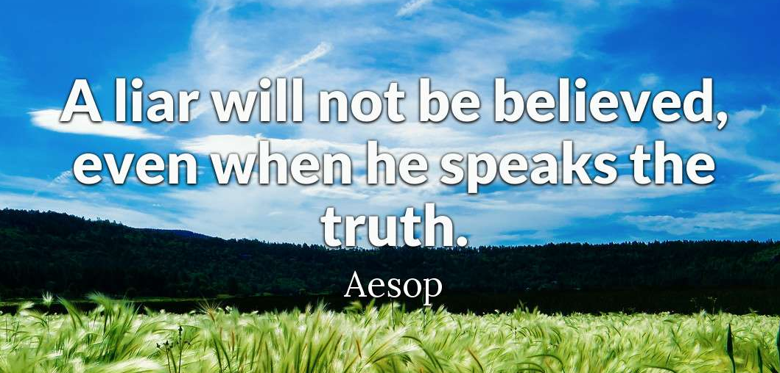

Slide 31
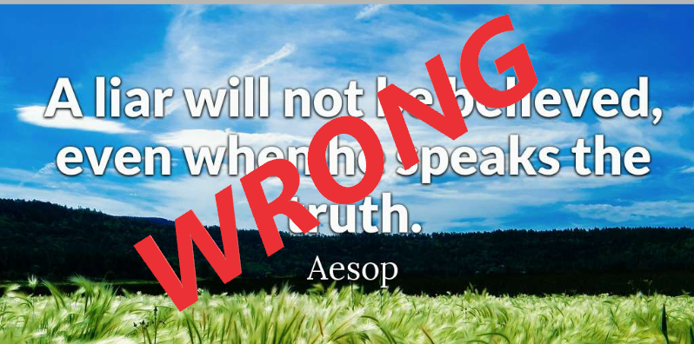

Slide 32
R v Beaudin, 2017 ONSC 1435
DV assault, confinement, B&E, threats etc.
Melissa Henry and Beaudin in relationship on and off for years
At time of trial she was 43 (kids in care, drug addictions, sex trade worker)
Melissa has criminal record
Testified at trial under sub and made clear she didn't want to be here
No good experiences with the court and made it clear that she didn’t want to be here (the trial)

Slide 33
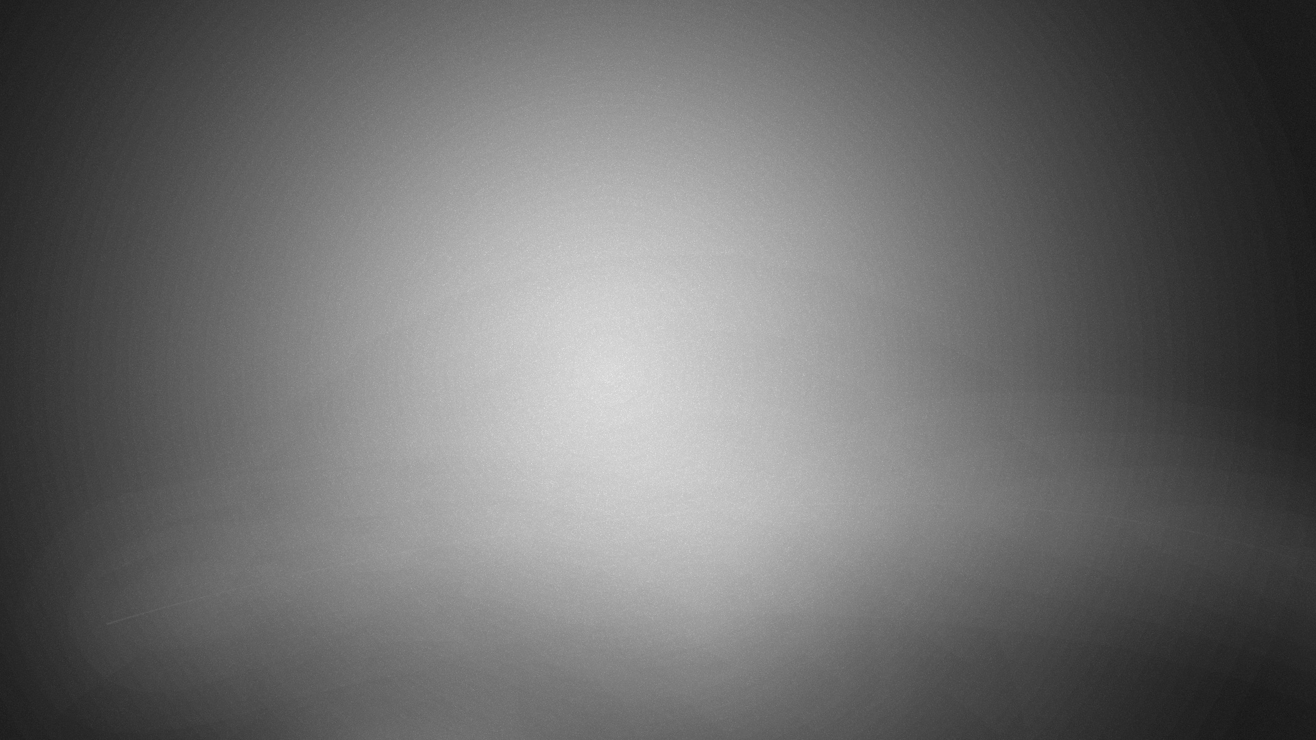
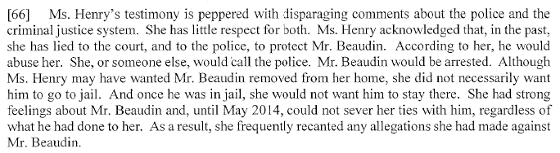
R v Beaudin, 2017 ONSC 1435

Slide 34
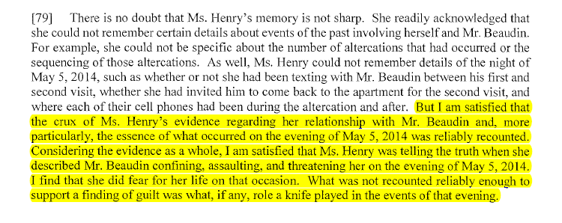
R v Beaudin, 2017 ONSC 1435

