Slide 1
MCM #149: 715.1 Evidence of a victim or witness under 18 Moreno & Tansey 5apr2023

Slide 2
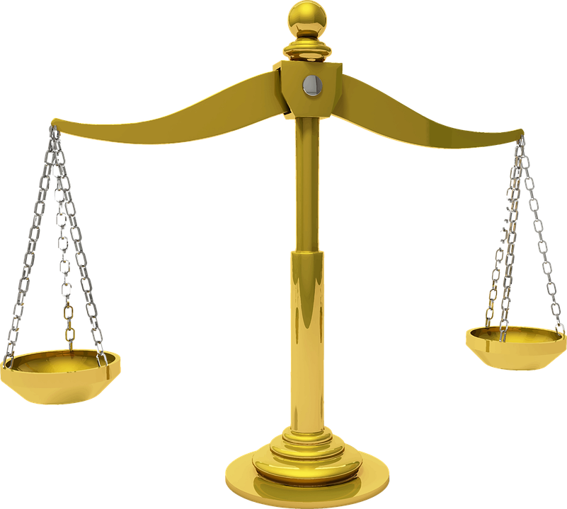
Overview
715.1: The Law
715.1: The Practice
CPD: this session is has 0 hours of professionalism and 1 hour of substantive content

Slide 3
715.1(1) Evidence of victim or witness under 18
In any proceeding against an accused in which a victim or other witness was under the age of eighteen years at the time the offence is alleged to have been committed, a video recording made within a reasonable time after the alleged offence, in which the victim or witness describes the acts complained of, is admissible in evidence if the victim or witness, while testifying, adopts the contents of the video recording, unless the presiding judge or justice is of the opinion that admission of the video recording in evidence would interfere with the proper administration of justice.

Slide 4
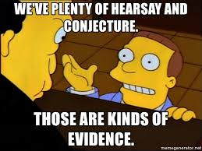
What is 715.1?
A statutory exception to the common law hearsay rule
Allows the victim or witness to adopt the prior video recorded statement as part of their “in chief” trial testimony
Allows the witness’s best recollection of events to form part of their trial testimony
Attempts to reduce the harm on a young person participating in the Court process

Slide 5
R. V. L (D.O.), [1993] 4 S.C.R. 419
Paragraph 1:
It is my view that s. 715.1 of the Criminal Code is a response to the dominance and power which adults, by virtue of their age, have over children. Accordingly, s. 715.1 is designed to accommodate the needs and to safeguard the interests of young victims of various forms of sexual abuse, irrespective of their sex. By allowing for the videotaping of evidence under certain express conditions, s. 715.1 not only makes participation in the criminal justice system less stressful and traumatic for child and adolescent complainants, but also aids in the preservation of evidence and the discovery of truth.

Slide 6
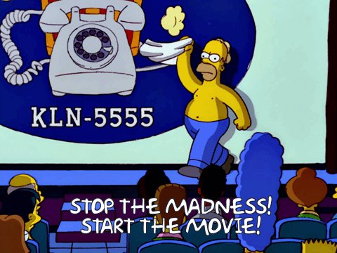
One of the main purposes of this provision is to ensure that the courts have access to the best description possible of the events, as a child is more likely to have an accurate and complete memory of the events when the videotape is made, than several months later at the time of trial. Children are also more likely to fully remember and relate often painful memories in a relatively relaxed interview than in the strange, stressful, and formal court environment.
RATIONALE:
R. v. F.(C.C.) [1997] 3 S.C.R. 1183 at para. 23

Slide 7
ELEMENTS OF 715.1

Slide 8
True or false: This section is only available for WITNESS who IS 18 at the time of testifying?

Slide 9
FALSE!

Slide 10
False! Age at the time of the offence
In any proceeding against an accused in which a victim or other witness was under the age of eighteen years at the time the offence is alleged to have been committed, a video recording made within a reasonable time after the alleged offence, in which the victim or witness describes the acts complained of, is admissible in evidence if the victim or witness, while testifying, adopts the contents of the video recording, unless the presiding judge or justice is of the opinion that admission of the video recording in evidence would interfere with the proper administration of justice.

Slide 11
NOT TO BE CONFUSED WITH 486.2
486.2 (1) Despite section 650, in any proceedings against an accused, the judge or justice shall, on application of the prosecutor in respect of a witness who is under the age of 18 years or who is able to communicate evidence but may have difficulty doing so by reason of a mental or physical disability, or on application of such a witness, order that the witness testify outside the court room or behind a screen or other device that would allow the witness not to see the accused, unless the judge or justice is of the opinion that the order would interfere with the proper administration of justice.

Slide 12
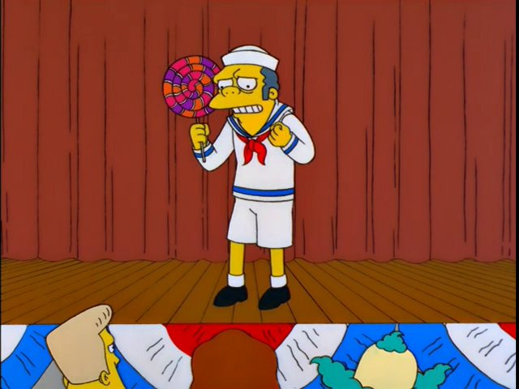
(1) Under the age of 18 at the time of the offence
In any proceeding against an accused in which a victim or other witness was under the age of eighteen years at the time the offence is alleged to have been committed, a video recording made within a reasonable time after the alleged offence, in which the victim or witness describes the acts complained of, is admissible in evidence if the victim or witness, while testifying, adopts the contents of the video recording, unless the presiding judge or justice is of the opinion that admission of the video recording in evidence would interfere with the proper administration of justice.

Slide 13
(1) Under the age of 18 at the time of the offence
Available to any witness under the age of 18 at the time of the offence
See: R. v. L (DO) [1993] 4 S.C.R. 419
I find that the inclusion of all children up to the age of 18 under the protections afforded by s. 715.1 of the Code is required by the continued need for such protection and is in conformity with international and domestic instruments. As such, it is in no way arbitrary and, accordingly, it was perfectly legitimate for Parliament to draw the line where it did. A claim of unconstitutionality of s. 715.1 on such a basis must be rejected.
BOTTOM LINE: The Code affords the same protection to a 17-year-old victim as it does to a 5-year-old victim

Slide 14
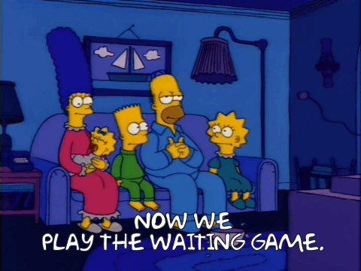
(2) Video taken “within a reasonable time after the alleged offence”
In any proceeding against an accused in which a victim or other witness was under the age of eighteen years at the time the offence is alleged to have been committed, a video recording made within a reasonable time after the alleged offence, in which the victim or witness describes the acts complained of, is admissible in evidence if the victim or witness, while testifying, adopts the contents of the video recording, unless the presiding judge or justice is of the opinion that admission of the video recording in evidence would interfere with the proper administration of justice.

Slide 15
(2) Video taken “within a reasonable time after the alleged offence”
Two main components :
Statement is video recorded
Timing of video recording in relation to when the offence allegedly occurred

Slide 16
(2) Video taken “within a reasonable time after the alleged offence”
“Within a reasonable time”
Time between the making of the video and the alleged offence
Not between time of disclosure and making of the video
R. v. T. (D.), 2017 ONSC 1953 at para 7
Long period of abuse, relevant time is the date of the last incident
R. v. Archer (2005), [2005] O.J. No. 434(C.A.) at paras 72-76
How do we determine what is a reasonable time?
Number of factors but the two most important are:
Reasons for the delay
Impact of the delay on ability to recall the events
R. v. S. (P.) (2000), 144 C.C.C. (3d) 120 (C.A.) at para 71

Slide 17
(2) Video taken “within a reasonable time after the alleged offence”
True or false?
You cannot rely on this section if the delay is more than 2 years?

Slide 18
(2) Video taken “within a reasonable time after the alleged offence”
FALSE!
Argument that delay longer than two years is unreasonable was based on an inaccurate reading of S.(P.)
Since then, ONCA has made it clear that:
the “reasonable time” analysis is not a matter of counting days or years
The analysis is contextual, case-specific
Delayed disclosure is common for offences against children and should be dispositive of the admissibility inquiry
The key features are the reasons for the delay and the impact the delay has on the child’s ability to accurately recall events
R. v. P.S., 2019 ONCA 637 paras 19-22

Slide 19
(2) Video taken “within a reasonable time after the alleged offence”
Some examples
R. v. P.S., 2019 ONCA 637—3 Years and 4 months held to be reasonable
R. v. Trottier, 2022 CarswellOnt 5709 (CJ) Justice Brunet—6-year delay
R. v. Dennstedt, OCJ (Unreported)—approximately 6-year delay
Bottomline: Cases decided prior to P.S. that suggest delay beyond 2 years is “unreasonable” should be treated with caution

Slide 20
(3) the witness describes the acts complained of
In any proceeding against an accused in which a victim or other witness was under the age of eighteen years at the time the offence is alleged to have been committed, a video recording made within a reasonable time after the alleged offence, in which the victim or witness describes the acts complained of, is admissible in evidence if the victim or witness, while testifying, adopts the contents of the video recording, unless the presiding judge or justice is of the opinion that admission of the video recording in evidence would interfere with the proper administration of justice.

Slide 21
(3) the witness describes the acts complained of
“Acts complained of” includes more than the bare physical acts constituting the assault→ their version of events underlying the charge before the court
R. v. J.A.T., 2013 ONSC 5787 at para 6
HOWEVER:
Otherwise inadmissible evidence may need to be edited out, for example:
Other sexual assaults without a similar fact application
R. v. A. (J.F.), [1993] O.J. No. 1494 (C.A.) at para 24
Other hearsay statements or inadmissible bad character evidence
R. v. Toten, [1993] O.J. No. 1495 (C.A.) at para 56

Slide 22
(4) while testifying, adopts the contents of the video recording
In any proceeding against an accused in which a victim or other witness was under the age of eighteen years at the time the offence is alleged to have been committed, a video recording made within a reasonable time after the alleged offence, in which the victim or witness describes the acts complained of, is admissible in evidence if the victim or witness, while testifying, adopts the contents of the video recording, unless the presiding judge or justice is of the opinion that admission of the video recording in evidence would interfere with the proper administration of justice.

Slide 23
(4) while testifying, adopts the contents of the video recording
Adoption is not an overly stringent test, it occurs where:
The witness recalls giving the statement
They were attempting to be truthful when they gave the statement
R. v. K.S., 2017 ONCA 307 at para 13

Slide 24
(4) while testifying, adopts the contents of the video recording
WHAT IF THERE ARE MATERIAL INCONSISTENCIES?!?!?
Once a statement is adopted it becomes part of the evidence
Any questions about veracity or reliability go to the weight of the statement
If cross-examination elicits contradictions it does not render the statement inadmissible
R. v. F. (C.), [1997] 3 S.C.R. 1183 at para 45-47

Slide 25
(5) admission of the statement would interfere with the proper administration of justice.
In any proceeding against an accused in which a victim or other witness was under the age of eighteen years at the time the offence is alleged to have been committed, a video recording made within a reasonable time after the alleged offence, in which the victim or witness describes the acts complained of, is admissible in evidence if the victim or witness, while testifying, adopts the contents of the video recording, unless the presiding judge or justice is of the opinion that admission of the video recording in evidence would interfere with the proper administration of justice.

Slide 26
(5) admission of the statement would interfere with the proper administration of justice.
Balancing the probative value versus prejudicial effect of admitting the statement
TJ may only exclude where admission would operate unfairly to the accused, and these cases will be “relatively rare”
R. v. F. (C.), [1997] 3 S.C.R. 1183 at para 51

Slide 27
(5) admission of the statement would interfere with the proper administration of justice.
Factors from R. v. F. (C.):
(a) The form of questions used by any other person appearing in the videotaped statement;
(b) any interest of anyone participating in the making of the statement;
(c) the quality of the video and audio reproduction;
(d) the presence or absence of inadmissible evidence in the statement;
(e) the ability to eliminate inappropriate material by editing the tape;
(f) whether other out‑of‑court statements by the complainant have been entered;
(g) whether any visual information in the statement might tend to prejudice the accused (for example, unrelated injuries visible on the victim);
(h) whether the prosecution has been allowed to use any other method to facilitate the giving of evidence by the complainant;
(i) whether the trial is one by judge alone or by a jury; and
(j) the amount of time which has passed since the making of the tape and the present ability of the witness to effectively relate to the events described.

Slide 28
Weight or admissibility?
Issues that go to weight:
Inconsistencies between video statement and cross
R. v. F.(C.C.), [1997] 3 S.C.R. 1183 at paras. 48-49
Unrecorded interactions with the police
R. v. F.(C.C.), [1997] 3 S.C.R. 1183 at paras 53
Leading questions
R. v. F.(C.C.), [1997] 3 S.C.R. 1183 at paras 53

Slide 29
Procedure
How to 715.1

Slide 30
True or False?
You must enter into a voir dire to determine the admissibility of a statement pursuant to s715.1

Slide 31
True
54 Wherever evidence is tendered for admission under s. 715.1 of the Code, a formal voir dire must be held to determine whether the requirements of the section are met and to ensure that the videotape conforms with the rules of evidence. R v CCF, [1997] SCJ No 89 (SCC) @54

Slide 32
True or False
A 715.1 voir dire shares the same discovery function as a preliminary inquiry

Slide 33
False
s. 715.1(1) application does not share the same discovery function as a preliminary inquiry. Determining any details about a complainant's counselling that took place after the video-recorded statement was created would be immaterial and irrelevant to the question of whether the s. 715.1(1) test has been met: R v PS, 2019 ONCA 637 @42

Slide 34
Tangent: Discovery & Prelims
A preliminary inquiry is NOT designed to constitute a discovery hearing. The discovery function of the preliminary inquiry is ancillary. This is “incidental to the central mandate of the preliminary inquiry as clearly prescribed by the Criminal Code; that is, the determination of whether ‘there is sufficient evidence to put the accused on trial.”: R v Hynes, 2001 SCC 82 @31
Moreover, “the incidental function of the preliminary inquiry as discovery mechanism has lost much of its relevance: R v SJL, 2009 SCC 14 @23

Slide 35
File an Application?
OCJ Rules: no mention of 715.1
SCJ Rules: no mention of 715.1 BUT it is on SCJ pre-trial conference report
Criminal Code: no mention of an application

Slide 36
Application Not Required But
Best practice
Raise it at JPT
Confirm position by email following JPT

Slide 37
Don’t just hit play
Once the trial judge rules that the statement has been adopted, the video becomes the evidence of the events described as if the child were giving the statements on the videotape in open court (L. (D.O.), supra, at p. 458). An adopted videotaped statement should, together with the viva voce evidence given at trial, comprise the whole of the evidence-in-chief of the complainant: R v CCF, [1997] SCJ No 89 (SCC) @45

Slide 38
715.1 as a pre-trial motion?
Only if the issue is something other than adoption
Adoption is the key to admissibility and that can only come from the complainant.

Slide 39
If Jury trial
Remind your judge that an instruction (mid-trial and/or) may be appropriate

Slide 40
The end!

