Slide 1
Wasn’t me! Presented by MGM and the Champ
Identification Evidence 101
MCM #144
Sonia Beauchamp and Matthew Geigen-Miller
January 11, 2023

Slide 2
The Champ’s Slides

Slide 3
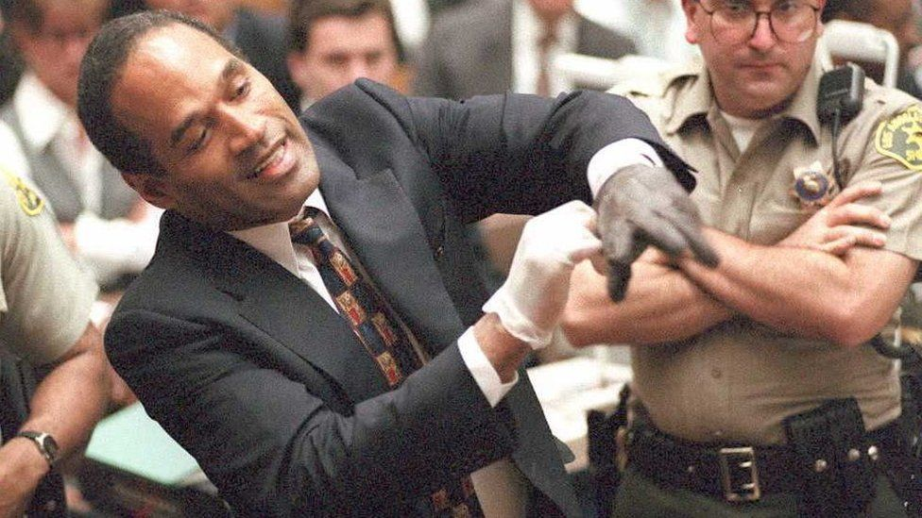
ID can be all or nothing – your trial may go down in flames.

Slide 4
What’s important in ID evidence
Opportunity to observe the accused
During/contemporaneous to offence
Any familiarity with the accused
Ability to ID that person out of court (by physical description or photo lineup)
Communicate the ID by identifying the person in court

Slide 5
Danger of ID ev: Inherent frailties
ID evidence = inherently unreliable & difficult to assess
“[…]deceptively reliable because it comes from credible and convincing witnesses and is difficult to discredit on cross-examination for those same reasons”
Issue is usually the reliability of the evidence, rather than witness’s credibility. R. v. Jack, 2013 ONCA 80 at para. 14.; R. v. Olliffe, 2015 ONCA 242 at para. 37
Studies show that triers of fact place undue reliance on ID evidence vs other types of evidence.
Witness’s confidence in the correctness of the identification does not increase the accuracy of the identification
Danger heightened when person identified is a stranger to the witness & opportunity to observe is limited
“Many wrongful convictions result from faulty, albeit convincing, eyewitness testimony, even in cases where multiple witnesses identify the same person.”
R v M.B., 2017 ONCA 653, para 61
Notes:
Dangers of ID evidence: R v MB, 2017 ONCA 653 at para 61
confidence vs accuracy of ID evidence : R v Hibbert 2022 SCC 39 at para 5
Heightened danger: R. v. Miaponoose (1996), 110 C.C.C. (3d) 445 (Ont. C.A.) at pp. 450-451; R. v. Pelletier, 2012 ONCA 566 at para. 90, R. v. Olliffe, 2015 ONCA 242 at para. 36; R. v. Mills, 2019 ONCA 940 at para. 186; R. v. Huerta, 2020 ONCA 59 at para. 34.

Slide 6
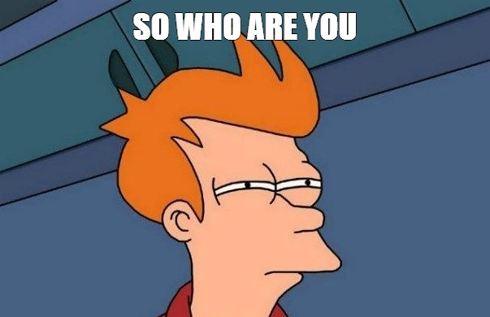
How to address these
Trier of fact must exercise special caution when dealing with ID
R. v. Hersi (2000), 137 O.A.C. 60, at para. 14.
Jury instruction
Other confirmatory evidence
R. v. Quercia (1990), 60 C.C.C. (3d) 380 (Ont. C.A.).
BUT, ID can still be proven BRD, even with a single eyewitness.
R. v. Hay, 2013 SCC 61 at para. 40

Slide 7
Factors that should be considered to assess ID evidence
Time between the identification and the events described
Witness identifying someone they know or stranger
Physical circumstances of the sighting (distance, sight lines, clear/unobstructed view)
Duration of the observation (fleeting glance vs observation over longer period of time)
Emotional state of the witness at the time of the sighting
Quality of the description (detailed vs a generic listing of characteristics)
Competing or inconsistent descriptions between witnesses
Whether witness exposed to other images of the person being identified
Type of pre-trial identification process witness participated in
Possibility of identification influenced by other witnesses
Description of the person vs their actual appearance at the time of offence
Cross-racial identification
Other reliable circumstantial evidence capable of confirming or supporting the identification evidence
R. v. Powell (2007), 215 C.C.C. (3d) 274 (Ont. C.A.) at para. 15

Slide 8
DNA

Slide 9
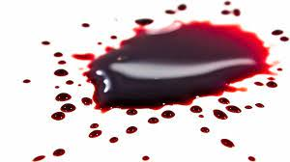
DNA
DNA warrant s.487.05: to seize bodily substance for purpose of forensic DNA analysis
To prove ID, you will receive and have to tender two CFS reports:
CFS Report #1
Sufficient DNA for testing
Profile was obtained from DNA
DNA sample from Accused
CFS Report #2
Comparing Profile from report #1 to Accused’s DNA

Slide 10
DNA databank hit
Hit cannot be used to prove ID in court.
DNA Identification Act, SC 1998, C.37 prohibition
DNA hit would be evidence of Prior Discreditable Conduct – A’s presence in DNA databank is evidence of prior conviction (R v Dehart, [2015] OJ No 1899 (Ct. J.))
We will need a sample of A’s DNA to substitute the comparison sample.

Slide 11
DNA databank hit
First, seek consent sample
Crown or police can communicate with defence counsel to canvass. Set firm time limit for response to avoid delay.
Police will arrange for DNA sample to be taken
+: faster
-: defence may challenge if consent not properly informed (ie beware consent DNA sample if A not represented)
If no consent sample -> police will need to get warrant
The databank hit can be used as grounds to obtained DNA warrant
ITO will also include that consent sample was canvassed

Slide 12
CFS has a DNA profile, no hit on databank
Methods to obtain DNA sample
Consent sample
Discard or abandoned sample
Police can’t seize A’s bodily substance when detained or search incident to arrest – R v Stillman, [1997] 1 SCR 607
Discarded glass in restaurant = abandoned R v Usereau, 2010 JQ No 4050 (C.A.)
A not detained when discarded tissue at police station while picking up items police had seized R v Chukwu, 2016 ABCA 146
Search warrant

Slide 13
Proving ID through V’s DNA on A
Police can take skin swabs from A during search incident to arrest if grounds to believe V’s DNA on A’s skin.
Penile swabs to locate V’s DNA – R v Saeed, [2016] 1 SCR 518
*But remember, if A’s DNA is also found on this swab, it CANNOT be used to compare to the crime scene samples (b/c he was detained). Will need a DNA warrant.

Slide 14
Tips on dealing with DNA and CFS
Timing
CFS delayed testing/backlog (watch how close your trial date is)
Push for CFS testing
Submit other samples
Conducting other or further testing
Talk to your expert!!!! They will often give you golden nuggets.
Have someone present and must disclose
REMEMBER TO CALL ALL OF THE EVIDENCE LEADING UP TO THE CFS REPORTS
Witness who collected the evidence and everyone thereafter
OR SEEK ADMISSION OF CONTINUITY OF SAMPLES ONCE SEIZED BY POLICE
Expert notice, disclose reports, virtual testimony
Disclosing CFS file

Slide 15
Nikolovski

Slide 16
R v Nikolovski – [1996] SCJ No 122
Trier of fact can use a surveillance video as the sole basis for identifying the accused.
Weight of that evidence will depend on quality of video
Another, although lesser factor, is how long A is depicted on video
But this can be outweighed by a few frames which clearly show A and/or trier reviewing the video several times, stopping it to study pertinent frames
Notes:
This was a convenience store robbery. The victim picked out the accused in a photo line-up, but also tentatively identified a second person. He testified that the person in the video was the robbery, but was not able to point out the accused in court.
Trial Judge: “ I looked at that video, and I looked at it very carefully, and I can honestly tell you there is no doubt in my mind that the man who committed that robbery on that video was your client.”

Slide 17
Recognition Evidence

Slide 18
Recognition Evidence
Recognition evidence is a subset of eyewitness identification evidence, where the eyewitness’ identification is based on prior acquaintance. R. v. Thind, 2018 ONSC 1607, at para. 91.
Degree of level of familiarity with the accused may enhance the reliability of an eyewitness’ identification. R. v. Olliffe, 2015 ONCA 242 at para. 38; R. v. Benson, 2015 ONCA 827 at para 25; R. v. Spatola (1970), 4 C.C.C. 241 at para. 22.
Time to observe, circumstances of the observation, and conflicting evidence constitute are still factors/frailties. R. v. Chafe, 2019 ONCA 113 at para. 30
TIP: Ascertain W’s familiarity and extent of relationship prior to trial! Prep. Trial resources are precious.

Slide 19
Berhe Identification [2012] OJ No 5029 (C.A.) See also R v Leaney [1989] 2 SCR 393
When someone other than the trier, and who wasn’t present during offence, will ID A based on surveillance video
Ex: Civilian responding to a press release/CP24
But more often, is from officers who have interacted with A before.
When would you want to do this?
As confirmatory evidence , to supplement other ID evidence (which can include other Berhe witnesses)
If the quality of your video isn’t great ie to supplement Nikolovski type evidence (and so ability of trier per Nikolovski to ID could be diminished/evidence given less weight)
When it’s the only ID evidence you’ve got
Notes:
Aka Leaney
A exposed penis to a family in subway. Chased but got away. Dad couldn’t ID in lineup. Mom wasn’t shown lineup. Both in-docked. Transit officer testified he could ID from the video b/c was familiar w/ A due to prior dealings. No voir dire held re: admissibility of this ev. At sentencing, it came out that the “previous dealings” were one brief incident 2 years earlier.

Slide 20
Berhe Identification [2012] OJ No 5029 (C.A.)
How do you enter this evidence
Voir dire must be conducted
Test: prior acquaintance/better position test
Witness has a prior acquaintance with the accused and is thus in a better position than the trier of fact to ID the perpetrator (para 14)
Witness does not need to be able to identify a unique feature or idiosyncrasy of the person
Factors: duration of prior relationship, time between prior contact and offence, circumstances of prior relationship (ie did they have opportunity to engage with A up close)
Fleeting interactions, if memorable, may be enough (i.e. the interaction having a notable feature for the witness)
Prior relationship does not require inter-personal history (ie officers who have spent hours looking at photos of A or surveillance of A)
Length of trial may provide trier with more familiarity/better position than the witness (***recent flavour)
Low threshold + bal of prob
**As for ultimate reliability of this evidence, careful tainting of witness -> where officer was aware person X was arrested for the offence and then they are asked to look at the video to ID

Slide 21
Berhe tips
Get officer’s notes of prior interactions and disclose them
Consider calling more than one Berhe witness
Prior discreditable conduct will often be intertwined because of the reasons for prior interaction with police. Lead only what you need so as to not tip probative vs prejudicial effect.

Slide 22
In-Dock ID

Slide 23
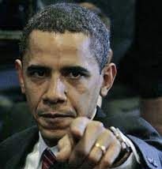
In-dock identification – DO IT!
AKA in-court identification of accused
On it’s own, has little to no value.
R. v. Hibbert, 2002 SCC 39 at para. 50; R. v. Jack, 2013 ONCA 80 at para. 17; R. v. Bailey, 2016 ONCA 516 at para. 48; R. v. Clark, 2022 SKCA 36 at para. 117 per Leurer J.A. in dissent, aff’d 2022 SCC 49.
Value comes from entirety of the identification evidence, including prior identification, descriptions given.
It is a chain that builds a bridge to pointing to the accused. Literally and figuratively.

Slide 24
In-dock id
ID evidence

Slide 25
In-dock
CCTV logistics
Through courtroom window
Inside courtroom
Panning the camera
Timing: advantages/disadvantages of doing it at end of in-chief
ADMISSIONS on ID
Wording
At a minimum: That Mr. Doe is the person before the court.

Slide 26
MGM’s Slides

Slide 27
Fingerprints
Fingerprinting of accused persons is authorized under the Identification of Criminals Act, RSC 1985, c I-1
Section 2 of the Act authorizes police to fingerprint and photograph persons charged with an indictable or hybrid offence
A person who is held for show cause will be fingerprinted while in custody at the police station. A person who released on an appearance notice or PTA is compelled to attend the police station to be fingerprinted and photographed on a specified date.

Slide 28
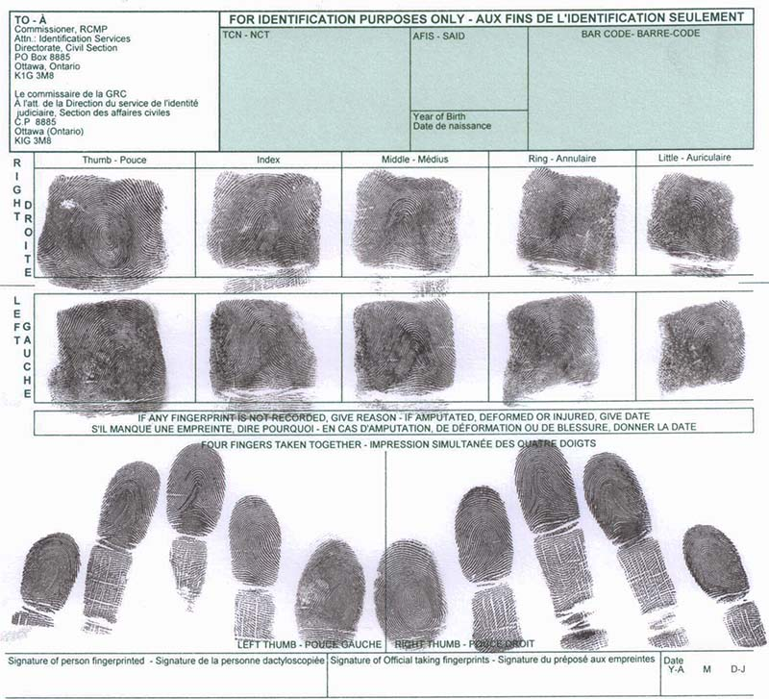
Depending on the police service, the fingerprints may be taken by an electronic scan or traditional ink-on-paper, using Form C216

Slide 29
Automated Fingerprint Identification System (AFIS) Match
AFIS
CHARGED PERSON
CRIME SCENE
SPECIAL CONSTABLE
at police station
IDENT OFFICER
Who processes scene and/or exhibits

Slide 30
Trial Evidence
EXPERT
SPECIAL CONSTABLE
Took fingerprints of charged person
IDENT OFFICER
Lifted fingerprints from exhibit or crime scene

Slide 31
Case management and trial considerations
Request a fingerprint expert report. This will usually be done by the IDENT officer who processed the scene/exhibit.
Give expert notice in accordance with s. 657.3 of the Criminal Code
Carefully prepare your expert witness. Many IDENT officers have never given expert evidence on a fingerprint match.
E-Library has a check-list for questioning the fingerprint expert
Always consider the significance of the fingerprint evidence. A fingerprint match is circumstantial evidence. It may play a large or small role in your case. For example, it may corroborate a witness, identify the accused, or rule out a person.
A fingerprint that cannot logically be connected to the crime has no probative value and does not support an identification: R. v. Mars, 2006 CanLII 2460 (ON CA) at paras 21-24

Slide 32
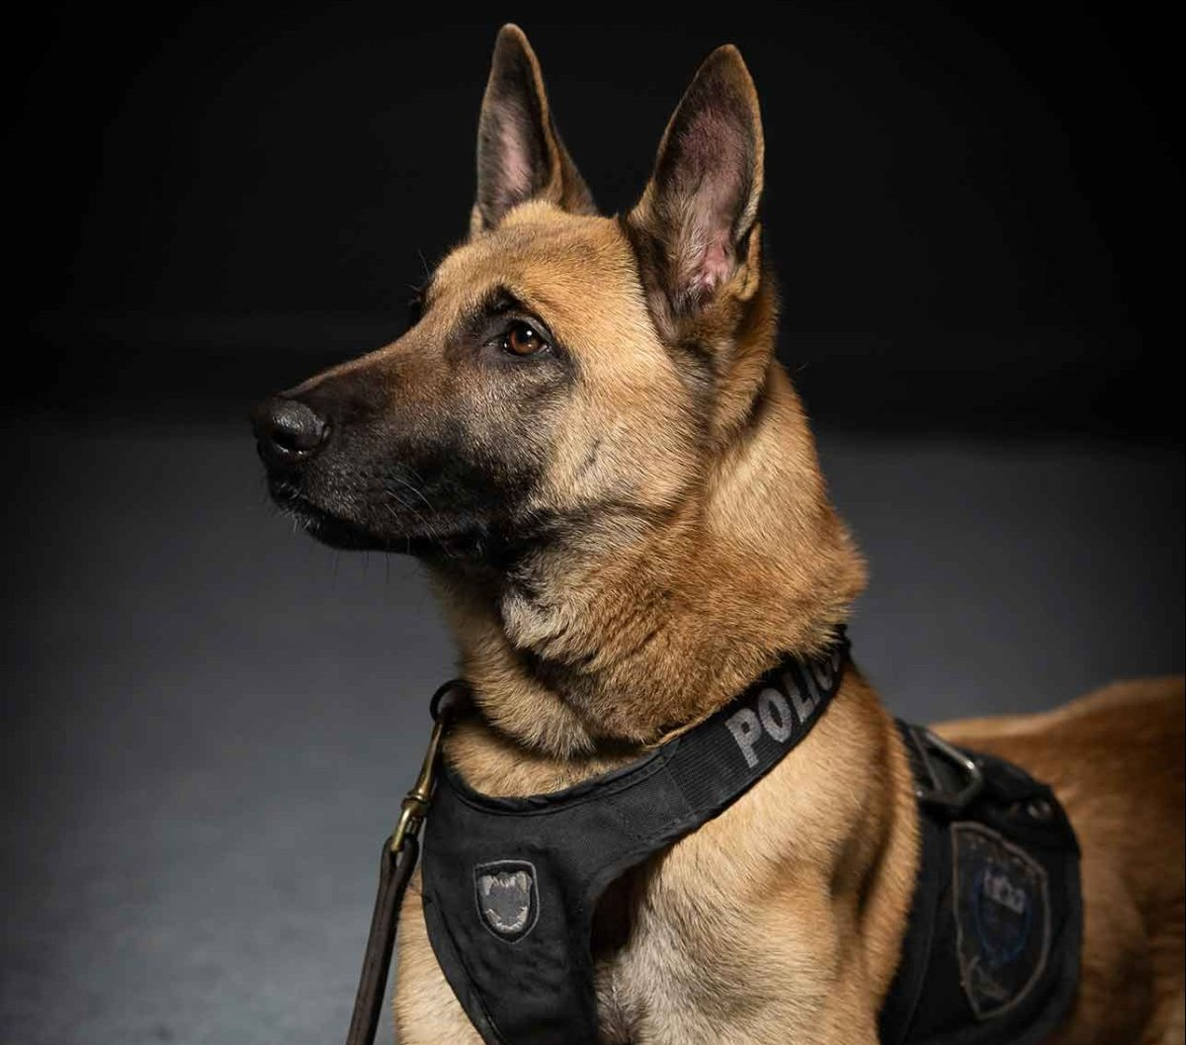
Tracker dog

Slide 33
Case management and trial considerations
Tracker dog evidence is admissible as identification evidence
In some circumstances, the absence of a track will be admissible (Klymchuk)
Tracker dog evidence is expert evidence
Obtain the handler’s statement of qualifications and give expert notice in accordance with s. 657.3 of the Criminal Code
In jury trials an instruction is required because the dog cannot be cross-examined (Klymchuk, Holmes)
These authorities are a useful starting point:
R. v. Klymchuk, [2000] OJ No 4435 (SCJ)
R. v. Holmes, [2002] OJ No 4178, 2002 CanLII 45114 (ON CA)
R. v. Menezes, [2011] OJ No 3528 (CA)

Slide 34
ID by continuity
This is not a formally recognized category of identification evidence but it is a very common means of proving ID
Generally, it takes the following form:
CIVILIAN WITNESS | POLICE OFFICER
I witnessed the offence. I was on scene when the police arrived and arrested a person. The person who I saw being arrested by the police is the person who committed the crime. | I arrested a person. I identified the person by driver’s license. That person is in court today (DOCK ID).

Slide 35
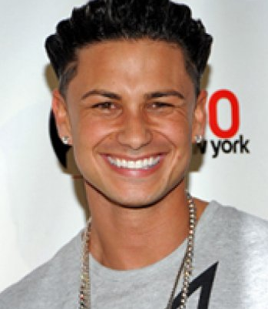
Case management and trial considerations
Ensure there are no missing links! Subpoena every witness in the chain
Where possible adduce descriptions from the eye witness(es)
Ensure the arresting officer is prepared to ID the accused
File exhibits that support identification
EXHIBIT 14
INTERNET PHOTO OF “PAULIE D”

Slide 36
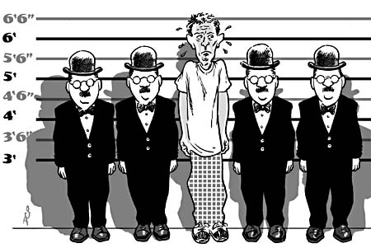
Photo Lineup

Slide 37
What is involved?
An officer creates a photo array using IntelliBook. The array consists in 1 photograph of the suspect and 11 filler photos.
A different officer administers the photo line-up. This officer will not know which photo is the suspect photo.
The photo line-up is administered on video.
The documents that result from this process are:
A set of instructions signed by the witness and the administering officer
The photos, which are numbered, signed, and dated by the witness

Slide 38
Legal context
Canadian police services create and administer photo line-ups in accordance with the recommendations of The Inquiry Regarding Thomas Sophonow. They are contained in the notes page below
You should become familiar with these recommendations before screening or prosecuting a photo line-up case
One of the recommendations is almost never followed:
“The photos should resemble as closely as possible the eyewitnesses' description. If that is not possible, the photos should be as close as possible to the suspect.”
This above recommendation assumes a photo line-up that is designed and used to identify a suspect. Police services rarely, if ever, use photo line-ups for this purpose. Photo line-ups are now exclusively used to identify a known suspect. For this reason, the filler photos must resemble the suspect photo, not the descriptions of the witnesses.
Notes:
The Inquiry Regarding Thomas Sophonow
Photo pack line-up
The photo pack should contain at least 10 subjects.
The photos should resemble as closely as possible the eyewitnesses' description. If that is not possible, the photos should be as close as possible to the suspect.
Everything should be recorded on video or audiotape from the time that the officer meets the witness, before the photographs are shown through until the completion of the interview. Once again, it is essential that an officer who does not know who the suspect is and who is not involved in the investigation conducts the photo pack line-up.
Before the showing of the photo pack, the officer conducting the line-up should confirm that he does not know who the suspect is or whether his photo is contained in the line-up. In addition, before showing the photo pack to a witness, the officer should advise the witness that it is just as important to clear the innocent as it is to identify the suspect. The photo pack should be presented by the officer to each witness separately.
The photo pack must be presented sequentially and not as a package.
In addition to the videotape, if possible, or, as a minimum alternative, the audiotape, there should be a form provided for setting out in writing and for signature the comments of both the officer conducting the line-up and the witness. All comments of each witness must be noted and recorded verbatim and signed by the witness.
Police officers should not speak to eyewitnesses after the line-ups regarding their identification or their inability to identify anyone. This can only cast suspicion on any identification made and raise concerns that it was reinforced.
It was suggested that, because of the importance of eyewitness evidence and the high risk of contaminating it, a police force other than the one conducting the investigation of the crime should conduct the interviews and the line-ups with the eyewitnesses. Ideal as that procedure might be, I think that it would unduly complicate the investigation, add to its cost and increase the time required. At some point, there must be reasonable degree of trust placed in the police. The interviews of eyewitnesses and the line-up may be conducted by the same force as that investigating the crime, provided that the officers dealing with the eyewitnesses are not involved in the investigation of the crime and do not know the suspect or whether his photo forms part of the line-up. If this were done and the other recommendations complied with, that would provide adequate protection of the process.

Slide 39
Case management considerations
Photo line-ups are used in a variety of cases. Sometimes the victim or eye witness to a crime is identifying a stranger. In other cases, the photo line-up is used to confirm the identity of a person known to the witness.
In the case of a stranger identification, the value of a photo line-up diminishes rapidly after the crime. Usually there is no point in submitting a screening request for a photo line-up months after the crime.
Ensure that you have the officer who generated the photo array and the officer who administered the photo line-up on video
Obtain an admission that the suspect photo is a photograph of the accused. Without that admission, you must call the officer who took the photo to identify the accused as the person in the photo.

Slide 40
Trial considerations – Police
In many cases it will not be necessary to call the officer who generated the photo array. If it is admitted that the suspect photo depicts the accused, this will usually not be necessary.
However, if this officer needs to testify you should prepare them carefully. Review the Sophonow Inquiry recommendations, the OPS Photo Line-Up policy, and prepare them on the issues that are likely to arise.
The officer who administered the photo line-up usually does not need to testify. This may be necessary if the witness recants or if there is some irregularity that needs to be explained.

Slide 41
Trial considerations – The eye witness
Do not re-administer the photo line-up! Not in your prep meeting, and not on the witness stand.
Adduce all evidence of the identification process. That includes descriptions given to police or in statements, the video of the photo line-up, the instructions, and the photos themselves.
Adduce all evidence relevant to the witness’s ability to identify the suspect: Any prior relationship, ability to observe (lighting, distance, duration), etc.
Play the video of the photo line-up in court, show the witness the photos, confirm that Photo #X is the photo they selected, and then ask the witness to Dock-ID the accused (if they can)
In a jury trial an instruction is required regarding the use of photo line-up evidence

Slide 42
The end

