Slide 1
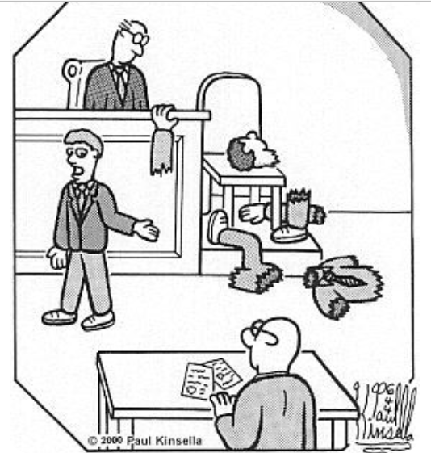
MCM #142: CROSS
Cavanagh & Tansey
23nov2022

Slide 2
What’s the Point?
The purpose of cross-examination is not just to ask random questions or have a witness repeat what they said in direct examination.
Cross is "beyond any doubt the greatest legal engine ever invented for the discovery of truth"
Three purposes are generally attributed to cross-examination:
to weaken, qualify or destroy the opponent's case;
to support the party's own case through the testimony of the opponent's witnesses;
to discredit the witness.
“Cross-examination may often be futile and sometimes prove fatal, but it remains nonetheless a faithful friend in the pursuit of justice and an indispensable ally in the search for truth. At times, there will be no other way to expose falsehoods, to rectify error, to correct distortion or to elicit vital information that would otherwise remain forever concealed.” Lyttle, 2004 SCC 5 @1
“Crown counsel is entitled, indeed, in some cases expected, to conduct a vigorous cross‑examination of an accused. Effective cross‑examination of an accused serves the truth‑finding function as much as does effective cross‑examination of a complainant.” AJR, 1994 OJ No 2309 (CA) @22
Notes:
R v Borden, 2017 NSCA 45

Slide 3
He said/she said cross: That Sinking Feeling
We are about to be on the spot.
Without a safety net.
Stress and pressure elevate.
This Photo by Unknown Author is licensed under CC BY

Slide 5
Unrealistic Expectations
Cross-examination is a battle of wits producing tension, cleverness, suspense and humor and requires the spontaneous formulation of strategy. The cross-examiner must be perceptive while exercising ingenuity and logical thought and must intuitively read the mind of the witness while judging motives. Quickness of mind, control of one’s self, control of the witness and thinking on one’s feet, is demanded in the face of the unexpected. The cross-examiner must be able to make an instant analysis and formulate a method of attack while asking questions.

Slide 6
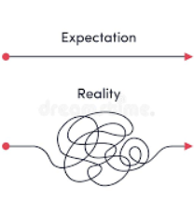
EXPECTATIONS
A thousand cuts
But really… one will do
R v JJRD, [2006] OJ 4749 (CA)
An outright rejection of an accused's evidence based on a considered and reasoned acceptance beyond a reasonable doubt of the truth of conflicting credible evidence is as much an explanation for the rejection of an accused's evidence as is a rejection based on a problem identified with the way the accused testified or the substance of the accused's evidence.

Slide 7
FORTUNE FAVORS
This Photo by Unknown Author is licensed under CC BY-NC

Slide 8
There is
no substitute
for prep

Slide 9
Cross-examination: 3 rules
Always leading questions
One fact per new question
A logical, baby step progression, from basic facts to a coherent conclusion

Slide 10
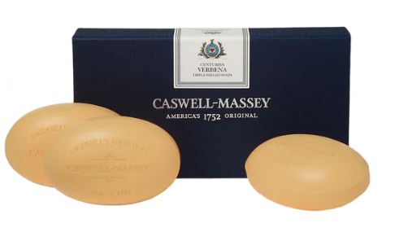
Cross-examination 3 rules: practice
You can practice the three rules anywhere.
For example, in the shower.
You are small.
You are oval.
You are a bar of soap.
You are a small, oval, bar of soap.

Slide 11
Cross-examination: 3 rules: practice
You went out
To a bar
With friends
We talked before you went out
You told me you would be home at 8 or 9
You got home at 10
You stayed drinking with your friends between 8 and 10
Despite your promise
Your friends matter more than I do
This Photo by Unknown Author is licensed under CC BY

Slide 12
Benefits of short sequences of short questions
Judge/Jury can follow
Witness can follow – witness cannot claim does not understand
Defence cannot object to questions as being confusing or compound
Defence cannot object regarding relevance
It is immediately apparent if the accused becomes being evasive
Maximize impact
Maximize control
This Photo by Unknown Author is licensed under CC BY-SA

Slide 13
Benefits from Short Sequences of Short Questions with Accused
The Crown can confront the accused for being evasive:
Do you remember my question?
What was my question?
That’s a simple question?
You understood that question?
Will you answer that question?

Slide 14
There is no substitute for practice
Best place to hone cross may be in bail court:
Surety cross re: knowledge/ or lack thereof of accused criminal activity
Accused cross re: previous breaches on record
Second best place may be Partner/Sexual Assault Trials
Be brave: cross
It doesn’t matter if the JP is already filling out the JIRO
This Photo by Unknown Author is licensed under CC BY-NC-ND

Slide 15
Modular Sequence Example – Surety Cross #1
You knew nothing about the CR, so you agree he was able to keep important parts of his life hidden from you
You didn’t know of accused CR
Learned of it today
Had not heard accused had been arrested many times
Did not know accused had been to jail (repeatedly)
Arrests are significant events
Jail time is significant
There are lots of important parts of his life you didn’t know about
Accused was able to keep important parts of his life hidden from
Very significant parts of his life
For as long as you’ve known him
You agree you don’t know the accused as well as you thought

Slide 16
Modular Sequence Example – Surety Cross #2
You have tried in the past to convince the accused to stay out of trouble but he keeps getting in trouble
You were upset/worried when accused was charged in past
You spoke to the accused
Sat down with him
Told him you were worried
Told him it hurt you (if parent)
Told him he was going to ruin his life if he didn’t change
That he would end up back in jail
Said everything you could think of to help him change….

Slide 17
Modular Sequence Example – Surety Cross #2 continued
Did everything you could think of to help change him
Said everything you could think of
He listened to you
He told you he would change
He looked you in the eye when he promised to change
BUT here he is charged again
Despite doing everything you could think of
Saying everything you could think of
You had no influence on him

Slide 18
He said/she said cross: That Sinking Feeling
We are about to be on the spot.
Without a safety net.
Stress and pressure elevate.
This Photo by Unknown Author is licensed under CC BY

Slide 19
He said/she said cross: That Sinking Feeling
Antidotes:
Short sequences/ability to make an evasive accused pay.
R v JJRD [2006] OJ 4749 (CA): death by 1000 cuts, not knockout blows.
The trial judge rejected totally the appellant's denial because stacked beside A.D.’s evidence and the evidence concerning the diary, the appellant's evidence, despite the absence of any obvious flaws in it, did not leave the trial judge with a reasonable doubt. An outright rejection of an accused's evidence based on a considered and reasoned acceptance beyond a reasonable doubt of the truth of conflicting credible evidence is as much an explanation for the rejection of an accused's evidence as is a rejection based on a `problem identified with the way the accused testified or the substance of the accused’s evidence.
3. Brevity – Irving Younger: The 10 Commandments of Cross
This Photo by Unknown Author is licensed under CC BY-SA-NC

Slide 20
He said/she said: fruitful v. toxic
Diagram out areas – then write out sequences.
No motive to falsely accuse
Choices
Refuse to admit the obvious.
Anger/Flight/Injuries/Damage
Bigger/Stronger
If his story is true, what follows…would he have stayed at the scene, would he have approached the police, if he was worried about the children
This Photo by Unknown Author is licensed under CC BY-SA

Slide 21
NO MOTIVE TO FALSELY ACCUSE
This Photo by Unknown Author is licensed under CC BY-NC

Slide 22
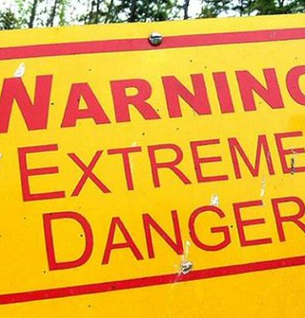
He said/she said cross: no motive to falsely accuse
Known complainant for years
Enjoy company
Try to be supportive
Many good times, happy times
Lots of laughs
Celebrate special occasions
Treat Respectful
Friendly relationship
Never abusive, never insulting
Overall a good, positive relationship
This Photo by Unknown Author is licensed under CC BY-NC

Slide 23
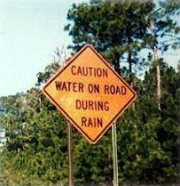
He said/she said cross: “ will accused refuse to admit the obvious”
She called you names
She called you a jerk
Called you a bastard, etc (1 q. per insult to maximize effect)
Accused you of… (1 q. per accusation)
That made you upset…
Made you angry…

Slide 24
He said/she said cross: “ will accused refuse to admit the obvious”
If accused denies anger:
But you were called names?
Being called names is unpleasant
You don’t like being called names
These were very unpleasant names (list the names in separate questions)
What name would make you mad
If the accused says it doesn’t bother him, reverse the proposition
You like being called names?
You don’t mind being called an asshole
Liar
drunk
You enjoy being called names?

Slide 25
He said/she said cross: “Will accused refuse to admit the obvious”
You were 10 feet from the door
Could have turned on heel
Walked out the door
Gone down the street
Could have made that choice…

Slide 26
He said/she said cross: “IF your story was true”
If the accused story is true, what follows, ie what logically should have happened during the incident or after the incident.
What choices would make sense?

Slide 27
He said/she said cross: “IF your story was true”
If your story was true, you would have injuries?
If your story was true, you would have stayed nearby?

Slide 28
He said/she said cross: Choices
Nothing stopped you from making that choice
If you chose to walk away, none of this would have happened
Would have been a sensible choice
Didn’t make that choice
The choice you made doesn’t make a lot of sense [if you really wanted to calm things down]
This Photo by Unknown Author is licensed under CC BY-SA

Slide 29
He said/she said cross: Choices
You left the scene
Knowing she was hurt
Knowing she was crying
Knowing she called police
Could have stayed nearby [or just outside immediate scene]
No one forced you to run away
You chose that
If were worried about your property/kids/ would make sense to stay nearby
If story was true would have stayed
Fled
Cause story not true

Slide 30
ABC CROSS
Hedley –
Sexual predator that night
Didn’t care what she wanted
Didn’t ask her what she wanted
That’s why you fed her booze
That’s why you invited her back to your home
To get away from her friends
To get her alone
Vulnerable

Slide 31
Bald Denial Cross
Should you or shouldn’t you: WD vs JJRD
Bearing the onus, unless the victim was extraordinary, conduct cross-examination
Methodically explore areas support/confirm prosecution
You admit you were there at the time of offence
You admit that the apartment was in disarray

Slide 32
Bald Denial Cross
You just testified
Just answered all your lawyers questions
Said nothing about what happened that night
You could have given your side of the story when you took the stand
You decided not to give your side of the story
This Photo by Unknown Author is licensed under CC BY-NC

Slide 33
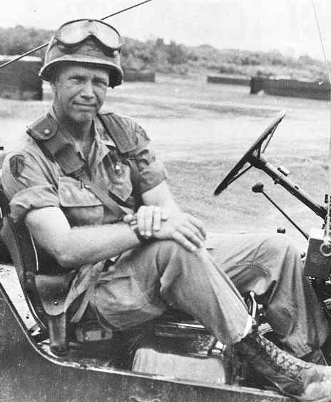
General G. Patton
“A good plan executed violently today is better than a perfect plan sometime in the future”
Notes:
There will probably never be enough time to prepare a perfect cross
And you will always hit upon better questions after the fact during your morning shower, as you replay the cross
Was a Crown a long time before a lot of these simple ideas were passed on to me – so I hope you’ll consider these ideas and that if you try them they will be helpful

Slide 35
Pro Tips
Just do the stupid voluntariness voir dire- you will never regret having the statement even if you do nothing with it
Preparing for cross means knowing the entire file, even the stuff from the witnesses you didn’t call
You don’t need to be loud or sarcastic to be effective. You can do everything we presented on today in your own way
Don’t overthink what the accused’s answers are going to be
This Photo by Unknown Author is licensed under CC BY-NC-ND

Slide 36
Pro Tips
Use objective evidence to anchor questions for cross
Cell phone records
Video
Admissions
Consider using a short powerpoint
Listen to the answers
Don’t be afraid of the dark

Slide 37
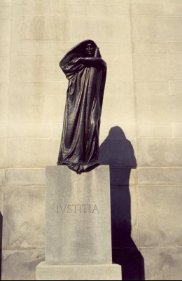
The End

