Slide 1
The Road Less Travelled
MCM #136: past recollections, refreshed memories, adversity, hostility & inconsistencies: where am ? Where am I going? How do I get there?
AUGUST 25, 2022 Trail guides Lt & MGM

Slide 2
Overview
Topic | Substantive | Professionalism
Introduction to types of evidentiary applications | 0h10m
Selecting the correct evidentiary application | 0h15m
Procedural requirements | 0h20m
Professional obligations of Crown counsel: witness preparation |  | 0h15m

Slide 3
What are we doing here?
This is not a session about:
ss. 9(1) or 9(2) of the Canada Evidence Act (see MCM #28 & #72)
Past recollection recorded (see MCM #55)
KGB or Khan applications
This is a session about:
How to figure out what, if anything from the list above, you might do and how to get there

Slide 4
Defining the Terms
S.9(2) CEA:
Application to cross on prior inconsistent statement
s.9(1) CEA:
Declaration that witness is adverse
KGB/Bradshaw:
Application to adduce prior inconsistent statement for the truth of its contents
Khan
Application to adduce prior consistent statement for the truth of its contents
Section 715
Application to introduce previously taken (usually prelim or trial)
Past Recollection Recorded
Application to adduce prior statement for the truth of its contents where witness genuinely does not recall the contents of the statement in whole or part

Slide 5
Why do we need this session?
Each of the applications listed on the previous slide are difficult, technical and very likely will be a ground of appeal
We spend a lot of time working on the mechanics, logistics and tactics of these applications and almost no time on figuring out how to get to where we need to go
This session is dedicated to the those of us stumbling around in the woods trying to get to the trailhead that will lead us to the path to a trial based on the truth

Slide 6
Common Scenario #1
Accused charged with assault with a weapon. Will likely be advancing self-defense
Barry, a witness, gives statement to police. He says:
Was at bar having drink. Heard loud voices, over the music. Looked over saw accused and victim arguing. Accused is a regular. Couldn’t hear what the argument was about, heard accused say “I’m gonna fuck you up” before accused swung his beer bottle at the victim. Saw victim try to punch the accused and get hit with bottle. He saw victim grab his head and drop to the floor. Saw the accused give a fist bump to guy in a plaid shirt.
Barry had 4 jack and cokes. He orders doubles because he finds the bar waters things down.

Slide 7
Common Scenario #1 continued
Barry gave R7, no interview, no line-up
He shows up for trial. He is not interested in being there but says he will tell the truth. You give him R7 to read over.
On the stand Barry is reluctant and curt but answers the questions asked of him and then you hit CRISIS #1
Your questions for Barry followed the narrative of his R7 you get to the end and Barry has said NOTHING about the fist bump

Slide 8
Why is this happening?
Most common:
Legit loss of memory: the fist bump has legit slipped his mind
Crown has failed to ask the right question: now that you think about it you have actually not asked any questions about the fist bump
Illegitimate loss of memory: Barry is a scroatty-scroate and knows self-defence is on the table, accused is a regular and known to Barry and now he’s going to fuck you over and your case is over and this was a total fucking waste of time and everyone lies and why do you always get all the crap cases

Slide 9
What do you do?
A. refresh memory
B. ask a couple more questions
C. call no further evidence. Sit down and drink. Bradshaw fucked everything up anyway.

Slide 10
If you said A and or B you can stay
In defence of ask more questions
You know what you want from your witness, what you expect and how it ties into your case- they have no idea.
You understand how to tell a story, how to recount details, and what your cryptic open-ended questions are driving at- they have no idea
You get very little prep with these types of witnesses (10 min before trial starts?)- you can’t read them and they sure can’t read you
You haven’t fucked anything up if you ask more questions

Slide 11
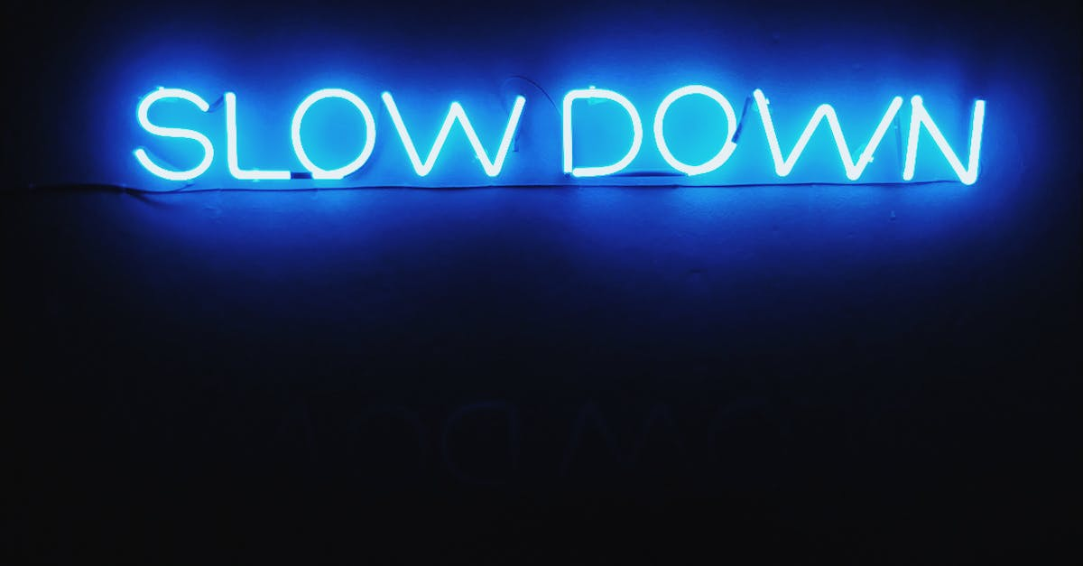
Refresh Memory
Whether you refresh right away or ask a few more questions this step is critical
Getting it ‘right’ matters because it is what will set you on your course to whatever comes next

Slide 12
Fact or Fiction?
In order to refresh a witness’ memory the witness must have expressed some issue with their memory or inability to recall something.

Slide 13
Fiction
Where it is a case of refreshing memory as opposed to past recollection recorded, the witness usually does not realize she has omitted to mention the matter of interest and therefore would have no reason to ask (for the statement to refresh)
COUNSEL is the ONLY one who realizes this and wants to jog the memory of the witness
R. v. SS, [1997] OJ No 361 (Gen Div) @6-7
The fact that a witness does not say they need their memory refreshed is “neither here nor there”. If the witness did not want their memory refreshed the matter would have moved to cross under 9(2) CEA
R. v. Slatter, 2018 ONCA 962 @53-54
R. v. Baier, 2016 BCCA 426

Slide 14
Shortcut- the MGM
In order to avoid this argument over a point where you are entirely in the right and yet defence and often the judge will give you a hard time try the following
Crown: is there anything else that you remember about what happened right after the victim was hit with the bottle?
Barry: ya there was a lot of yelling and blood
Crown: do you recall anything else other than the yelling?
Barry: ya like my gf called and I was telling her about what happened.
Crown: do you recall anything the accused did right after hitting the victim with the bottle?
Barry: not really
Crown: sir, shortly after this you wrote out a statement about what happened right? Do you recognize this? Have a look a page 2, just read it yourself and then I’ll have some questions for you (wait) does that jog your memory at all about what if anything the accused did after the bottle swing.
Barry: oh like the fist bump thing, ya I saw that. I thought you were like talking about more violent stuff

Slide 15
Fact or Fiction?
You can’t ask leading (ish) questions to jog a witness’ memory?

Slide 16
Fiction
While, as a general rule, a party may not either in direct or re-examination put leading questions, the court has a discretion, not open to review, to relax it whenever it is considered necessary in the interests of justice
Reference re R v Coffin, [1956] SCJ No 1 (SCC)
The trial judge has discretion to permit some leading questions of the witness regarding the prior statement without the need to invoke the procedure in s. 9(2) of the Canada Evidence Act
R. v. Baier, 2016 BCCA 426 @28
R. v. SS, [1997] OJ No 361 (Gen Div) @6-7

Slide 17
Shortcut- the Dallas Mack
Ask until you get objected to
Our friend Barry:
Crown: can you tell us anything about the accused’s hands after he struck the victim with the bottle?
Barry: his hands?
Crown: yes, did you make any observations about his hands?
Barry: well. I mean he was only holding the bottle with one hand. Ya know
Crown: ok and after the did you see either one of his hands?
Barry: ya
Crown: ok and did he make any gestures with his hands?
Barry: gestures?
Crown: yes. did he you know give someone the finger? Or a high five or something like that?
Barry: oh you mean the fist bump. Ya he like fist bumped the hipster in a plaid shirt.
Notes:
Please note Dallas Mack has not approved these questions, in fact I suspect she would be FAR more direct.

Slide 18
Fact or Fiction?
The document that the witness refreshes their memory from must be theirs

Slide 19
Fiction
A witness may refresh their memory from ANYTHING
The document relied upon is IMMATERIAL and may include inadmissible evidence: R. v. Fliss, 2002 SCC16 @45, see also R. v KGB, 1998 OJ No 1859 (CA) @18

Slide 20
Refresh Fail
You’ve done your perfect refresh BUT it hasn’t worked
Crown: sir you’ve had a chance to read your statement does that jog your memory about what if any observations you made about the accused’s hands after he swung the bottle?
Barry: nah. Not really.

Slide 21
Paths Diverging in the Woods
If refreshing memory doesn’t work you are now faced with diverging paths
1. based on everything you know both before the witness hit the box and from the remainder of their testimony you know that this is a legitimate memory loss
2. based on everything you know both before the witness hit the box and from the remainder of their testimony you know that this is an illegitimate memory loss
3. based on everything you know both before the witness hit the box and from the remainder of their testimony you have no idea wtf is going on

Slide 22
Paths Diverging in the Woods
Legit memory loss
Solution: past recollection recorded
Practical tactics:
finish your in chief, make sure there are no other memory lapses which cannot be refreshed
If there are additional memory lapses note them they will form part of your application
Before bringing your past recollection recorded application ask:
When you spoke to the police and provided the R7 “were you trying to be truthful and accurate?”
See R v Richardson, 2003 OJ No 3215 (CA) @24-28
If you get a yes to this question, congratulations you have arrived at the past recollection recorded trailhead

Slide 23
Fact or Fiction?
You can only bring a past recollection recorded application when the witness has a total loss of memory about the incident

Slide 24
Fiction
One of the four criteria for admission of hearsay evidence as past recollection recorded is the absence of memory. However, this does not require the witness to have a total loss of memory regarding the relevant events.
Past recollection recorded can apply where a witness has no memory of a portion of a statement.
R. v. Richardson, 2003 OJ No 3215 (CA) @30-31
See also: R. v. Louangrath, 2016 ONCA 550 @43

Slide 25
Paths Diverging in the Woods
Illegitimate Memory Loss
Solution: 9(2)
Practical Tactics:
Finish your in chief, note all of the memory losses or inconsistencies, try to refresh on each memory loss
Before bringing your application you may want to consider asking stuff about:
Relationship with the accused
other things that you can demonstrably prove (ie witness will always say they were drunk when they spoke to police- you have video showing (hopefully) level of sobriety)
If witness says no to refresh ask why
Congratulations you have now arrived at the 9(2) trailhead

Slide 26
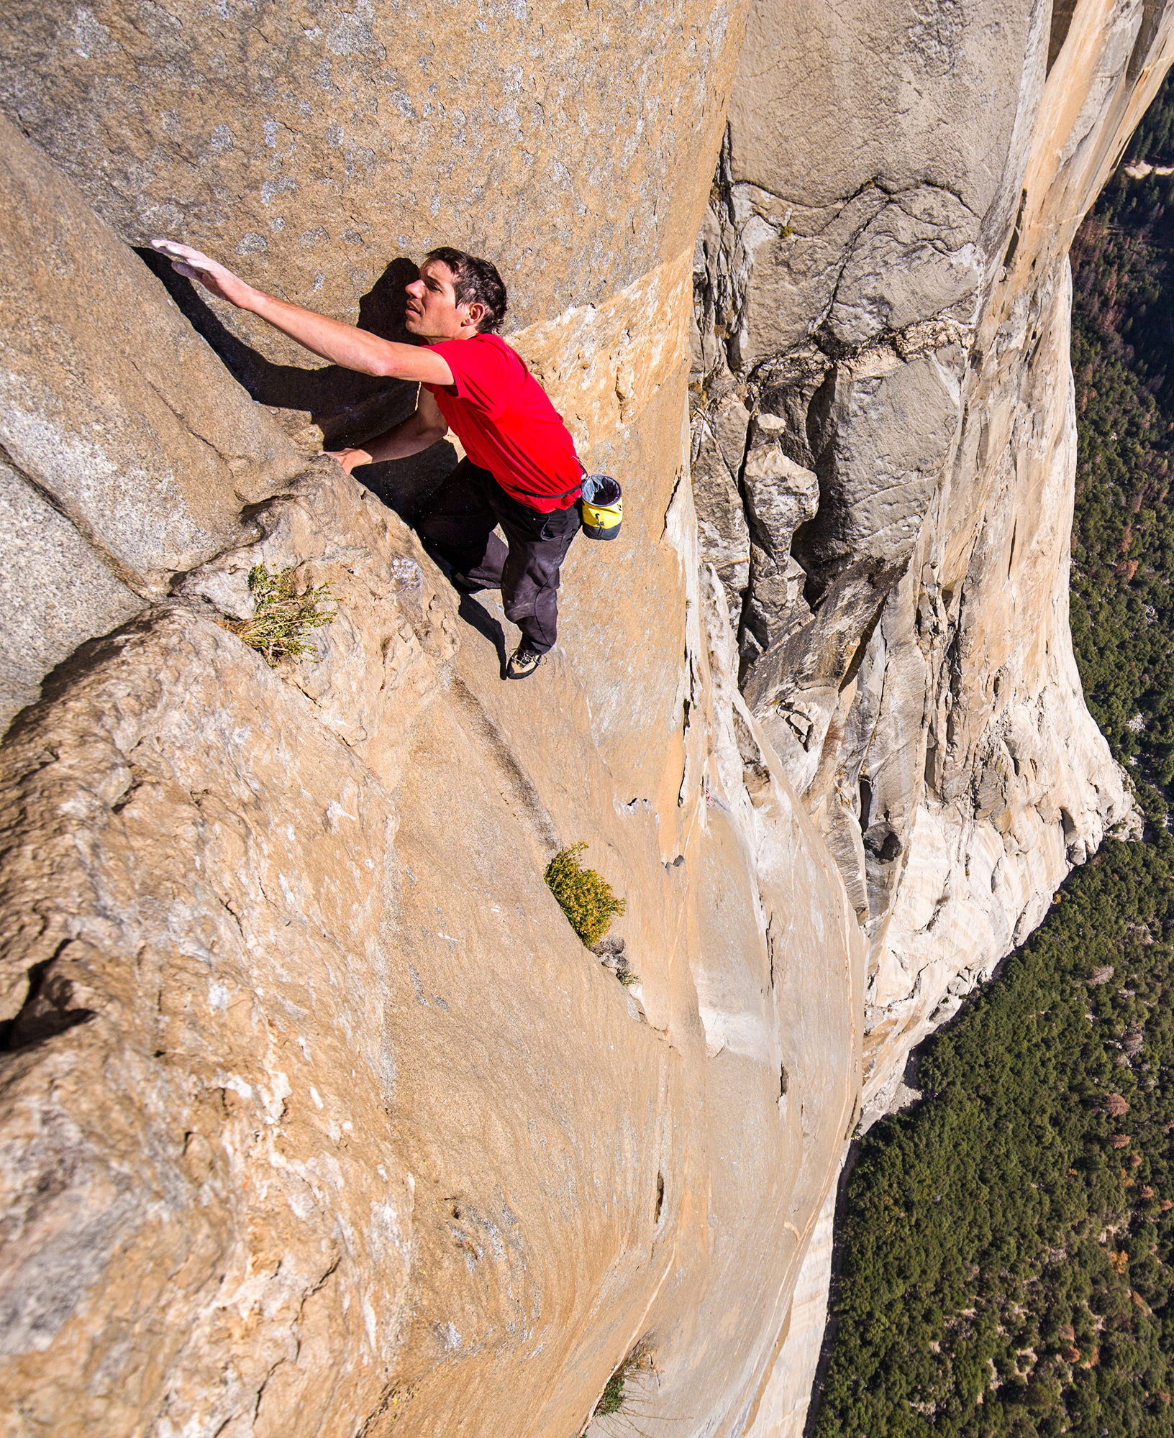
Congratulations! you have arrived at the 9(2) trailhead. This is your free solo.
This Photo by Unknown Author is licensed under CC BY-SA-NC

Slide 27
Fact or Fiction?
You can only 9(2) where you believe that there is some shot at getting the witness to adopt the statement?

Slide 28
Fiction
You can 9(2) even when no prospect of adoption.
R. v. Boyce, 2014 ONCA 150 @17, 22
Notes:
Section 9(2) of the Canada Evidence Act [CEA] permits cross-examination “as to the statement” and does not permit cross-examination at large. The ONCA has confirmed a wide scope for this cross-examination.
R v Dayes, 2013 ONCA 614
R v Boyce, 2014 ONCA 150
R v Taylor, 2015 ONCA 448
You can 9(2) even when no prospect of adoption.
R v Boyce, 2014 ONCA 150 @17, 22
You can cross on the reasons for the recantation.
R v Dayes, 2013 ONCA 614 @29-31
R v Taylor, 2015 ONCA 448 @49
You can cross on the truthfulness of the non-inconsistent parts of the prior statement.
R v Taylor, 2015 ONCA 448 @39, 54

Slide 29
Paths Diverging in the Woods
You are not sure whether the memory loss is real or feigned, you do not know wtf is going on and why this is happening
Solution: you gotta figure this out and the only way to do that is to keep asking questions
Practical Tactics:
Don’t panic
Refresh on everything and don’t limit yourself to a single reference (for example use R7, police interview, prelim transcript, 911 call etc… )make the point through your suggestions that they refresh on so much that they have said this SOOO many times before
The nature of what they are not remembering may be a good tell about the authenticity of the memory loss (anything that makes the accused look bad)

Slide 30
Don’t Psych Yourself Out
This Photo by Unknown Author is licensed under CC BY-SA-NC

