Slide 1
MCM #125: Admissions
January 13, 2022
Tansey & MGM

Slide 2
Overview
The law
Scenarios
Strategy and practice
Examples of admissions

Slide 3
The law

Slide 4
Statutory Authority: Criminal Code
Admissions at Trial
655. Where an accused is on trial for an indictable offence, he or his counsel may admit any fact alleged against him for the purpose of dispensing with proof thereof.

Slide 5
Statutory Authority: Criminal Code
Does section 655 apply to summary conviction proceedings?
Yes.
Section 795 provides that “the provisions of Parts XX and XX.1, in so far as they are not inconsistent with this Part, apply, with such modifications as the circumstances require, to proceedings under this Part.”
Notes:
In R v Fatima Watt J. held that s. 655 applies only to a trial on an indictable offence, but does not appear to have considered the operation of s. 795 of the Code: [2004] OJ No 6155 (SCJ) at para 19

Slide 6
Statutory Authority: YCJA
Admissions
149. (1) A party to any proceedings under this Act may admit any relevant fact or matter for the purpose of dispensing with proof of it, including any fact or matter the admissibility of which depends on a ruling of law or of mixed law and fact.
(2) Other party may adduce evidence — Nothing in this section precludes a party to a proceeding from adducing evidence to prove a fact or matter admitted by another party.
Notes:
Note this is different than 655
YCJA says any party
655 says accused or counsel may admit

Slide 7
Common law authority
Section 655 of the Criminal Code is not the only authority for admissions of fact. Admissions may be made at common law. For example, an accused or counsel representing an accused may waive a voir dire into the voluntariness of a statement allegedly made to a person in authority.
R v Fatima, [2004] OJ No 6155 (SCJ) at para 24
See also: R v Park, [1981] SCJ No 63; R v Dietrich, [1970] OJ No 1603 (CA)

Slide 8
Crown is in the driver’s seat
It is for the Crown, not for the defence, to state the fact or facts which it alleges against the accused and of which it seeks admission. The accused, of course, is under no obligation to admit the fact so alleged but his choice is to admit it or to decline to do so. He cannot frame the wording of the allegation to suit his own purposes and then insist on admitting it.
R v Castellani, [1969] SCJ No 85 @10
See also Fatima, 2004 CarswellOnt 8868 (SCJ) @18-22

Slide 9
Crown is in the driver’s seat
There is no rule of law that requires the Crown to accept an admission rather than tender evidence. To the contrary, the Crown is not required to adopt an admission and is entitled to call evidence it considers necessary regardless of the admission: R. v. Castellani, [1970] S.C.R. 310. The Crown is given broad discretion as to how it will prove its case, subject to the rules I have mentioned about prejudicial effect and probative value. The Crown controls its case and the defence cannot pre-empt the Crown's ability to call whatever relevant and admissible evidence it wishes. [Emphasis added].
Basi, 2010 BCSC 1599 @27

Slide 10
An admission is conclusive proof
An admission validly made in the context of s. 655 of the Code is an acknowledgement that some fact alleged by the prosecution is true. Such an admission dispenses with proof of that fact by testimony or ordinary exhibit and the accused is not entitled to set up competing contradictory evidence in an attempt to disprove the judicial or formal admission. In other words, the formal admission is conclusive of the admitted fact.
R v Baksh, [2005] OJ No 2571 (SCJ) at para 84, aff’d [2008] OJ No 538 (CA)

Slide 11
Withdrawal of admissions
Once an admission is tendered and accepted by the court it is an integral part of the record
Formal admissions may be withdrawn or amended on the consent of all parties
Absent consent, the permission of the judge is required
Once an admission is made the discretion to allow withdrawal should be exercised “sparingly and cautiously”
R v Basi, 2010 BCSC 738 at para 16
R v Lapps, 2018 ONSC 5728 at para 21

Slide 12
Withdrawal of admissions
There is an onus on defence to present “cogent evidence” that the admission had been made by a matter of mistake or misunderstanding
Regrets about a tactical decision to make an admission, a strategic decision otherwise falling within the range of reasonably competent decision-making, will rarely result in an admission being backed out of the record of the proceeding. In other words, a factual admission, even if ill-advised or improvident, cannot be simply retracted at the will of a party.
The BC Supreme Court in R v Basi and the Superior Court of Justice in R v Lapps dismissed applications to withdraw admissions where there was an insufficient evidentiary foundation
R v Basi, 2010 BCSC 738 at para 16
R v Lapps, 2018 ONSC 5728 at para 21

Slide 13
Withdrawal of admissions
At what stage does the admission become a s 655 admission such that an application is required to withdraw that admission?
CPT?
JPT?
Judicial admission?
Admission on the record at an appearance before trial?
Written admission confirmed by counsel?

Slide 14
Trial judge has discretion to reject admissions
The trial judge may refuse to admit into evidence admissions because
they were oath helping and not probative of innocence or guilt, and
(b) the prejudicial effect of the admissions outweighed any probative value.
R v Akleh, [2008] OJ No 5581 (SCJ)

Slide 15
Jury trials: reading and filing exhibits
The contents of each admission may be read to jurors by a prosecutor at an opportune time during the prosecution's case in-chief
The written admissions may be filed as exhibits
The trial judge should give an instruction on admissions
R v Fatima, [2004] OJ No 6155 (SCJ) at paras 38 to 46
Notes:
Watt’s Preliminary 16 (Evidence Defined) contains the following description of admissions:
We permit, but do not require the lawyers to make admissions about matters of fact (relevant facts). When admissions are made, no evidence is required about any fact that is admitted. Whatever the lawyers admit as a fact is a fact in this case.
Watt’s Mid-Trial 1-A is a model mid-trial instruction regarding admissions:
In this case, the parties have agreed on (admitted) some facts. When this happens, no witnesses have to be called or exhibits filed for you to accept what they agree about (have admitted) as facts. You must take what the parties have agreed on (admitted) as facts (proven) in this case. In your deliberations at the end of the trial, you consider the fact(s) admitted (what has been admitted), along with the rest of the evidence, in deciding this case.
Watt’s Final 21
[1] The parties (The Crown and defence) have agreed on (admitted) some facts. When they agree, no witnesses have to be called, or exhibits filed for you to accept what they have agreed upon (admitted) as facts. You must take what the parties (the Crown and defence) have agreed on (admitted) as facts in this case and take those admitted facts into account, along with the rest of the evidence, in deciding this case.
[2] In this case the parties have admitted
A footnote to Final 21 states:
Formal admissions should be reduced to writing and filed as an exhibit at trial. Jurors may better appreciate their value if the admissions are not read in bulk, rather inserted in the evidentiary references in the charge on the issue to which they relate.

Slide 16
Jury trials: reading and filing exhibits
As a general rule, written admissions filed as exhibits should be allowed to go to the jury room for review during deliberations.
R v Fatima, [2004] OJ No 6155 (SCJ) at para 35
Notes:
Admissions should be filed as exhibits and exhibits go to the jury room

Slide 17
Admissible against the accused in future proceedings
In a case where there is an Agreed Statement of Facts admitted at trial for the purpose of dispensing with the proof of those facts, as set out in s. 655 of the Criminal Code, they may be entered as ordinary admissions in a subsequent trial. These admissions are akin to any other statement made by the Accused, but he is no longer bound by them - they are no longer conclusive of the facts related therein - and is at liberty to explain, attack, or counter them, as he would be entitled to with any other non-judicial admissions.
R v Smith, [2008] OJ No 1262 (SCJ) at para 15
See also: R v. Baksh, [2005] OJ No 2971 (SCJ), aff’d [2008] OJ No 538 (CA)

Slide 18
Admissible against the accused in future proceedings
The Agreed Statement of Facts does not amount to testimony of a witness and s. 13 of the Charter does not preclude its use in any other proceedings.
R v Baksh, [2005] OJ No 2571 (SCJ) at para 79, aff’d [2008] OJ No 538 (CA)

Slide 19
Admissible against the accused in future proceedings
Both Baksh and Smith involved admissions made in a mistrial, that were admitted in the new trial of the same matter. However, there does not appear to be anything in the reasoning that would confine admissibility to this circumstance.
If the agreed statement of facts/admissions are an ordinary admission of the accused and s. 13 of the Charter does not apply, would they not be admissible against the accused in any subsequent matter?

Slide 20
Scenarios

Slide 21
Scenario #1
Crown cannot "refuse acceptance [of an admission] where its purpose in doing so is to keep an issue alive artificially." These cases emphasize that the accused must "make all necessary admissions" related to the proposed evidence and must make the admission "fully and without ambiguity." But assuming the proffered admission fully covers the facts which the Crown's evidence seeks to prove, the admission must be accepted.
LeSage Report, The Review of Large and Complex Criminal Case Procedures (The History of Case Management in Ontario, Chapter 4, Part I, Section 3)
Agree or disagree?
Notes:
Code/LeSage adopted the following words from Wigmore:
Nevertheless, a colorless admission by the opponent may sometimes have the effect of depriving the party of the legitimate moral force of his evidence; furthermore, a judicial admission may be cleverly made with grudging limitations or evasions or insinuations (especially in criminal cases), so as to be technically but not practically a waiver of proof. Hence, there should be no absolute rule on the subject; and the trial court's discretion should determine whether a particular admission is so plenary as to render the first party's evidence wholly needless under the circumstances.
Code/LeSage added:
We would only add the caution, as does Dean Wigmore, that there may be instances where the "dramatic force" of the viva voce evidence will be lost on the trier of fact, if the evidence goes in in the form of a dry admission. We are not referring to any prejudicial impact of the viva voce evidence, which is obviously not a legitimate reason to hear it, but to the trier's greater ability to remember the evidence and appreciate it, especially in a long trial, after hearing it from a live witness. This assessment should be left to the discretion of the court which will have to consider the importance of the evidence and the sufficiency of the admission.

Slide 22
Scenario #2
Mr. A was charged with a number of firearms offences. An agreed statement of facts was filed at trial. In particular, Mr. A had admitted a previous statement he made to Mr. Y.
Mr. A testified at trial and denied making any such statement, contrary to the ASF.
What do you do?
Notes:
See R v Coburn, [1982] OJ No 41 (ONCA) at para 13.
13 This case emphasizes that although Agreed Statements of Facts are often useful, they should only be used where the facts are clearly agreed upon. When it became apparent that this was not the case, and that there was a conflict between the appellant's evidence on the one hand, and the Agreed Statement of Facts on the other, the trial judge should have required the Crown to call evidence on the points in issue. The trial judge, however, attempted to perform an impossible task, namely to decide between what was set forth in the Agreed Statement of Facts and the viva voce evidence of the appellant. The trial judge in effect set out to determine the question of credibility of the appellant without hearing Inspector Yorkston and weighing in turn his credibility.
Practice Note: agreed statements of fact should be framed as 655 admissions

Slide 23
Scenario #3
You are prosecuting a commercial Break and Enter wherein the accused smashes the front glass door to enter the property. He cuts his hand in the process. In his attempts to steal, he leaves blood on one of the items in the store. A DNA swab was taken and CFS analysis resulted in a positive match for the accused.
At the JPT, Defence counsel agreed to admit the DNA evidence as positively identifying the accused. However, at trial, Defence counsel seeks to resile from this admission.
What is your remedy?

Slide 24
Strategy and practice

Slide 25
Screening
Think about what admissions you want during initial screening
Generally speaking, defence counsel will not admit a fact that you cannot prove
For example, ensure that a report or will state has been filed identifying the witness who downloaded or seized each surveillance video

Slide 26
Pre-Trial Discussions
Canvas admissions at the CPT
Write up the exact admissions that you are seeking for the JPT
Secure agreements at the JPT
Follow-up with an e-mail to defence counsel confirming that an agreement has been reached in regard to these admissions. List the admissions in full.
For Superior Court trials, the sought admissions should be listed in the Pre-Trial Conference Form. The defence copy of the form should indicate agreement with the admissions.

Slide 27
Strategy
Ask for a lot. Defence may give you more than you expect. Or, defence may reveal their strategy or position in the admissions they refuse.
A defence lawyer who is “not making any admissions” may have a very different attitude in front of the JPT judge
Write out the exhibits and file them as exhibits

Slide 28
Examples of admissions

Slide 29
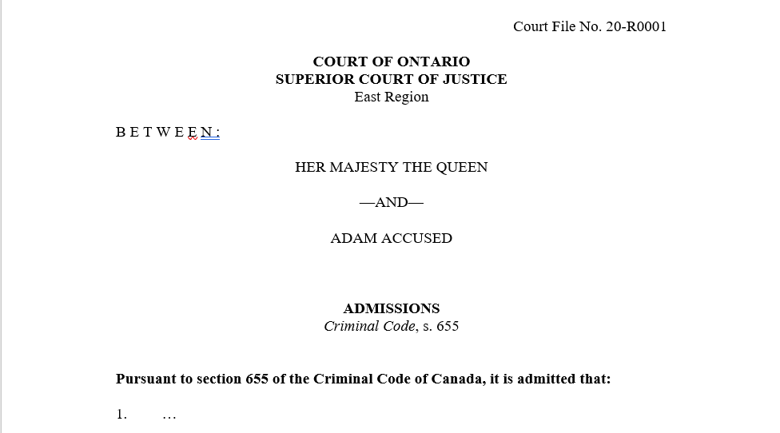
Criminal Code admission:

Slide 30
Court order
The Release Order and specific condition referred to in Count 4 of the Information were valid and in force on December 1, 2019. The accused is the person named in the release order.

Slide 31
Photographs
The photographs contained in Exhibit #1 were taken by Det. Jane Smith of the Ottawa Police Forensic Identification Section on March 28, 2019. These photographs are authentic and have not been altered.

Slide 32
Surveillance Video
1. The surveillance video from 138 Arlington Street, Ottawa, on September 4-5, 2014, is admitted to be authentic. The time and date stamp is accurate, except that the time stamp is 7 minutes fast.
2. The surveillance video from Mr. Gas, 980 Cameron Street, Cumberland, on September 4, 2014, is admitted to be authentic. The time and date stamp is accurate.

Slide 33
Bodily harm
The assault perpetrated on Justin Huynh caused bodily harm to him within the meaning of section 2 of the Criminal Code. Specifically, he sustained:
Bruising and swelling to the right eye
Bruising to right shoulder
Cuts and bruises of various sizes to his face, neck, torso, arms, and wrists
Fear for his life, and for the life of his family members and pets
.

Slide 34
Wound, maim, disfigure, endanger life
The assault perpetrated on Linton Campbell wounded, maimed, disfigured him, or endangered his life within the meaning of section 268(1) of the Criminal Code. Specifically, he sustained:
A compound (open) fracture to his right ankle and ruptured right quadricep tendon, both of which required surgery
A stab wound to the right buttock, which was closed by stapling
A laceration to the left ear, which was closed by suturing
A laceration to the back of head

Slide 35
Cell phone extraction
On September 15, 2014, Laura Brahaney was arrested in her motor vehicle following a traffic stop. Laura Brahaney’s cell phone (phone number: 613-799-7869) was seized in evidence. The data on the cell phone was subsequently extracted by Det. Haing and turned over to Det. Jacobs, who searched the data. The data on the cell phone was not altered or compromised during extraction.

Slide 36
Hospital records
The records of the Mackenzie Richmond Hill Hospital regarding the care of Linton Campbell are admitted to be authentic. The records were made in the usual and ordinary course of business of the Mackenzie Richmond Hill Hospital. A scanned copy of these records may be admitted on consent.

Slide 37
Voluntariness
On January 1, 2019 Adam Accused was interviewed by Det. Debbie Dunn while under arrest at the Ottawa Police Station, 474 Elgin Street, Ottawa. The interview was video-recorded. This interview is voluntary within the meaning of the common law confessions rule. A voir dire in respect of this statement is waived.

