Slide 1
Witness Prep: Eight ways to f*ck it up
MCM #124
Presented by MGM and Louise

Slide 2
It is not just proper for Crown counsel to interview witnesses prior to their testifying: it is necessary that these meetings take place. Witnesses are often not familiar with courtroom procedures and the rules of evidence. Unprepared witnesses may blurt out things that should not be said in front of the jury. They may be too talkative, and less than responsive to the questions they are asked. Testifying is an unusual, and even intimidating experience for many witnesses. Counsel owes it to the witness and to the court to prepare witnesses carefully.
R v Liard, 2013 ONSC 5457 at para 424

Slide 3
Crown counsel's preparation of witnesses for trial is not only appropriate but also necessary for the efficient administration of justice and the truth finding process.
R v Trought, 2019 ONSC 1421 at para 18

Slide 4
[1] It is perfectly proper for a witness who testifies in a criminal trial to review previous statements or evidence that he or she has given at a preliminary inquiry or elsewhere in preparation for their testimony at trial. It happens all the time that witnesses do so to refresh their memory of events that have happened in the past, perhaps months or even years ago.
[2] It is also a common occurrence, and proper preparation for trial, for the lawyer calling a witness, for that matter a lawyer on the other side, to interview witnesses who will or may be called to give evidence at trial. There is nothing unusual or improper about this practice. You should take nothing from it.
Watt’s Manual of Criminal Jury Instructions, Mid-Trial 22

Slide 5
Witness prep: Eight ways to f*ck it up
These items are in no particular order
They are NOT in order of importance

Slide 6
#1 Don’t prep for your prep
A PowerPoint by Peter Keen on Victim and Witness Preparation contains this sound advice:
Similarly, ensure that your investigator is prepared and understands her/his role in the meeting.
If this isn’t second nature …. Prepare Note what steps to go through Note topics to cover Note advice to provide

Slide 7
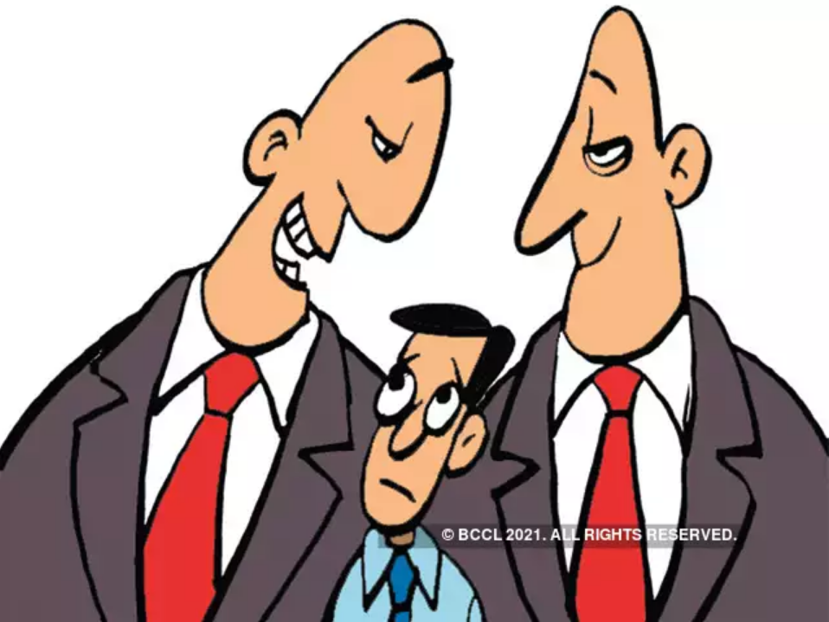
#2 Forget about building a relationship, trust, and rapport

Slide 8
#3 Don’t show the witness the exhibit that you plan to show them

Slide 9
#4 Fail to promptly disclose new information provided in the meeting
Wherever practical, the interview should be conducted in the presence of a police officer or other appropriate third person. That person can assist in making a record of the meeting. This practice will be critical in documenting the process, preserving the integrity of the interview, and preserving the role of Crown counsel by minimizing the possibility that counsel will be called as a witness.
. . . . .
Where a witness provides information which apparently conflicts with or is not contained in his or her prior statements, that information, along with the general circumstances in which it came to light, must be recorded in writing and disclosed in accordance with the Policy and Practice Memoranda regarding disclosure.
Conduct of Witness Interviews, PM [2006] No 5 at page 2 [no longer in force]

Slide 10
#5 Tell the witness she/he is wrong
Questioning should not suggest that Crown counsel desires a particular answer.
Where Crown counsel believes that a witness may be honestly mistaken, counsel may appropriately inquire into the circumstances surrounding the witness’s present recollection. Crown counsel should not tell a witness that he or she is wrong.
Conduct of Witness Interviews, PM [2006] No 5 at page 2 [no longer in force]

Slide 11
#6 Neglect the basics of testifying
1. Tell the Truth, and the whole truth 2. Don’t anticipate the question 3. If you don’t understand, ASK! 4. Control the pace of your answers 5. If you don’t know, don’t guess 6. If you are sure, stand your ground
There are several versions of these “basics” including the “6 Rules” and the “Fisher 5.”

Slide 12
#7 Convey your feelings about the case

Slide 13
#8 Forget what the witness is, and is not

Slide 14
Scenario #1
Day of trial you are meeting with a civilian witness on an impaired. The witness says that he took a cell phone video of the accused at the scene of the collision. The video is 2 min long. He told police about it at the time but he thought it was weird that they never asked for the video. The witness’ R7 says “I’m pretty sure it’s on the video”. He has the video on his cell phone. Defence has never made a disclosure request about a video. It’s 9:23. Trial starts at 10.
What do you do?
Notes:
Questions to ask yourself
Is it relevant?
Do you want it?
Are you going to watch it?
The answer to these questions is yes.
Tell defence about existence
Get video and disclose it
Carry one with calling police witnesses
If Jordan crunch- give it over undertaking not to lead if proceed today- earliest (undertakings talk to Deputy)
Pro Tip:
Breathe. Everyone missed this (including you!) be curious about stuff when you prep. Be calm. This is a good thing. Think it through. Delegate (put an officer in charge of getting the video. Maybe by simply emailing it. maybe by calling Micah or Bill, or walking over to 474 elgin maybe by going to case management and having the officer connect to a computer there. The point is this is something you delegate.

Slide 15
Scenario #2
Prep session with victim of intimate partner violence 1 month before trial. Towards the end of the session the victim says that this event has had a huge impact on her life. She left her studies at university. She was living independently but has now returned to live with her mom. She’s in therapy and on medication for anxiety and depression. She went through a very rough patch where she was abusing alcohol.
What do you do?
Is any of this disclosable?
Notes:
To the extent it’s flowing from the charges it’s disclosable
If it’s not flowing from this it’s not disclosable
You are going to need to clarify this.
Pro tip: don’t let this happen. Discuss the parameters of prep and the reason for the parameters.
Legal threshold
“While the Crown must err on the side of inclusion, it need not produce what is clearly irrelevant”: R. v. Stinchcombe, at paragraph 20.
In assessing potential relevance, Prosecutors should consider if there is a reasonable possibility that the information, pointing to either to guilt or innocence, could be used by the accused in meeting the case for the prosecution, advancing a defence, or otherwise determining how to conduct a defence: R. v. Egger, [1993] 2 S.C.R. 451 at para. 20; R. v. Dixon, [1998] 1 S.C.R. 244 at para. 23; Disclosure Confidential Advice to Prosecutors. If so, the evidence should be disclosed.
In considering whether or not information is clearly irrelevant, the comments of Doherty JA in R v. LS, 2017 ONCA 685 at paragraph 89 are instructive: “Evidence does not have to establish or refute a fact in issue to be relevant; it need only, as a matter of common sense and human experience, have some tendency to make the existence of non-existence of that material fact more or less likely. There is a big difference between evidence that is relevant and evidence that is determinative.” At the same time, in considering potential uses of “other sexual activity evidence” and available inferences in sexual violence cases, Prosecutors must exercise caution and avoid relying on harmful myths and stereotypes including twin myth reasoning: Sexual Offences Against Adults Confidential Advice to Prosecutors. Where evidence is withheld, the defence should be alerted to that fact and the reason for it – that it is “clearly irrelevant”.
In this process, it is important for Prosecutors to remember that disclosure of other sexual activity evidence does not render it admissible at trial. The defence is required to comply with the requirements of the s. 276 regime even for evidence that has been disclosed by the Crown.

Slide 16
Scenario #3
Prep session 1 week before trial with ID witness in a residential break and enter. Witness is a neighbour who saw the accused leaving the residence. Witness positively id’ed the accused from a photo line-up. Additional forensic evidence also points to this accused. In prep the neighbour reveals that after he got his subpoena he’s been googling the accused’s name and found his social media accounts and some new articles about other crimes he’s committed. He says “I’m really glad I picked the right guy out of the line up”.
What do you do?
Notes:
Fully disclosable
Pro tip: tell him to stop googling stuff

Slide 17
Boom!
Merry Xmas

