Slide 1
JUDICIAL PRE-TRIALS

Slide 2
JPTS are a Critical component of the crown’s case management function
Fair and just resolution of cases
Trial efficiency – streamlining the issues and admissions
Trial within a reasonable time – realistic time estimates – 11(b)/Jordan
Ensuring complainant’s rights are safeguarded (278 – third party records, 276 – other sexual activity)

Slide 3
JPTs are an exercise in advocacy
Highlight the strengths of the Crown’s case to encourage resolution. Acknowledge and address weaknesses. (Get your Judge on-board).
Be prepared to persuasively advance the relevant aggravating and mitigating factors in the case in articulating the Crown position on a plea. Make it clear Crown position factors in early GP, mitigating factors and Gladue if applicable.
Focus in on the real issue or issues at trial to encourage defence to make reasonable admissions.
Be prepared to address the merits of lack thereof of anticipated pre-trial motions (esp., 278/276) to discourage meritless, time-consuming applications that negatively impact the complainant’s rights (myths and stereotypes)

Slide 4
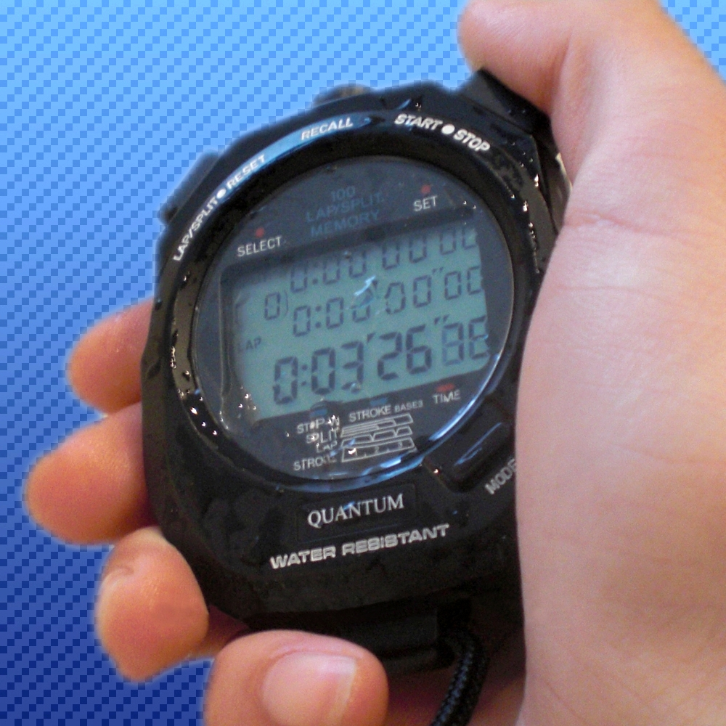
ALL IN 20 MINUTES OR LESS

Slide 5
Preparation is KEY
You can only carry out these case management and advocacy objectives if you’re extremely well prepared.

Slide 6
Preparation starts with the initial screening
Thorough initial screening of the file with pay dividends come JPT time
Assessing public interest in proceeding in light of impact of COVID on CJS
Correct Charges
Election
Police Follow-up required
Disclosure issues
Identify essential witnesses
Identify Possible Admissions
Preliminary trial estimate
Preliminary Crown Sentencing Position

Slide 7
Preparation
Make sure the Judge has what they need and make sure they have it in advance – sometimes the synopsis is not enough. Like when you have to read to page 119 of the brief to figure out how they ID’d the guy.
The CPT is not meaningless – a productive discussion at the CPT can help frame or narrow the discussion for the JPT.
Get your input from IO or complainant before the JPT if possible.

Slide 8
Formulating a crown position on a plea
Identifying the right counts
What is the gravamen of the conduct?
Do minimum sentences apply on some counts?
Do consecutive sentences apply either through statute of common law?
S. 117.01 (breach weapons prohibition) – R. v. Ellis 2013 ONSC 3092 at paras 30-31
S. 85(4)
718.3(7) – consec sentences for each separate child victim sexual offence
Do certain ancillary orders only apply to particular counts?
Crown policy – firearms, IPV, Impaired, SVAG, COVID Backlog

Slide 9
Formulating a crown position on a plea
Quantum
Joint versus Open position
Crown Policy – firearms, IPV, SVAG, Impaired
Code Provisions outlining aggravating factors and those offences where denunciation and deterrence are given primacy
Gladue
Totality
COVID Backlog

Slide 10
Formulating a crown position on a plea COVID considerations
See Updated COVID 19 Recovery CAP
Diversion
Impact of COVID in the particular accused
Disproportionate impact of COVID on vulnerable or marginalized groups
Consider the impact of COVID-19 on the criminal justice system and the need to reduce the number of cases in the courts to ensure that resources are directed to the prosecution of serious offences.
Consider all available and appropriate sanctions, consistent with public safety, to resolve cases as early as possible.
Greater consideration to discharges and conditional sentences where those sentences are consistent with the principles of sentencing and can be imposed while maintaining the safety of the public and victims.

Slide 11
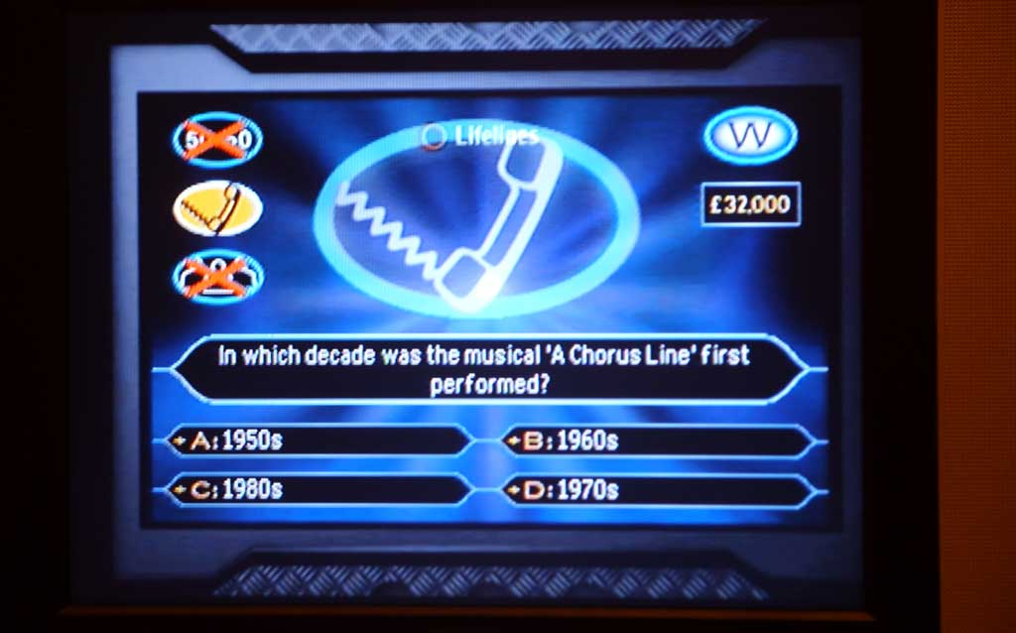
Play what’s it worth before the JPT
With your colleagues
With your Team Captains
With the Specialty Crowns
SVAG – Fara Rupert
ICE – Kerry McVey
HT – Meaghan Cunningham
G&G – Matt Humphreys, MGM, Emilie Farrell, Jason Neubauer
Impaired – Carl Lem
E-Library Sentencing materials are invaluable
This Photo by Unknown Author is licensed under CC BY-NC-ND

Slide 12
Formulating a crown position on a plea
MAKE YOUR BEST OFFER AT THE JPT CONSISTENT WITH THE PRINCIPLES OF SENTENCING
“This position is primarily based on an early guilty plea. Our Court of Appeal in R v Mann, [2010] OJ No 1924 at ¶21 stated, “A guilty plea, especially an early one, is entitled to a substantial credit in the sentencing process.” In R v Faulds, [1994] OJ No 2145 the Ontario Court of Appeal at ¶14 held that a guilty plea is important for several reasons, one of which is saving “valuable judicial resources.” All of this to say, the more time that passes, the more judicial resources that are expended, the more likely our position is to increase in recognition of the decreasing mitigation afforded to the guilty plea. I want to make this clear for Mr. XXXX from the outset and the basis for the Crown’s reasoning moving forward.”

Slide 13
discussing the Crown position at JPT
Always formulate a specific Crown position before the JPT. Going in without a clear position makes it more likely you will agree to something that may not be appropriate.
Keep an open mind during the discussion, listen to the input from the Judge; consider the information provided by defence. Be open to modifying your position as the circumstances warrant.
But don’t be pressured into taking a position you’re are not comfortable with.
Don’t feel pressured to give an answer on the spot.
You may need further approvals (CC5 or Team Captain) or input from IO or complainant.

Slide 14
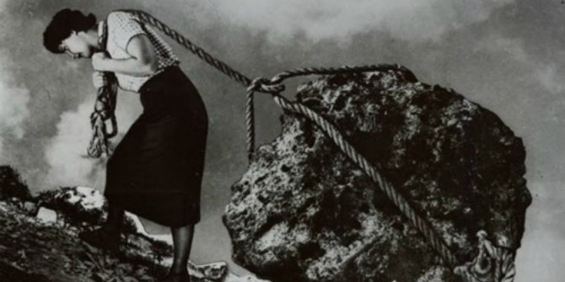
JPT Judge TAKING Plea
The Crown should not agree to have the JPT Judge hear the plea unless it is a joint submission.
Some Judges will signal or outright express a position lower than the stated Crown position and then suggest that they hear the plea.

Slide 15
Discussing a time estimate
You are better positioned than anyone else in the room to provide an accurate trial estimate (if you’re prepared)
Resist pressure to agree to reduce your time estimate by those who know much less about your case than you do.
Be prepared to articulate with specificity why your estimate is accurate and advocate for the time.
Be specific about what your estimate includes – Crown’s case.
Factor in extra time for cases with interpreters
Factor in extra time for child witnesses or witnesses with other special needs

Slide 16
Discussing a time estimate
Some Judges will authorize an insufficient amount of time for trial based on the fact that they think the Crown’s case is going to fold at the trial door.
This may be a case worth a second look for RPC and perhaps consultation with a senior Crown or CC5.
However, if you feel you have a route to conviction notwithstanding difficulties in the Crown case, hold your ground in terms of your time estimate (i.e Khan, KBG Applications)

Slide 17
Discussing pre-trial motions
Timing of Application
Severance applications need to heard early or we run into Jordan problems
Does it make sense to hear some before others – if a confession goes in, will it be a plea? If a gun is excluded will that end the prosecution?
Procedure
Blended with trial
Extrinsic SFE on paper or viva voce.
Between count SFE to be argued at the end of the Crown’s case
Court time – do you have a 6-hour accused statement that you want a voluntariness ruling on?

Slide 18
Preliminary Hearing Estimates
Has defence filed a statement of issues?
Is committal in issue?
Will you rely on s. 540? On consent?
If only one offence on the information triggers a right to a prelim, do you need it or can it be replaced (i.e can a kidnapping be replaced with a forcible confinement)
Or maybe no prelim at all? (direct indictment)

Slide 19
Admissions – Lock THEM down in writing
The discussion of admissions at the JPT is useful to get a sense as to what the contentious issues are or are not
But admissions at the JPT are often loose.
Any admissions at the JPT must be followed up through confirmation in writing to be relied upon.
Make sure everyone is on the same page about what the admission means. Sometimes it’s not always clear. (i.e. admitted the sexual act occurred; the only issue is consent)

Slide 20
Discussion of testimonial aids
Ascertaining the defence position as early as possible may bring certainty and reduce anxiety for the complainant.
Support person (or dog) 486.1
Testimony outside courtroom (CCTV or screen) 486.2
Publication Ban 486.4 – sexual offences, offences where victim <18, cp offences
715.1
714.1

Slide 21
Sexual assault JPT’s – Special considerations
High volume of these cases in our daily work
Decisions made up front at the JPT stage can have significant impact on the rights of the complainant as well as trial efficiency and the accused’s 11(b) rights
Effective pre-trials are essential to a fair and efficient prosecutions

Slide 22
Crown Led Evidence of Other Sexual Activity (OSA)
At JPT Crown Should articulate:
What evidence it seeks to admit
Basis for admissibility
Purported Use
Put defence on notice that Crown position is that this doesn’t open the door to general cross on OSA
Put defence on notice that any use beyond what the Crown is seeking will require a defence application
Schedule a motion for directions in before the TJ if no consent from defence/complainant
If evidence of OSA in disclosure and Crown not seeking to admit it, put defence on notice that Crown position is that an application is required by defence in order to adduce it.

Slide 23
Defence 276 Application
Address timing of stage 1 and 2 (together or separate)
If together discuss fact that C’s counsel will receive materials prior to a ruling on whether application proceeds to stage two
If separate then ensure sufficient time in between for Judge to issue decision
Seek order for ILA ASAP

Slide 24
278.92 Applications – complainant’s records in the hands of the accused
Address Timing of stage 1 and 2 (together or separate)
Canvass procedure for the application
Will the records be filed on the application?
Resist mid-trial applications
If dispute about whether regime applies, schedule motion for directions before TJ
NCQ – if defence is challenging the legislation
Word coming soon from the SCC on these provisions – R. v. J.J.
Order appointing counsel ASAP

Slide 25
Defence application to obtain records in possession of third party
Third party records in the possession of the Crown? Waiver?
SAEK Records now disclosed as first party
Address issue of timing - 3rd party – stage 1 and 2 together or separate
Address fact that the application relates to production only and not admissibility – separate application required to determine admissibility if produced.
Seek order for ILA ASAP.

Slide 26
SEXUAL ASSAULT JPTs special considerations
If in doubt about procedure, reach out to SVAG Crowns or SVAG alumni for advice.

Slide 27
Final word

