Slide 1
MCM 120: Charge Screening for Rookies
Brought to you by: MGM & LT
16Sept2021
This program contains 0 h 40 m of professionalism hours
This program is eligible for up to 0 h 20 m of substantive hours
This organization has been approved as an Accredited Provider of Professionalism Content by the Law Society of Ontario.

Slide 2
Reasonable Prospect of Conviction **this show is about crowns who are extremely knowledgeable about the law and kick ass in court- in other words they are all fighter pilots. You may have confused it with a show about an extreme sport lover who accidentally got involved in international illegal trade and so became a special agent (available on prime)…

Slide 3
Overview
Topic | Substantive | Professionalism
The duty to assess for reasonable prospect of conviction The legal standard Factors Assessment of credibility and reliability | 0 h 0 m | 0 h 40 m
The duty to assess for public interest Relevant and irrelevant factors | 0 h 0 m | 0 h 20 m
Screening multiple or repeated offences | 0 h 20 m | 0 h 0 m
TOTAL | 0 h 0 m | 1 h 0 m

Slide 4
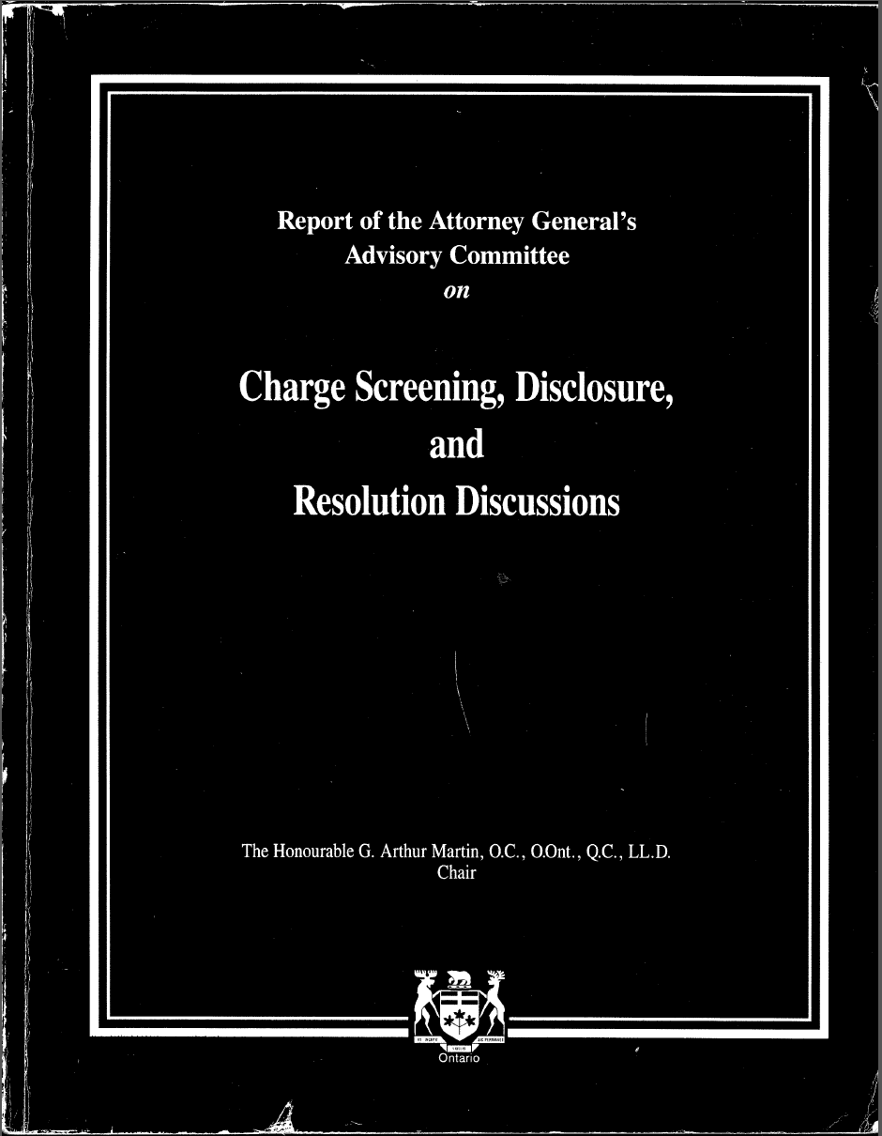
The Martin Committee Report
True or False:
“You are not a real prosecutor until/unless you have read the Martin Committee Report” -MGM

Slide 5
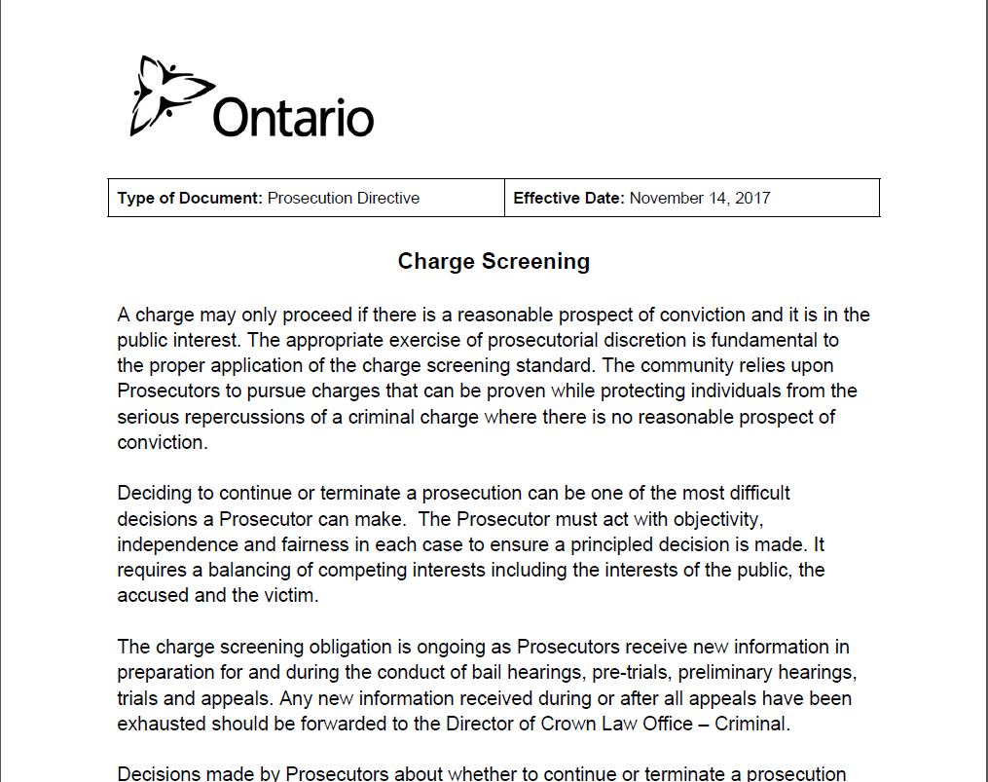
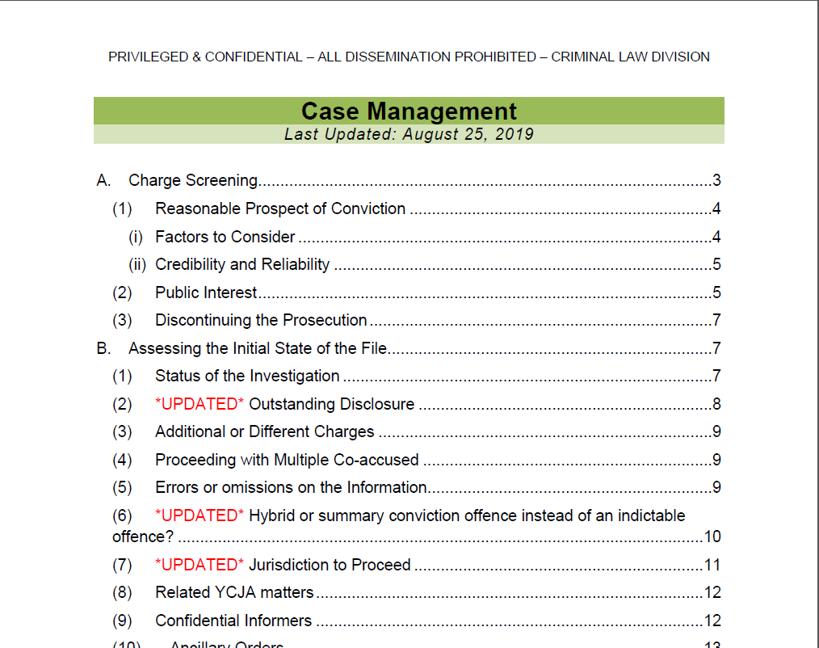
Other required reading
Charge Screening
Prosecution Directive
Case Management
Confidential
Advice to Prosecutors

Slide 6
What is RPC?
Standard which applies to all cases and at all stages
If at any stage there is no RPC the prosecution MUST be discontinued
It is higher than prima facie case BUT does not require a probability of conviction
The exercise of prosecutorial judgment and discretion is based on the objective indicators found in the case itself

Slide 7
Factors
Prosecutors should consider the following factors:
the availability of evidence
the admissibility of evidence implicating the accused
an assessment of the credibility and competence of witnesses, without taking on the role of the trier of fact
the availability of any evidence supporting any defences that should be known or that have come to the attention of the Prosecutor.

Slide 8
How do you do this?
First, you must know what the essential elements of the offence(s) are.
If you don’t know it’s ok—here’s some ideas:
Jury instructions
Leading cases
The Code (the criminal one)
Second, you must look critically at the facts of the case to assess them in the framework of the essential elements.

Slide 9
How do you do this?
Third, now that you’ve plugged the facts into the elements:
is that evidence available?
does the evidence implicate the accused? (ie how strong is your case on ID)
is the evidence credible? The witness competent? (but don’t assess this as if you are the trier of fact)
are there defences that are available on the evidence you have considered?

Slide 10
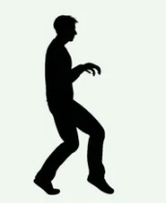
Scenario #1
Peter Prowler is charged with one count of trespass by night (section 177). He and the Victim used to be co-workers. He propositioned her and she was not interested. He kept approaching her until she complained to her employer, resulting in Mr. Prowler being moved to a different location. That was two months ago.
Three weeks ago Mr. Prowler was arrested. The victim looked out her front window and caught a glance of Mr. Prowler outside her front window. It was dark so she couldn’t see him completely. She called 9-1-1 at 8:40 pm and gave a description. The police attended and found Mr. Prowler a block away. He was arrested at 8:45 p.m. wearing the same clothes that the victim described.
The next-door neighbor was walking his dog when he saw Mr. Prowler walking up and down the street near the victim’s home around 8:15 pm. He has never met Mr. Prowler before. He picked out Mr. Prowler in a photo line-up.

Slide 11
Prowl by Night
177 Every person who, without lawful excuse, loiters or prowls at night on the property of another person near a dwelling-house situated on that property is guilty of an offence punishable on summary conviction.

Slide 12
Terms Defined (s2 Criminal Code)
dwelling-house means the whole or any part of a building or structure that is kept or occupied as a permanent or temporary residence, and includes (...)
night means the period between nine o’clock in the afternoon and six o’clock in the forenoon of the following day; (nuit)

Slide 13
Pop Quiz
True or False:
Credibility plays no role in the prosecutor’s assessment of RPC

Slide 14
Answer
Applying the reasonable prospect of conviction standard requires a limited assessment of credibility based on objective factors, an assessment of the admissibility of evidence and a consideration of likely defences.

Slide 15
Credibility and Reliability: Limited Assessment
The Prosecutor should take care not to usurp the function of the trier of fact when
assessing the credibility and competence of witnesses. A Prosecutor should not
substitute their own views about the witness, but should look for objective indicators in
the evidence, including:
a) a witness's history of dishonesty;
b) a strong motive to lie;
c) an inadequate opportunity to observe; or
d) irrefutable evidence indicating that a witness is mistaken or lying.
In making this limited assessment of credibility, the Prosecutor should take care to set
aside personal views about a witness and ensure that their credibility assessment is not
based on discriminatory views. A Prosecutor should avoid stereotypes when assessing
categories of witnesses such as child witnesses, witnesses with mental disabilities and
complainants of spouse/partner abuse or sexual offences. The screening function is
limited to determining whether there is a reasonable basis for accepting the witness’s
credibility after applying professional judgment to the objective indicators in the case.
Notes:
Case Management CAP at page 5

Slide 16
Pop Quiz
True or False:
If I conclude that I do not have RPC I must still consider whether this prosecution is in the public interest?

Slide 17
Answer
The public interest factors must only be considered after it is determined there is a reasonable prospect of conviction. No public interest, however compelling, can warrant the prosecution of an individual if there is no reasonable prospect of conviction.

Slide 18
Public Interest: factors
When deciding whether to prosecute or discontinue the prosecution a number of public interest factors should be considered. No one factor is determinative when assessing the public interest, but consideration should be given to:
1. the gravity or relative seriousness of the incident
2. circumstances and views of the victim including any safety concerns
3. the age, physical health, mental health or special vulnerability of an accused , victim or witness
4. the prevalence of the type of offence and the actual or potential impact of the offence on the community and/or victim

Slide 19
Public Interest: factors
5. the criminal history of the accused
6. whether the consequences of any resulting conviction would be unduly harsh or oppressive to the accused
7. whether the accused is willing to co-operate or has already co-operated in the investigation or prosecution of others
8. the degree of culpability of the accused, particularly in relation to other alleged parties to the offence
9. the likely outcome in the event of a finding of guilt, having regard to the sentencing options
10. the length and expense of a trial when considered in relation to the seriousness of the offence
11. the availability of any alternatives to prosecution such as diversion and civil remedies.

Slide 20
Public Interest
In determining whether there is a public interest to proceed or discontinue the prosecution, the Prosecutor must remain objective and be aware of the negative impact of stereotypes. In particular, stereotypes relating to race or ethnic origin, colour, religion, sex, sexual orientation, gender identity, gender expression, political association or beliefs of the accused or any person involved in the case must be rejected.

Slide 21
Pop Quiz
True or False:
There are two classes of cases that are presumptively outside the public interest to prosecute.

Slide 22
Answer
There is no class of cases that are of necessity outside the public interest to prosecute.

Slide 23
Pop Quiz
Where there is no RPC or it is not in the public interest to proceed the charge must be stayed.

Slide 24
Answer
Where there is no reasonable prospect of conviction or there is no public interest to proceed, the Prosecutor must withdraw the charge.
A stay of proceedings is not appropriate where a charge does not meet the charge screening standard and there is no expectation that it will meet the standard within a year.

Slide 25
Discontinuing the Prosecution
Brief reasons should be provided on the record where the Prosecutor withdraws the charge unless such comments would breach a privilege or create a risk of harm.

Slide 26
Screening multiple or repeated offences

Slide 27
Scenario
A group of accused committed three violent robberies over the course of a week:
A robbery / kidnapping that began in Ottawa
The victim was driven to Gananoque where he was strangled unconscious and left for dead in the woods. Gananoque OPP interviewed the victim.
They committed a robbery / aggravated assault in Richmond Hill
They returned to Ottawa and committed a third robbery / aggravated assault
Two of the accused were arrested in Ottawa, one was arrested in Richmond Hill, and one was arrested in Toronto.
Who has jurisdiction? How many trials will there be? Where will these trials take place?

Slide 28
Scenario
The accused assaulted his spouse over a period of four years, with incidents in three different locations:
Five or six incidents occurred in the family home in Windsor, Ontario.
After two years the family moved to Ottawa. The abuse increased and several incidents occurred over the next two years.
During one summer the accused and his spouse visited an extended family member’s cottage for three weeks. Three or four incidents occurred at this cottage, which is located in Gracefield, Quebec.
Who has jurisdiction? How many trials will there be? Where will these trials take place?

Slide 29
Some thoughts on “jurisdiction”
Pop quiz: We often hear this phrases “this jurisdiction” or “another jurisdiction” being thrown around in court.
What jurisdiction are we in?

Slide 30
The jurisdiction of the OCJ and SCJ
The jurisdiction of the Ontario Court of Justice and Superior Court of Justice is the Province of Ontario.
In Ontario, “territorial division” and “territorial jurisdiction” in the Criminal Code refer to the Province of Ontario.
R v Feige, [1992] OJ No 2521 (Gen Div)
R v Ellis, [2009] OJ No 2460 (CA)
R v Hackett, [2002] OJ No 3887 (SCJ)
R v Ponnuthurai, [2002] OJ No 4741 (OCJ)

Slide 31
The Libman test: Real and substantial link
What is necessary to make an offence subject to the jurisdiction of our courts is that a significant portion of the activities constituting that offence took place in Canada. It is sufficient that there be a "real and substantial link" between an offence and this country. This can include an offence consisting of acts committed abroad that have adverse effects here.
R v Libman, [1985] 2 SCR 178 at paras 50 and 74
Facts that are relevant to the existence of a substantial link to Canada are those that legitimately give this country an interest in prosecuting the offence, even if they may not in strictness constitute part of the offence.
R v Barra, 2021 ONCA 568 at para 55 R v Libman, [1985] 2 SCR 178 at para 71
The substantial link test is not limited to the essential elements of the offence.
R v Karigar, 2017 ONCA 576 at para 30

Slide 32
Special jurisdiction: s. 476
If the offence is committed in or on any water or on a bridge between two or more territorial divisions, it is deemed to be committed in any of them
If the offence is committed on the boundary of two or more territorial divisions or within five hundred metres of any such boundary, it is deemed to be committed in any of them
If the offence was commenced in one territorial division and completed within another, it is deemed to be committed in any of them
Section 476, subsections (a) and (b)

Slide 33
What is “the offence”
If the offence was commenced in one territorial division and completed within another, it is deemed to be committed in any of them

Slide 34
Single transaction rule: s. 581
581 (1) Each count in an indictment shall in general apply to a single transaction and shall contain in substance a statement that the accused or defendant committed an offence therein specified.
How does this rule apply to the case of the man who abused his spouse in Windsor, Ottawa, and a cottage in Gracefield, Quebec?

Slide 35
A single count may refer to multiple incidents
A single count in an indictment may refer a number of separate incidences over a lengthy period of time, where the acts the accused allegedly committed amounted to a pattern of conduct, the acts being domestic abuse against the same complainant in the family home over a period of four years.
R v Sandhu, 2009 ONCA 102 at paras 22-23
Numerous incidents of spousal assault by a husband against his wife were properly treated as a single transaction "occurring as they did in the appellant's home and representing a consistent pattern of conduct."
R. v. Kaushal, [1998] OJ No 1470 (CA) at para 1, leave to appeal refused [1998] SCCA No 417.

Slide 36
Scenario
The accused abused his spouse over a period of six years. All of the incidents occurred in the family home in Ottawa.
The incidents included an aggravated assault where he choked her and cut her with a knife, an aggravated assault where he broke her arm, and a dozen simple assaults.
The police laid an Information containing 14 counts, one for each incident. The charge wording contains specifics in order to identify each incident (“by punching in the fact” or “by pushing into the coffee table” etc.)
We are proceeding by Indictment and the accused has elected trial by judge and jury.
How do you want to write your indictment?

Slide 37
Combining counts and simplifying your Indictment
There are two good reasons to combine these counts and reduce the number of counts on your Indictment
The charge to the jury. The judge has to charge the jury on each count. It will be hopelessly long and complicated if you have a separate count for each incident.
The jury unanimity rule. Individual jurors may take different factual paths to reach a conclusion of guilt provided each juror is convinced beyond a reasonable doubt on all the essential elements of the offence. Individual jurors are entitled to reach different conclusions on which incident or incidents included in a single count are made out on the evidence.
R v Sandhu, 2009 ONCA 102 at para 31; R v SMR, [2004] OJ No 3988 (CA) at paras 55-57, leave to appeal refused [2010] SCCA No 289; R v Morin, [1988] 2 SCR 345 para 36

Slide 38
Scenario
You are screening an intimate partner violence file. The accused has three files as follows:
File #1: On January 1, 2021 the accused was charged with several threats, assaults, and mischief to property incidents that occurred from 2019 to 2020. The accused was released from the station on an undertaking. He set a trial in OCJ and it will take place in six months. This file is assigned to another ACA. The investigator is Det. First.
File #2: Yesterday the accused was arrested and held for show cause. He showed up at the complainant’s new apartment, forced his way in, threatened her, and assaulted her. He was held for show cause. This is the file you are screening. The investigator is Det. Second.
File #3: Det. Second tells you that Det. First is about to charge the accused with criminal harassment in relation to hundreds of text messages that he sent the complainant over the summer. The comments range from annoying, to threatening, to begging her to drop the charges. The accused will be charged with criminal harassment and breach of undertaking.
What do you want to do with these charges?

