Slide 1
Voluntariness aka the confessions rule
MCM #148
8mar2023
Mack & Tansey
This Photo by Unknown Author is licensed under CC BY-NC

Slide 2
Defining the Terms
Voluntariness = the confessions rule

Slide 3
Will of the Accused
The primary question to be answered under the confession rule is:
Has the will of the accused been overborne by the conduct of the police: Oickle, 2000 SCC 38 @57
The exercise of the will that is in question relates to the accused choice about whether to speak to police or not.
That choice doesn’t have to be a good choice

Slide 4
Truth and Fairness
Right to silence does not mean that you have the right not to be spoken to
Impossible for police to investigate anything if they can’t ask questions
One can readily appreciate that the police could hardly investigate crime without putting questions to persons from whom it is thought that useful information may be obtained. The person suspected of having committed the crime being investigated is no exception. Indeed, if the suspect in fact committed the crime, he or she is likely the person who has the most information to offer about the incident. Therefore, the common law also recognizes the importance of police interrogation in the investigation of crime: Singh, 2007 SCC 48 @28

Slide 5
Preliminary Matters
Contextual factors

Slide 6
Status of Declarant?
Detainee
Person of interest
Suspect
Arrestee
Witness
This Photo by Unknown Author is licensed under CC BY

Slide 7
Witnesses and Persons of Interest
The voluntariness rules, of course, traditionally apply only to accused persons. Mere witnesses, who have no likelihood of becoming accused persons have no need for the protections afforded by the rule. They are in no jeopardy of prosecution and thus of providing evidence against themselves. However, a person whom the police reasonably suspect may become an accused person must also be afforded the protection of the rule: Butorac, 2010 BCSC 1173 @53-54; JR, 2003 OJ No 718 (SCJ) @18

Slide 8
Suspect
A person is a "suspect" when, objectively viewed, the information collected during an investigation tends to implicate him/her in the crime. It is an objective test, not a subjective one, that is to be applied to the totality of the information. An objective test better cares for the public interest in imposing duties on interrogating officers when the coercive power of the state is brought to bear on an individual in the context of a custodial interrogation: Butorac, 2010 BCSC 1173 @53; Morrison, 2000 OJ No 5733 (SCJ) @18
This Photo by Unknown Author is licensed under CC BY

Slide 9
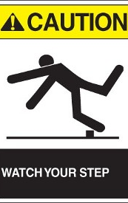
Caution
The caution should be given when a reasonably competent police investigator is in possession of information that should alert him or her to the "realistic prospect" that the person may be involved in the commission of a criminal offence: Butorac, 2010 BCSC 1173 @53; Worrall, 2002 OJ No 2711 @104
This Photo by Unknown Author is licensed under CC BY-SA

Slide 10
What if no caution given?
While the absence of a caution will not render a statement involuntary, its presence will not transform the statement into a voluntary one. It is just one factor to consider in the contextual analysis: Daley, 2015 ONSC 7164 @46; EB, 2011 ONCA 194 @88
The mere fact that a warning was given is not necessarily decisive in favour of admissibility but, on the other hand, the absence of a warning should not bind the hands of the Court so as to compel it to rule out a statement: Butorac, 2010 BCSC 1173 @58
Note: Daley- no Charter application caution just considered as factor

Slide 11
Proving the Statement
What kind of utterance is it and does it matter?
Notebook statement?
Audio? [rare, but think 911 by complainant where acc can be heard in the background or better takes the phone]
Video with audio
Consider body worn and in car cameras

Slide 12
Proving the Statement
Crown must satisfy the court that:
“some evidence” that the statement attributed to the accused was made by the accused
Burden is minimal
R v Montgomery, [2011] OJ No 4031 (SCJ) @9
R v Mohamed, [2012] OJ No 2441 (SCJ) @12

Slide 13
Proving the Statement
Burden to prove some evidence that the statement was made is satisfied where the officer gives direct evidence of the making of the statement.
Whether the officer is to be believed, and the weight given is matter for the trier of fact
R v Park, [1981] 2 SCR 64 (SCC)
Notes:
Proving the statement is easy when it’s audio and video. For notebook statements- write it out! Provide a copy of the notes to the judge. Hand it to the judge on the voir dire.

Slide 14
Proving the Statement
The state of the record is a factual consideration
The ultimate weight to be accorded to a statement that is not video or audio-recorded is a matter for the trier of fact, and does not go to its admissibility: Forslund, 2007 BCSC 357 @21-33
As a general rule, however, the state of the record does not impact on admissibility – it is relevant at this stage, however, where the court is unable to determine if the statement was voluntary because the record is so deficient: Khiari, 2012 ONSC5549 @80-85, 92; Morgan, 1997 CarswellOnt 5468 (SCJ) @73-75; Franklin, 2011 BCPC 16 @70-71

Slide 15
Proving the Statement
Informing this factual consideration are many factors including:
The intention of the police/nature of the interaction
The content of the conversation
Contemporaneity of the recording
Whether there is any evidence contradicting or confirming the officer
Mohammed, 2012 ONSC 1784 @6-20; Menezes, 2001 CarswellOnt 3374 @23-30; Butorac, 2010 BCSC 1173 @65-69; Sahota, 2009 CarswellOnt 4989 @25-29

Slide 16
Person in Authority
Someone who is formally engaged in the arrest, detention, examination or prosecution of the accused or who is acting at the behest of the state and could influence control over the proceedings against them: Hodgson, 1998 SCJ No 66 @32-34
This Photo by Unknown Author is licensed under CC BY-SA

Slide 17
Person in Authority
The mere fact that someone “may yield some personal authority over the accused is not sufficient to establish them as persons in authority”
Accused must have a reasonable belief as to the ability of the receiver to influence the prosecution or investigation of the crime: Harrison, 2007 OJ No 3523 (SCJ) @54-77

Slide 18
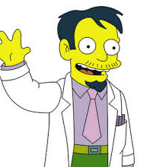
Medical Professional?
No
Unless asking questions not medically necessary
MRB,[1998] BCJ No 1197 (CA) @26-33

Slide 19
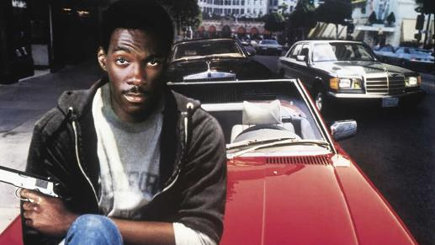
Undercover Police Officer
No
Grandinetti, 2005 SCC 5 @40-44
BUT BEWARE….

Slide 20
If you have one of these go talk to someone immediately
Presumptively inadmissible: Hart, 2014 SCC 52; Mack, 2014 SCC 58
presumption of inadmissibility will be overcome where the Crown can establish BOP that the probative value of the confession outweighs its prejudicial effect
This Photo by Unknown Author is licensed under CC BY

Slide 21
Employer?
Probably not…but maybe
No
Adeyokunn, 2011 ONSC 6380 (security officials at bank)
Otto, 2019 ONSC 3725 (statutorily compelled statement to College of Physicians and Surgeons)
Foster, 2017 ONCA 751 (security director)
Yes
Wilson, 2015 ONSC 5831 (employer at bank) statement voluntary

Slide 22
Victim’s Family Members???!?!
MAYBE
Harrison, [2007] OJ No 3523 (SCJ) (sitting as summary conviction appeal)
Although odd facts
No
Hodgson, 1998 SCJ No 66
Victim and family went to accused’s workplace to confront him- nothing to suggest that they were there on behalf of police or were even considering making a complaint

Slide 23
Probation Officer
No
Benham, 2013 BCCA 276
Brown, 2021 ONCA 836 @55 (gave phone number to probation officer prior to the shooting he was charged with took place)
Charles 2013 ONSC 6704 (phone number provided to probation officer)
Yes
Smyth [2006] OJ No 5528 (SCJ)@28 probation officer, to whom an accused charged with murder had previously disclosed graphic deviant fantasies and urges, was a person in authority.

Slide 24
Social Worker/CAS
Maybe
Sweryda, 1987 ABCA 75 Social worker may be person in authority if accused reasonably believed that worker is investigating child abuse allegations that could lead to prosecution
No
Mondor, 2005 BCSC 292 where support worker had no authority to apprehend child

Slide 25
Procedure on Person in Authority
Accused must raise the issue as it is only the accused who knows they regarded the person to whom the statement was made as person in authority
Evidential burden on accused demonstrating that “there is a valid issue for consideration”
If evidential burden met then over to Crown (on persuasive burden) to demonstrate BARD that receiver of statement was not person in authority
See Hodgson @48; SGT 2010 SCC 20

Slide 26
Voluntariness
The Test

Slide 27
Oickle
Promises, threats & inducements
Atmosphere of oppression
Operating mind
Improper police trickery

Slide 28
Promises, Threats & Inducements
Examples from Oickle
Obvious explicit threats of torture
The “hope of leniency”, if you speak to us, the charge will be reduced, you will receive a lesser sentence
An explicit offer by the police to obtain lenient treatment in exchange for a confession is a strong inducement, and will almost always warrant exclusion

Slide 29
Atmosphere of Oppression
Things that could create atmosphere of oppression:
depriving the suspect of food, clothing, water, sleep, or medical attention;
denying access to counsel;
excessively aggressive intimidating questioning for a prolonged period of time: Oickle @60

Slide 30
Atmosphere of Oppression
Scenario: Oppressive or Not?
Accused charged with sex assault and under influence of crack and alcohol at time of arrest
In cells @23:25
Accused’s clothes removed for forensic tests and left naked in cell for 90minutes.
Given light clothes, no underwear and shoes that didn’t fit
@3:00 woken up for interview
During interview he asked for warmer clothes and was refused

Slide 31
Oppression
Oppressive and overbore the will of the accused: Holliet (ONCA)

Slide 32
Police Trickery
Police can use trickery as long as the trickery does not overbear the accused’s will
Was it a dirty trick?
Would the trick shock the community?

Slide 33
Trickery
It must also be borne in mind that the investigation of crime and the detection of criminals is not a game to be governed by the Marquess of Queensbury rules. The authorities, in dealing with shrewd and often sophisticated criminals, must sometimes of necessity resort to tricks or other forms of deceit and should not through the rule be hampered in their work. What should be repressed vigorously is conduct on their part that shocks the community: Rothman

Slide 35
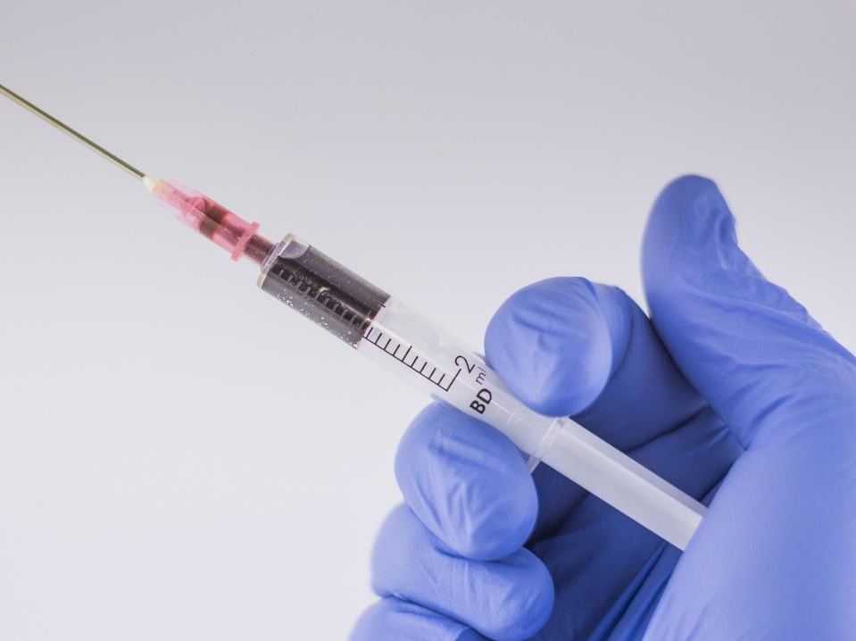
Trickery
Can the police pretend to be a priest?
Can the police pretend to be a lawyer?
Can the police inject a truth serum into a diabetic under the pretense that it was insulin?

Slide 36
This Photo by Unknown Author is licensed under CC BY-NC

Slide 37
Operating Mind
Limited degree of cognitive ability to understand what he or she is saying
And
To comprehend that the evidence may be used in proceedings against them: Whittle @45

Slide 38
Of course, one must remember that an interrogation is, by its very nature, susceptible to some friction between the police officer and the suspect. Not very many accused persons walk in to an interview room and exclaim, “You got me: I did it”. We do not expect police officers to behave as they would at the family dining table. Police officers are entitled to, and I think that most informed members of the public expect them to, employ legitimate tactics to ease the suspect in to talking.” O’Leary, 2015 ONSC 1346 @50, aff’d 2017 ONCA 71
This Photo by Unknown Author is licensed under CC BY-SA

Slide 39
When does the confessions rule not apply
Actus reus
I refuse to blow in that ASD
Threat to “person in authority”
Tendered in the context of a Charter application
Statement not made to a person in authority

Slide 40
Mechanics of the voir dire

Slide 41
Mechanics of the voir dire
Who do I call as a witness?
Why am I calling them?
Other evidence
Cell block video
Other surveillance video
Cell phones
Social media

Slide 42
Do I really need to call everyone?
Yes
Absent an admission that a particular officer’s contact with the acc did not in ANY WAY impact or affect the voluntariness of the acc’s statement, call the officer
Defence often says “I don’t need to hear from everyone”
Well the burden belongs to the Crown, so be wary if they say that but don’t give the admission; and
You may want or need those officers to speak to demeanour of accused and operating mind issues for example

Slide 43
What if I don’t call everyone?
Absence of evidence is not evidence that something occurred that impacted on the voluntariness of the acc’s statement
Especially absent the acc testifying

Slide 44
Someone not available?
Get other officers to comment on:
Whether they observe missing officer say/do anything to acc that was out of the ordinary
What they would have done if they observed that officer do something out of the ordinary
PREP your officers on this!

Slide 45
Using the Cell Block Video
Know what’s on the video
Know how to navigate it
Play the parts that matter
Show how mundane and routine the process is

Slide 46
Tactics

Slide 47
“Admitting” Voluntariness
Written admission
Identifying the statement
Admitting voluntariness
Waiving the voir dire
Notes:
Why waiving the voir dire too? See R v Park, [1981] SCJ No 63 basically b/c SCC dodged the questions whether voluntariness can be admitted pursuant to s.655 but agreed that statement voir dire can be waived at common law.

Slide 48
Identify what you want to do with the statement…
You don’t need to say this out loud – but you should know what you want to do with it (or have a plan) because things can change as the case goes on
Cross
Case in chief
Force a witness onto the stand
Notes:
Be wary of defence’s offer to admit voluntariness if only using for cross… a principled approach is that it’s either voluntary or not- the purpose for which the crown wishes to use the statement is not a factor in determining voluntariness.

Slide 49
What if the accused testifies?
Cross him!
Ask if the statement is true

Slide 50
Submissions: a good starting point
Stand up ask defence on the record what the issue really is? (so you can focus your submissions)

Slide 51
Submissions: sh*t defence say
Small room, door closed, acc couldn’t leave, took his shoes, in a jumpsuit, pounded with questions…
Answer: test is atmosphere of oppression- above is true for EVERY in custody interview
Acc said he didn’t want to talk, he said it 37 times
Answer: and yet acc kept engaging with officer

Slide 52
Additional Considerations
YCJA
It exists there are additional requirements

Slide 53
The End

