Slide 1
MCM 118
* RU-DAWG * * L-Tan Clan
June 3rd 2021

Slide 2
The Information

Slide 3
Why should I review the charge wording?
Part of charge screening is a review of the charges to ensure that the correct charges have been laid, and that they have been worded correctly
In almost every case the Information or Indictment will contain errors in the charge wording
Even when that is not true, the Information or Indictment can usually be improved
Explaining to a victim that the accused got off on a technicality because of the charge wording is unpleasant. Trust me!

Slide 4
How should I review the charge wording?
When you review the wording of a count, open your Criminal Code and read the offence section
Additional research will often be required if you do not have experience prosecuting the offence
Consider: Jurisdiction, date, names, particulars, the one-count-per-transaction rule, and conjunction vs. disjunction
Some offence provisions are legally complex. Examples: break and enter, robbery, criminal harassment
More generally, are the charges a fit with the conduct that is alleged?

Slide 5
Scenario 1
Ryan forced Marissa into his car at knifepoint after she exited the Cotillion Ball in Ottawa. He then drove her against her will, still at knifepoint, eventually driving to Gatineau, Quebec, where he threatened her with the knife once again. The police laid one charge:
Count 1
Ryan ATWOOD
On the 1st day of June in the year 2020 at the City of Ottawa in the East Region did assault Marissa COOPER with a weapon, to wit a steak knife, contrary to section 267, paragraph (a) of the Criminal Code of Canada.
Notes:
Special jurisdictions
476 For the purposes of this Act,
[. . . . .]
(b) where an offence is committed on the boundary of two or more territorial divisions or within five hundred metres of any such boundary, or the offence was commenced within one territorial division and completed within another, the offence shall be deemed to have been committed in any of the territorial divisions;

Slide 6
Scenario 2
The accused was intoxicated and aggressive at a bar. When bar staff asked him to leave he pulled a pistol from his waistband, pointed it at the bartended, and said “I’ll fucking smoke you, bitch!” The accused was arrested with the weapon. It looked exactly like a real gun, but testing showed that it was a non-functioning air pistol. Therefore the weapon is not a “firearm” within the meaning of the Criminal Code. The police laid one charge:
Count 1
Adam ACCUSED
On the 1st day of January in the year 2020 at the City of Ottawa in the East Region did use an imitation firearm to wit an air pistol, while committing the indictable offence of utter threats, contrary to section 85, subsection (2), paragraph (b) of the Criminal Code of Canada.
Notes:
The charge under s. 85 must clearly state the indictable offence, and the accused must have been convicted of that offence in a separate charge. A finding of fact that the accused committed the offence is not enough: R v Pringle, [1989] 1 SCR 1645 at paras 27-33

Slide 7
Scenario 3
The accused was pulled over and had an open liquor container in the centre console. The police search the accused and vehicle for liquor under the Liquor License Act. The accused was found to have an unloaded handgun in his backpack. The handgun was examined and found to be a functioning Beretta APX pistol. The police laid one charge:
Count 1
Adam ACCUSED
On the 1st day of January in the year 2020 at the City of Ottawa in the East Region did possess a restricted weapon, to wit a Beretta APX pistol, knowing that he was not the holder of a license under which he pay possess it, contrary to section 92, subsection (2) of the Criminal Code of Canada.
Notes:
A handgun is a “restricted firearm,” not a “restricted weapon”: Criminal Code, s. 84
If the accused is charged with unauthorized possession of a firearm under s 91, the onus is on the accused to prove that he was licensed: Criminal Code, s. 117.11.
However, the offence under s 92 contains an additional element: The accused person must know that he is not the holder of a license and (where applicable) registration certificate. The onus is on the Crown to prove that the accused knew he was not licensed.

Slide 8
Scenario 4
The accused was intoxicated and aggressive at a bar. When bar staff asked him to leave he struck the bartender in the face and arms with a broken beer bottle, causing multiple cuts that required stitches. The police laid one charge:
Count 1
Adam ACCUSED
On the 1st day of January in the year 2020 at the City of Ottawa in the East Region did wound, maim, disfigure, and endanger the life of Vicky VICTIM, contrary to section 268, subsection (2) of the Criminal Code of Canada.

Slide 9
When should I review the charge wording?
Do not waste any time on charges that will be diverted. There is no need to correct the wording of charges you will withdraw.
When a case is proceeding to prelim or trial, review the charge wording carefully when you set the date
If the accused elects trial in Superior Court without a prelim, review the charge wording and correct any errors before the accused consents to committal
Always review the charge wording in preparation for a prelim or trial

Slide 10
How should I correct the charge wording?
Review the charge wording when the trial is scheduled. Write to the I/O explaining the changes that you want to make. Once you have reached an agreement with the I/O, send detailed re-lay instructions to Ottawa Police Court Liaison Section.
Review the charge wording shortly before trial and identify any amendments that should be made. It’s probably too late to re-lay the Information at this stage, but you can correct errors in the charge wording. Write to defence counsel and tell them that you intend to amend the charges.

Slide 11
The OCJ
Pro Tips

Slide 12
Setting Yourself up for Not Falling Flat on Your Face
Trials are not set because the Crown has a flawless, overwhelming case, with, dreamy witnesses who all show up for prep and trial
Trials are supposed to be set when there are triable issues
Sometimes that triable issue is can the Crown actually get their witnesses to show up
Why is it important to remember this?
because every single case you prosecute has problems
And a HUGE part of our job is problem solving

Slide 13
Prep Your Witnesses (all of them)
If you are calling a witness to testify it is your job to prepare them (this goes for trials & Charter applications)
You have to prep the witnesses you have not the ones you want
Deal with weaknesses, frailties, vulnerabilities
Warn them about social media/communicating about the case
Basic ground rules for prep sessions:
The I/O (or a police officer) is present and taking notes
Exception: police witness prep on impaireds/80+/refusals
Talk to the I/O about your expectations around note taking in prep sessions
Do not be afraid of the evidence
Young victims/witnesses must meet with them more than once (some adults may need more than one session)

Slide 14
Prep Your Witnesses (all of them)
The length of time you prep each witness will vary but each prep session should generally include:
Explanation of roles (who you are)
What the witness is being called called to testify about
Providing/reviewing materials (including videos and photos)
Rules about accessing those materials in court
Refreshing memory
Asking questions about things that you aren’t clear about
Identifying likely areas of cross
Do not make assumptions about police witnesses- you need to prep them

Slide 15
Prepping Police Witnesses
Prepping police witnesses on impaired/80+/refusal is different than prepping other police witnesses
The I/O on your impaired/80+/refusal is usually the arresting officer and an essential witness
Prep these police witnesses by telling them what you will be asking them about, the focus of their testimony, the things you expect them to know (the wording of the demand)
If you need to ask for clarification, point out an inconsistency (between notes and IA) do it by email. Get a written response. Disclose the response.
Goal: do not make yourself a witness in this prosecution

Slide 16
Mine the File
Before you prep a witness you must know the file
You must read the whole file (not just the stuff for the witnesses that have been subpoenaed)
You may find details that prove an element, corroborate a witness, or resolve a discrepancy in unexpected places
If a helpful witness isn’t subpoenaed, get them subpoenaed
Just because someone isn’t subpoenaed doesn’t mean you can’t get them to court (even as the trial is proceeding)

Slide 17
Common Procedural Orders
Pub bans
517 (bail: ban on evidence taken, the information given, and the representations made at a bail hearing until a later time. includes the reasons of the Justice, but not the actual decision or the name of the accused.
486.4 (victim or witness under the age of 18)
486.5 (discretionary requires notice to the media)
278.95 (sexual assault 278.93/94 applications)
539 & 542(2) (preliminary inquiry)
Exclusion of witness orders

Slide 18
Admissions
Section 655 of the Code
It is for the Crown, not for the defence, to state the fact or facts which it alleges against the accused and of which it seeks admission. The accused, of course, is under no obligation to admit the fact so alleged but his choice is to admit it or to decline to do so. He cannot frame the wording of the allegation to suit his own purposes and then insist on admitting it: R v Castellani, 1969 SCJ No 85 (SCC)
Reduced to writing
Be clear what you are seeking

Slide 19
Plea Court
A Potential Danger Zone

Slide 20
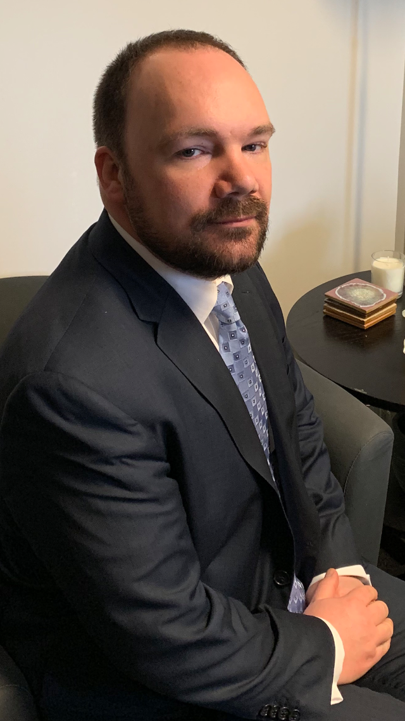
Some Key Terms
VIS = Victim Impact Statement
PSR= Pre-Sentence Report
Section 21 = Assessment, Sexual Behaviours Assessment
Section 34 = Youth Criminal Justice Act, Family Court Clinic Assessment
MGM = Matthew Geigen-Miller

Slide 21
Pro Tips
Scope Notes are for Crown’s eyes only
Watch what you say out loud (we never know who is listening and who is around)
Know who you are talking to
Do NOT rush
Your job is not to renegotiate the position on the file

Slide 22
Pro Tips
Ensure you have provided the clerk with the correct counts
The facts should be read in chronological order
You are not restricted to the facts in the police synopsis
On the other hand, you don’t have to read every word in the synopsis either
Ensure you have all the necessary exhibits that you need to file on the plea

Slide 23
The factual basis for the plea
There has to be one
Resist the tendency for counsel to stand up and say “the facts here are not really in dispute”
Read the facts into the record
It is a public proceeding
This Photo by Unknown Author is licensed under CC BY-SA

Slide 24
Scenario
The clerk and judge are pushing you to speed through the list.
There is a deficient note on six files where the accused is pleading to multiple counts of robbery with a firearm.
The note says “plea to counts TBD for pen time – lots of”
This Photo by Unknown Author is licensed under CC BY-NC-ND

Slide 25
Avoiding the Danger Zone
Leave very clear notes in the file – ensure this note is captured under the position section on scope
Ensure the note considers the information number, scope file number, count number (not simply “theft from Dollarama”), which facts are agreed to
Ensure the position includes: a clear position on sentence, less or in addition to pre-sentence custody, probation terms sought with names and addresses included, and ancillary orders including section numbers and length of respective orders (DNA, SOIRA orders, Section 109 and 110)
Note the precise amount of restitution and WHO it is to be paid to
Note whether the victim wants to provide a victim impact statement and whether he/she will be attending court to read it

Slide 26
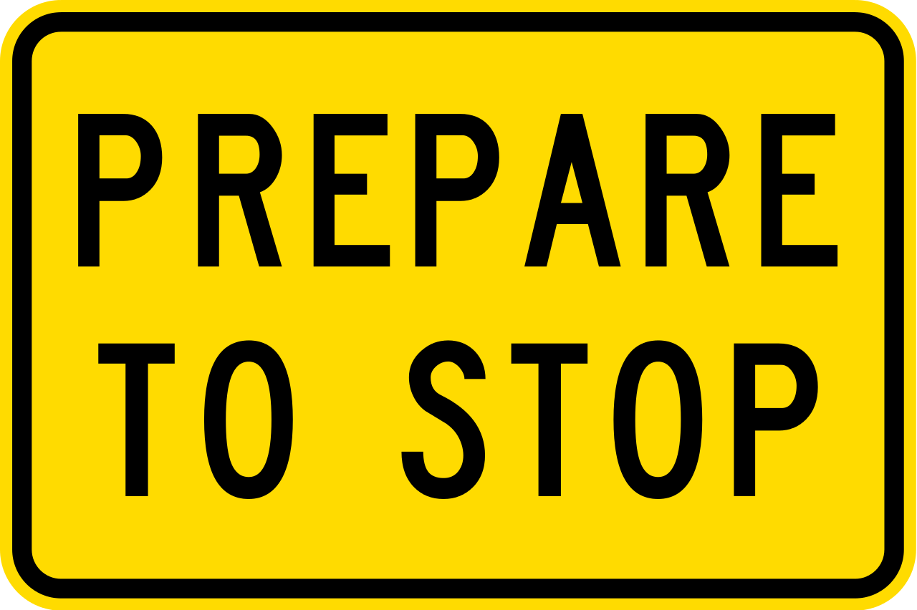
This is Important
Do not proceed to complete the matter if there is any uncertainty about whether the victim wants to provide a victim impact statement
If you are setting a matter from the plea court, send a request at that time to the CMC or VWAP for a victim impact statement
This Photo by Unknown Author is licensed under CC BY-SA

Slide 27
Victim Impact Statements
722.(1) – the court shall consider any statement of a victim and (2) shall inquire of the prosecutor if reasonable steps have been taken to provide the victim with an opportunity to prepare one…

Slide 28
Victim Impact Statements
722.(3) On application of the prosecutor or a victim on its own motion, the court may adjourn the proceedings to permit the victim to prepare a statement referred to in subsection (1) or to present evidence in accordance with subsection (9), if the court is satisfied that the adjournment would not interfere with the proper administration of justice
Notes:
There is no discretion to refuse a victim the right to read a statement provided it confirms with subsection (2): R. v. Cook (2009), 250 C.C.C. (3d) 248 (Que C.A.); leave to appeal SCC refused 253 C.C.C. (3d).

Slide 29
Credibility

Slide 30
Credibility
The vast majority of our trials turn on credibility assessments
The law with respect to credibility assessments has changed significantly in the past few years. Many of these changes arise out of sexual assault prosecutions. However, they are applicable to all cases.
We must guard against reliance on ungrounded common sense assumptions and stereotypical inferences when we make our case on credibility.
In the past, this meant fighting against defence counsel’s reliance on myths and stereotypes in sexual assault prosecutions.
But the law cuts both ways. Our attempts to bolster the credibility of the victim and attack the credibility of the accused must also avoid reliance on ungrounded “common sense” assumptions and stereotypical inferences

Slide 31
The rules against ungrounded common sense assumptions and stereotypical inferences
TL; DR: These rules are fully explained by the Court of Appeal in R v JC, 2021 ONCA 131
Reliance upon stereotypical views about how victims of sexual assault would behave is an error of law. See: R v ABA, 2019 ONCA 124; R v ARD, 2017 ABCA 237, aff’d 2018 SCC 6; R v DD, 2000 SCC 43
Example: it is a myth or stereotype that a complainant would avoid their assailant or change their behaviour towards their assailant after being sexually assaulted. See: R v ARD, 2017 ABCA 237 at paras 57-58, aff’d 2018 SCC 6

Slide 32
It cuts both ways
Recent Court of Appeal decisions make clear that this rule cuts both ways.
R v JL, 2018 ONCA 756: The trial judge erred by inferring that a complainant would not have consented to sex outside on the dirt, gravel and wet grass where the sexual act occurred, in mid-December.
R v Cepic, 2019 ONCA 541: The accused testified that the complainant touched his penis during a lap dance and later told him that she had a boyfriend when the accused was about to climax. The trial judge erred by rejecting this evidence as “implausible.”
In both cases the trial judge erred by relying on assumptions or generalizations about human behaviour that were not supported by the evidence at trial

Slide 33
The rule against ungrounded common sense assumptions
Judges must avoid speculative reasoning that invokes "common-sense" assumptions that are not grounded in the evidence or appropriately supported by judicial notice
However, there is no bar on relying upon common-sense or human experience to identify inferences that arise from the evidence. Were that the case, circumstantial evidence would not be admissible since, by definition, the relevance of circumstantial evidence depends upon using human experience as a bridge between the evidence and the inference drawn.
This rule does not bar using human experience about human behaviour to interpret evidence. It prohibits judges from using "common-sense" or human experience to introduce new considerations, not arising from evidence, into the decision-making process, including considerations about human behaviour.
R v JC, 2021 ONCA 131 at paras 58-62
Notes:
58 The first such rule is that judges must avoid speculative reasoning that invokes "common-sense" assumptions that are not grounded in the evidence or appropriately supported by judicial notice: R. v. Roth, 2020 BCCA 240, at para. 65; R. v. Cepic, 2019 ONCA 541, 376 C.C.C. (3d) 286, at paras. 19-27; R. v. Perkins, 2007 ONCA 585, 223 C.C.C. (3d) 289, at paras. 35-36. For clarity, I will call this "the rule against ungrounded common-sense assumptions".
59 To be clear, there is no bar on relying upon common-sense or human experience to identify inferences that arise from the evidence. Were that the case, circumstantial evidence would not be admissible since, by definition, the relevance of circumstantial evidence depends upon using human experience as a bridge between the evidence and the inference drawn.
60 Nor is there any absolute bar on using human experience of human behaviour to draw inferences from the evidence. If there was, after-the-fact conduct evidence about things such as flight or the destruction of evidence would not be allowed. Such evidence is relevant because human experience tells us that these behaviours, flight and destroying evidence after a criminal act, are generally undertaken to hide guilt. An absolute bar on using human experience of human behaviour to draw inferences would also mean that evidence that an accused drove a protesting sexual assault complainant to a secluded location could not be used as proof of his intention or her lack of consent. The inferences to be drawn from that evidence depend on common-sense conclusions about what a person acting in a particular manner is likely to be thinking.
61 Properly understood, the rule against ungrounded common-sense assumptions does not bar using human experience about human behaviour to interpret evidence. It prohibits judges from using "common-sense" or human experience to introduce new considerations, not arising from evidence, into the decision-making process, including considerations about human behaviour.
62 It was therefore an error in R. v. J.L., 2018 ONCA 756, 143 O.R. (3d) 170, at paras. 46-47, for the trial judge to infer that a complainant would not have consented to sex outside on the dirt, gravel and wet grass where the sexual act occurred, in mid-December. This conclusion was not a permissible logical inference drawn from the evidence. It was, instead, an additional factor for consideration introduced impermissibly into the deliberation process based on an untethered generalization about human behaviour. Had there been evidence from the complainant that she was careful or concerned about her appearance, her clothing, or her physical comfort, the impugned inference would have been grounded in evidence and would have been permissible.

Slide 34
The rule against stereotypical inferences
Factual findings, including determinations of credibility, cannot be based on stereotypical inferences about human behaviour. It is an error of law to rely on stereotypes or erroneous common-sense assumptions about how a sexual offence complainant is expected to act, to either bolster or compromise their credibility.
This rule does not bar all inferences relating to behaviour that are based on human experience. It only prohibits inferences that are based on stereotype or "prejudicial generalizations“.
This rule prohibits certain inferences from being drawn. It does not prohibit the admission or use of certain kinds of evidence.
R v JC, 2021 ONCA 131 at paras 63-70
Notes:
63 The second relevant, overlapping rule is that factual findings, including determinations of credibility, cannot be based on stereotypical inferences about human behaviour. I will call this "the rule against stereotypical inferences". Pursuant to this rule, it is an error of law to rely on stereotypes or erroneous common-sense assumptions about how a sexual offence complainant is expected to act, to either bolster or compromise their credibility: Roth, at para. 129; R v. A.B.A., 2019 ONCA 124, 145 O.R. (3d) 634, at para. 5; Cepic, at para. 14. It is equally wrong to draw inferences from stereotypes about the way accused persons are expected to act: R. v. Quartey, 2018 ABCA 12, 430 D.L.R. (4th) 381, at para. 21, aff'd 2018 SCC 59, [2018] 3 S.C.R. 687; and see Cepic, at para. 24.
64 Two points are critical in understanding this rule and ensuring that it does not impede proper judicial reasoning.
65 First, like the rule against ungrounded common-sense assumptions, the rule against stereotypical inferences does not bar all inferences relating to behaviour that are based on human experience. It only prohibits inferences that are based on stereotype or "prejudicial generalizations": R. v. A.R.D., 2017 ABCA 237, 422 D.L.R. (4th) 471, at paras. 6-7, aff'd 2018 SCC 6, [2018] 1 S.C.R. 218.
66 For example, it is a myth or stereotype that a complainant would avoid their assailant or change their behaviour towards their assailant after being sexually assaulted, and it is an error to employ such reasoning: A.R.D., at paras. 57-58; A.B.A., at paras. 6, 8-10; R. v. Caesar, 2015 NWTCA 4, 588 A.R. 392, at para. 6. Similarly, it is a stereotype that women would not behave in a sexually aggressive manner, or that men would be interested in sex. Reasoning that is based on such inferences is not permitted: Cepic, at paras. 14-16; Quartey, at para. 21.
67 By contrast, no stereotype or prejudicial generalization is offended by inferring, where a man drives a resisting woman to a secluded location before touching her sexually, that she did not consent and that he intended to touch her without her consent. Hence, such inferences are appropriate.
68 The second critical point in understanding the rule against stereotypical inferences is that this rule prohibits certain inferences from being drawn; it does not prohibit the admission or use of certain kinds of evidence. Professor Lisa Dufraimont makes this point admirably in "Myth, Inference and Evidence in Sexual Assault Trials" (2019) 44:2 Queen's L. J. 316, at pp. 345-46, 350; and it is reinforced in A.R.D., at paras. 6-8, 62; and Roth, at para. 73.
69 For this reason, it is not an error to admit and rely upon evidence that could support an impermissible stereotype, if that evidence otherwise has relevance and is not being used to invoke an impermissible stereotype: Roth, at paras. 130-38. For example, in R. v. Kiss, 2018 ONCA 184, at paras. 101-2, evidence that the complainant did not scream for help was admitted, not to support the impermissible stereotypical inference that her failure to do so undermined the credibility of her claim that she was not consenting, but for the permissible purpose of contradicting her testimony that she had screamed to attract attention.
70 By the same token, it is not an error to arrive at a factual conclusion that may logically reflect a stereotype where that factual conclusion is not drawn from a stereotypical inference but is, instead, based on the evidence. For example, although it is a stereotype that men are interested in sex, it was not an error to infer that the accused male was interested in sex at the time of the alleged assault where that inference was based on evidence: Quartey, at para. 21. Similarly, in R. v. F.B.P., 2019 ONCA 157, the trial judge was found not to have erred in finding it implausible that the complainant would consent to spontaneous sex on a balcony, potentially in full view of others, because that inference did not rest in stereotypes about the sexual behaviour of women. The inference was based on evidence about the ongoing sexual disinterest the complainant had shown in the accused, and the ready availability of a private bedroom.

Slide 35
Implausible, illogical, nonsensical
Beware a submission that the complainant’s evidence or accused’s evidence is implausible, illogical, or nonsensical
Ground your inferences in the evidence.
Consider the words of the Court of Appeal in R v JC, 2021 ONCA 131 at para 62:
It was … an error … for the trial judge to infer that a complainant would not have consented to sex outside on the dirt, gravel and wet grass where the sexual act occurred, in mid-December. … Had there been evidence from the complainant that she was careful or concerned about her appearance, her clothing, or her physical comfort, the impugned inference would have been grounded in evidence and would have been permissible.

Slide 36
Role of the Crown
We speak with one voice
Don’t shop (if you have spoken to a crown about an issue let the next person you speak with know that)
Don’t undercut your colleagues’ positions (bail, sentencing)
Be respectful of court staff
Be careful who is around when you are talking about your case
If you use “my friend” explain it to victims and their families

